Slide 1


Information Session on the Service Feedback Program’s Problem Resolution Service
November 16, 2023

Slide 2








Contacting the CRA - General
Common reasons taxpayers contact the Agency
Common contact methods
Alternative channel for unusual cases
Change of address
Obtain copies of official documents
For very specific requests, there is also another channel taxpayers can use through their Member of Parliament
Taxpayers can use the self-serve CRA portal or the General Enquiries telephone lines
Discuss questions about Notices of Assessment or
Reassessment
Raise issues relating to benefits and/or credits

Slide 3


What is Problem Resolution (PR)?
We are there to help Members of Parliament – and their constituency offices – resolve complex and sensitive issues that their constituents are experiencing with the Agency .
Using the PR service is justified when normal administrative and operational channels, and procedures have not been successful. Generally, taxpayers can resolve the issues they have with the Agency by using the online portals (My Account, My Business Account or Represent a Client) or by contacting contact centre representatives.
However, from time to time, exceptional cases arise that need more specialized and rapid intervention. Such cases can sometimes be referred to us.
Notes:
Title and Content
Option to add icon or small image on the right.

Slide 4
Service Feedback Program - Regional Offices
We operate across the country and have offices located in the following locations:
Atlantic:
Ontario:
Halifax
Sudbury
Kitchener/
Waterloo
Quebec:
Western:
Winnipeg
Québec
City
Surrey
The Territories that are served by the following offices:
Nunavut:
NW Territories:
Yukon:
Sudbury
Winnipeg
Surrey
Notes:
Title and Content

Slide 5



PR - Overview
Only cases that require specific intervention can go through Problem Resolution and one of the following criteria must be met:
Financial
hardship
  Recurring problem or part of a trend
Humanitarian reasons
  !
CRA error
Notes:
Title and Content

Slide 6





PR - Self-serve Options
Taxpayers must have tried to use the following self-serve options before going to see their MP office:
My Account: a secure online portal that allows taxpayers to complete simple actions (for example, to confirm the state of an income tax refund, to verify the amount of tax credits and benefits, to confirm the maximum RRSP contribution limit and to register to direct deposit).
The General Enquiries Lines
For the telephone numbers that must be used to contact the Agency and find out the wait times, you can click on the following link: Contact the CRA.
My Business Account: a secure online portal that provides an opportunity to interact electronically with the CRA on various business accounts.
Represent a Client: a secure online portal that provides an authorized individual with secure and controlled online access to both individual and business tax information.
Automated callback service
The Agency now offers an automated callback service. Please visit the following link for additional information: Automated Callback Service - Canada.ca.
Notes:
Title and Content

Slide 7

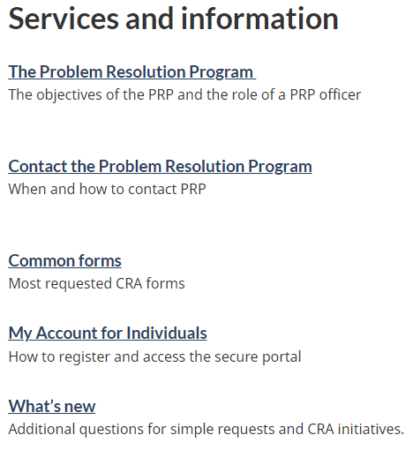
PR - Web page for MP offices
We have a web page strictly for the use of MP Offices.
Support for Members of Parliament and their constituency offices
It contains important information, namely:
general information about what we do;
quick links to most commonly used forms; and
information about tax filing season, benefits and credits
This MP web page is presently being updated.
Notes:
Title and Content

Slide 8

Quick-Action Enquiries
Limitations
We receive many different quick-action enquiries.
The following subjects are the most common:
While officers can provide an overview of an account, they are unable to:
Change or influence a decision regarding taxpayer relief or objections , audit results, benefits application including Disability Tax Credit.
Getting a printout of tax slips, notices of assessment and reassessment*
Updating marital-status changes*
Interfere in collection action.
Write letters to or for taxpayers.
Issuing forms*
Cancel benefits review, audit, etc.
Facilitating address changes*
Get involved in identity theft cases except to forward documents on behalf of a taxpayer.
Addressing issues surrounding the Canada Child Benefit
Expedite audits and objections and taxpayer relief applications.
Updating direct deposit information*
Addressing the Goods and Services Tax/Harmonized Sales Tax Credit issues
Request refund of corporate installment payments.
Addressing delays in processing of income tax and benefit returns
Request refund of payment when there is a compliance hold on file.
* While we will process these simple requests, in many cases it is quicker and more efficient to use the My Account portal
Notes:
Title and Content

Slide 9












PR - How to send a request?
FAX
Sudbury
Kitchener/Waterloo
Winnipeg
M1236466ABG@cra-arc.gc.ca
M1217430AAG.Ontario61A@cra-arc.gc.ca
WpgTSOPRPG@cra-arc.gc.ca
Email
Email
Email
1-833-940-4066
1-833-940-4054
1-833-940-4054
FAX
FAX
FAX
Halifax
Québec City
Surrey
NP151EX84G@cra-arc.gc.ca
QUE-QUEPSPMinisteriel@cra-arc.gc.ca
PRP.PAC-SUR-BFTSO@cra-arc.gc.ca
Email
Email
Email
1-833-940-4053
1-888-648-7212
1-833-940-4052
FAX
FAX
FAX

Slide 10



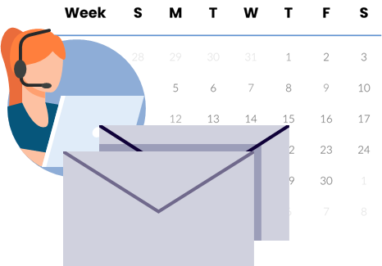
PR -Before sending an inquiry, an MP office must:
XXX – XXX - 000
Validate the identity of the taxpayer through a photo identification card
(e.g., valid driver’s license or a valid health card).
Obtain a completed and signed form RC 161, Authorization for Parliamentarians, that contains all relevant taxpayer information (name, coordinates and a summary of the issue).
When sent by email, this form must only include the last three digits of the social insurance number (SIN) and must not include the taxpayer’s address (except for the last three characters of the postal code).
When the enquiry is sent by fax, no redaction of the information is necessary.
For enquiries received by email, we will endeavour to contact the MP office within 5 business days of receipt to obtain the missing information.
NOTE: After a form RC 161 is sent to the program and a case is opened, the taxpayer can only enquire about their file with their MP’s office.

Slide 11
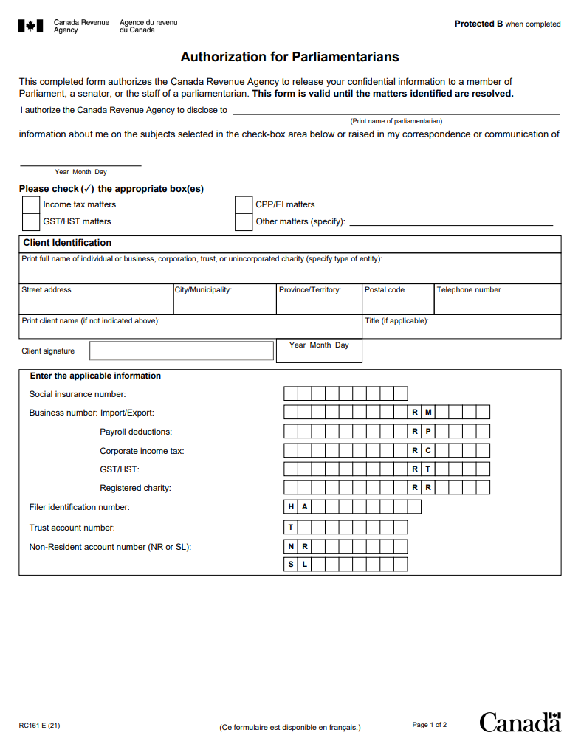
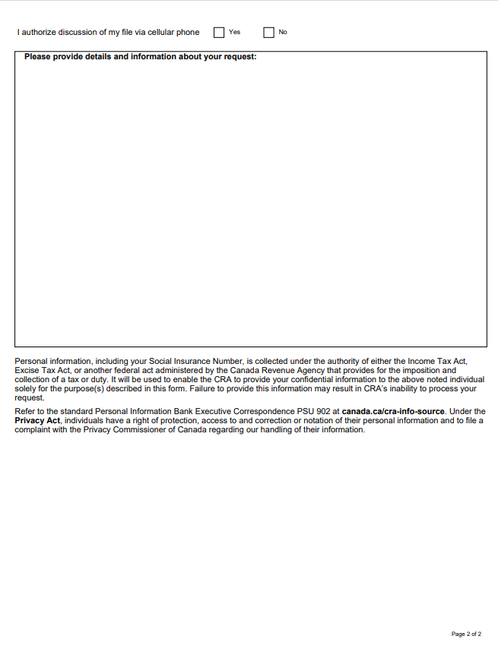


PR - Obtaining Constituent’s Consent
Constituent’s consent
Cell phone use is widespread, thus MP offices must obtain their constituent’s consent to discuss their files by cell phone (this consent can be indicated by checking the box on page 2 of the
RC 161). Both pages must be completed.
If a constituent does not agree to cell phone communication, the MP office must advise PR who will attempt to communicate with the MP office by land line.
New email communication protocol
We are working on implementing a new encrypted email communication protocol to ensure the security of taxpayer information. We will communicate all relevant details as soon as possible.

Slide 12

PR - Acknowledgement and resolution
5
15
Note: Our goal is to have a resolution within fifteen business days.
If we cannot, we will make contact within that time to indicate an anticipated date of resolution.
We strive to respond to initial requests within five business days from the day of receipt.
During times where volumes of requests are very high, acknowledgements may be sent after the five business days.
We are presently able to acknowledge all new requests in a timely manner.
When an officer makes contact with an MP office, they will:
ask for additional information about the matter, if needed (including the SIN and the address if necessary)
answer your questions
guide you through the process

Slide 13


PR - Closing notes
You now know in which circumstances you can call on Problem Resolution, in order to obtain a more specialized and faster intervention from the Agency.
We’ve provided an overview of our criteria, the steps you need to take before submitting a request, and what you can expect from us.
Working together to achieve the service performance results our clients expect is central to our People-First approach and we look forward to continuing our collaborative efforts.
Now that you have the contact information for your regional offices, all you have to do is send your request so that we can help you resolve the issues raised by your constituents.
We thank you for your participation and attention.

Slide 14
Questions?
Thank You!

Slide 15
Appendix A
Self-serve options for routine requests
Subject Phone number Canada.ca link
Proof of income (option C) 1-800-267-6999 Get a proof of income statement - Canada.ca
Notice of assessment 1-800-959-7383 Notice of Assessment - Get a copy - Canada.ca
Copy of tax slips 1-800-959-7383 Tax slips : Get a copy of your slips - Canada.ca
Account statement– T1 1-800-959-7383 My Account for Individuals - Canada.ca
Account statement-- CCB 1-800-387-1194 My Account for Individuals - Canada.ca
Status of your T1 return/refund 1-800-959-1956 Tax refunds: Check the status of your refund - Canada.ca
Direct deposit update 1-800-959-7383 Direct deposit - Canada Revenue Agency - Canada.ca
Change of address 1-800-959-7383 Update your CRA information: change your address - Canada.ca
Make a payment 1-800-959-7383 Make a payment for individuals - Payments to the CRA - Canada.ca
Confirm your payment 1-800-959-7383 Confirm your payment is received - Payments to the CRA - Canada.ca
Disability Tax Credit application 1-800-959-7383 Disability Tax Credit (DTC) - Canada.ca
My Account 1-800-959-7383 My Account for Individuals - Canada.ca
Child and family benefits 1-800-387-1194 Child and family benefits - Canada.ca
Request for information for businesses 1-800-959-7775 Business taxes - Canada.ca
Charities 1-888-892-5667 Contact the Charities Directorate - Canada.ca
Personal income tax debts 1-888-863-8661 Personal debts - Canada.ca
Corporate income tax debts 1-866-291-6347 Corporate debts - Canada.ca
GST/HST debts 1-877-477-5069 Corporate debts - Canada.ca
Source deductions debts 1-877-448-6017 Corporate debts - Canada.ca
CCB debts 1-888-863-8664 Contact the CRA – Canada Child Benefit (CCB) - Canada.ca
* To access the link, please right-click on the appropriate link and select “open link” or press Ctrl and click on the link

Slide 16
Appendix A (cont’d)
Other self-serve options
Self-serve options for most popular forms
RC325 Address change request - Canada.ca
Canada direct deposit enrolment form - Direct deposit - Receiver General of Canada - PSPC - Canada.ca (tpsgc-pwgsc.gc.ca)
RC66 Canada Child Benefits Application includes federal, provincial, and territorial programs - Canada.ca
RC65 Marital status change - Canada.ca
T1213OAS Request to Reduce Old Age Security Recovery Tax at Source - Canada.ca
T1213 Request to Reduce Tax Deductions at Source - Canada.ca
RC4288 Request for Taxpayer Relief - Cancel or Waive Penalties and Interest - Canada.ca
RC552 Appointing a Representative for a Deceased Person - Canada.ca
T400A Notice of Objection - Income Tax Act - Canada.ca
T2201 Disability Tax Credit Certificate - Canada.ca
T1-ADJ T1 Adjustment Request - Canada.ca
RC193 Service Feedback - Canada.ca
Other Useful Links
Check CRA processing times - Canada.ca
Types of review - Canada.ca
Review of your tax return - Canada.ca
Responding to us - Canada.ca
COVID-19 benefits and your taxes
Repay COVID-19 benefits: Payments to the CRA - Canada.ca
Slam the scam – Protect yourself against fraud - Canada.ca
* To access the link, please right-click on the appropriate link and select “open link” or press Ctrl and click on the link

