Slide 1
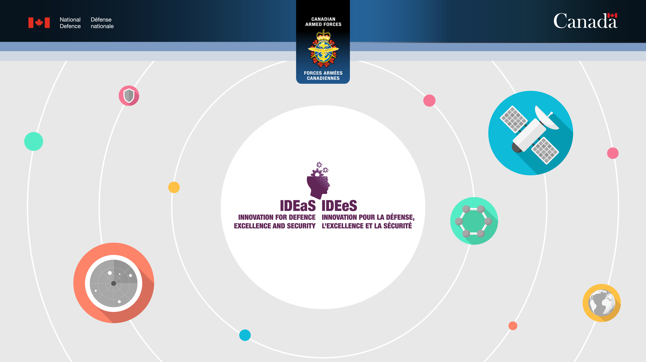
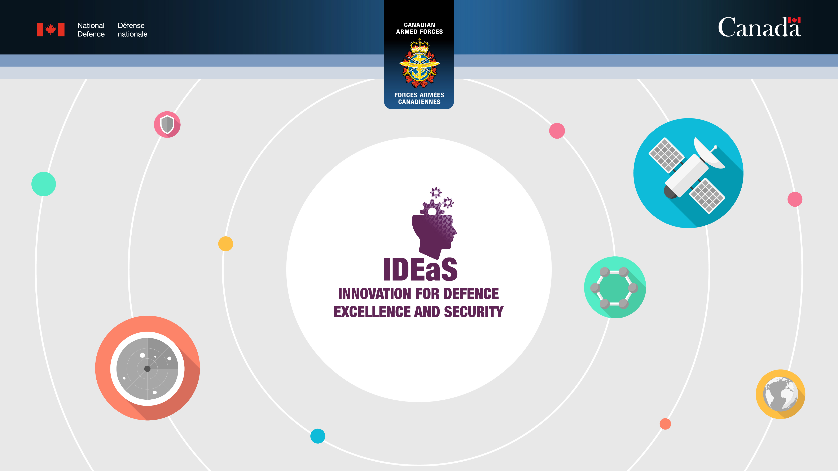
Notes:
Introduction…. (include a bit about yourself, the speaker)
Innovation for Defence Excellence and Security (IDEaS) is the Department of National Defence (DND) and the Canadian Armed Forces (CAF) access to innovation program. It transforms defence and security challenges being faced by the various partners in DND/CAF like the Air Force, the Navy, Army, special forces and others into innovative solutions to improve Canada’s defence capabilities.

Slide 2

Your Ideas. Our Support. Unlimited Possibilities.
IDEaS connects Canada’s toughest defence and security challenges with creative thinkers, providing them with the resources and guidance they need to bring new solutions to light.
Notes:
Announced in the Fall of 2017 in Strong, Secure, Engaged, Canada’s defence policy, the program officially launched on April 9th 2018. IDEaS has been given $1.6B over 20 years to deliver on its mandate and advance defence capabilities.
This equates to an approximate budget of $85 million per year. Our goal is to continuously tap innovators for their solutions with various calls for proposals every year.
IDEaS is for all Canadian innovators, from defence primes to academia, Small and Medium sized enterprises to not-for-profits, municipal/provincial/territorial entities to individuals.
All types of Canadian Innovators have responded. On average applicants are 60% SMEs, 20% academia, 15% large industry, 3-4% not-for-profit, and the remaining from individuals.
We are also very pleased with the good distribution of our proposals from across the country.
The whole program is full web based and I invite you to check the IDEaS webpage to find all the information about the program.

Slide 3

IDEaS is preparing for the next generation of threats and risks… to leap ahead of what’s next
Some of our areas of interest:
Autonomous vehicles
Space defence
Sustainable operations
Enhanced camouflage
And many, many more…
Data analytics
Cyber defence
Network security
Drone technology
Notes:
The IDEaS program was born from the need to be agile in responding to crisis and the impact of globalization of sciences & technology.
While DND/CAF has its own research and development organization, Defence Research and Development Canada (DRDC), more and more S&T work is being done outside government laboratories, by innovators who may not even know that our defence and security challenges exist.
To ensure that the Department has the best solutions, we need access to this innovation to support our efforts. In that extent, IDEaS provides an augmentative approach that enables us to tap into the extraordinary talent and ingenuity resident in Canada.

Slide 4
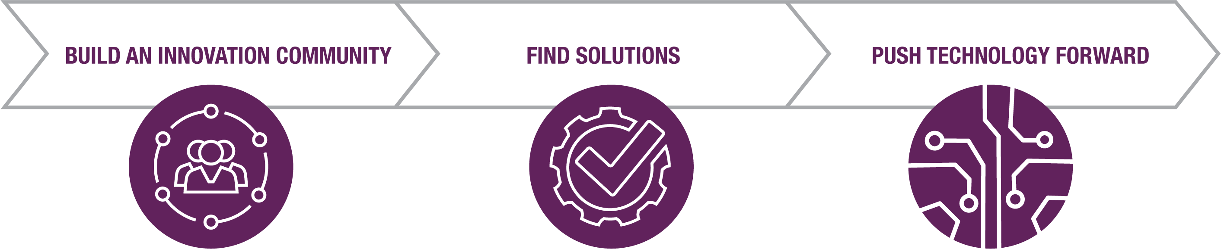
3 Pillars of IDEaS
Vibrant Innovation Community
Bring industry, researchers and academics together.
Open Competition of Ideas
Find multiple solutions to challenges faced by DND/CAF.
Validated Innovative Solutions
Advance the most promising technologies along the innovation continuum.
Notes:
In order for us to be successful, the Program is based on 3 pillars:
We help build a vibrant and engaged innovation community to apply their expertise to Canadian defence and military problems.
We support the development of Solutions to Canadian defence and military challenges. We have numerous funding tools to do this.
We push technology forward to a demonstrable level that can increase defence capabilities. Innovators have the opportunity to showcase their solutions through their own work (Sandbox) or through testing conducted by our military (Test Drive)
Over the next few slides I will take you through these pillars in more detail to show you how we are able fund innovative solutions to increase defence capabilities.

Slide 5

Building our Innovation Community
12
63
1st Test Drive contract of
$7.5M
More than
506
Innovators funded
DEFENCE
CHALLENGES
ISSUED
Collaborative research networks developed
AWARDED
$179.6M
MORE THAN
5500
INNOVATORS IN
OUR ECOSYSTEM
committed and spent
New upcoming challenges
Notes:
*note: this slide will be continuously updated as our results grow. Refer to monthly IDEaS Dashboard to update.
In order to build our innovation community, we need to ensure as many Canadian innovators as possible know about IDEaS, so we increase the number of potential solutions coming to us. We continuously conduct outreach activities – we have built a following of more than 5500 innovators, and it is still growing.
To date (October 14th, 2021):
63 challenges issued (4 for COVID)
More than 506 funded projects
12 collaborative research networks developed
$7.5M Test Drive funded
$179.6 committed & spent
New upcoming challenges (CP and IN)
IDEaS also has a partnership with the Office of Small and Medium Sized Enterprises to help broaden out reach and promote challenges with potential innovators across Canada.

Slide 6
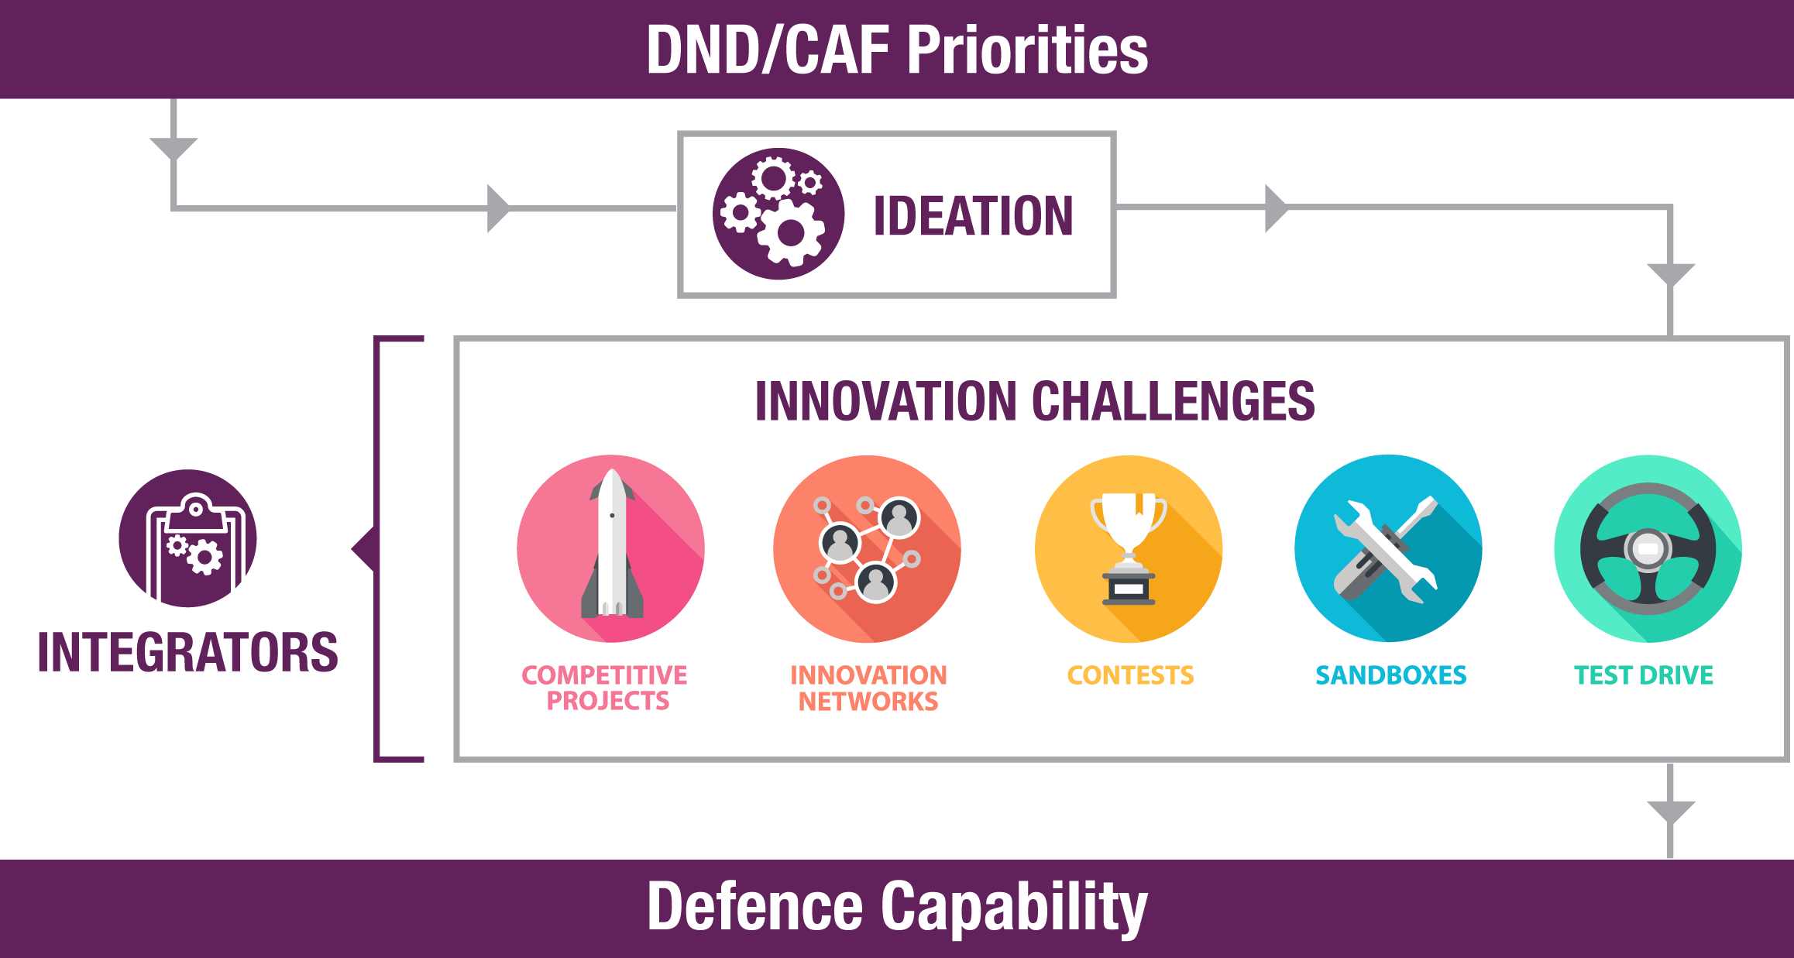
How IDEaS Delivers
IDEaS is intended to help foster solutions at any stage of development that have potential defence and security focus and align with DND/CAF priorities. ​
From early research and development to prototyping and testing your concepts, we help advance your technology.
Notes:
DND/CAF priorities: IDEaS challenges come directly from our DND/CAF stakeholders (RCAF, Navy, Army, Cyber and many more) , and they are important for them. These projects are part of their future capabilities.
Ideation: We take DND/CAF priorities and go through a multidisciplinary collective brainstorming process called “Ideation” to refine innovation challenges.
Innovation Challenges: Once refined, IDEaS will determine how to release the challenge to our innovator community using our funding or supporting elements.
Integrators: We also provide each funded project with a DND/DRDC Integrator who leverages their scientific, defence, and security knowledge and expertise to provide key insights and identify linkages to DND, with the goal of advancing IDEaS projects toward “adoption ready” solutions.
Defence Capability: Ultimately, IDEaS success is based on the changes in defence capabilities we will generate for the CAF. Not on the number of contracts we award, or the amount of money we invest.

Slide 7
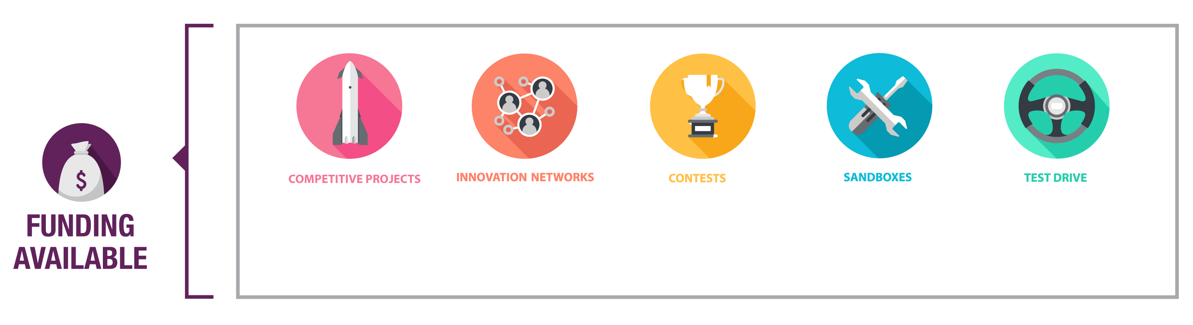
Benefits to you: Funding and Support
IDEaS has around $80 million in funding annually to develop, test or build your concepts
Post-IDEaS support: Partnerships with other government funding organizations enables referrals of IDEaS projects
Phased procurement advances your technology through
the innovation pipeline.
Collaborate with academic and private sector partners to build a network of expertise.
Compete against your peers for prizes while building your network.
Get your product in
front of national defence experts and demonstrate its capabilities.
Take your product through the final stage of the innovation journey towards commercialization
Notes:
Participating in the IDEaS program gives many benefits to the Innovators involved, from access to world-class subject matter experts to generous funding opportunities.
Each element is unique in how it is designed to advance S&T and deliver support to innovators.
Innovation Networks provides $1.5M to encourage collaboration and build a network of expertise that advances R&D in support of Canada’s current and future defence and security innovation challenges.
Competitive Projects provides Up to $1.2M in phased development funding to build and progress technology forward. Promising solutions can be selected to advance to demonstration/testing stages of IDEaS
Contests are about pitting the best solutions against each other to solve complex issues for cash prizes. Funding is contest-specific. As an example, our most recent contest had a total prize pool of $3.5 million for the winner. However, each of the four rounds had cash prizes to help selected innovators in developing their concepts resulting in an integrated solution.
Sandboxes are an opportunity for innovators to test and demonstrate their solutions in the presence of military experts and users. The Sandboxes element doesn’t provide funding directly, but will partially reimburse up to 50% of eligible travel expenses related to the sandbox.
Test Drive is the final stage of the IDEaS innovator journey. IDEaS acquires your solution so that DND/CAF can assess the readiness of your product (via evaluation and testing) in a real world environment for a military audience. Test Drive is specifically for the most advanced and promising technologies. The amount will vary per Test Drive and innovators will receive operational feedback from military experts and personnel.

Slide 8
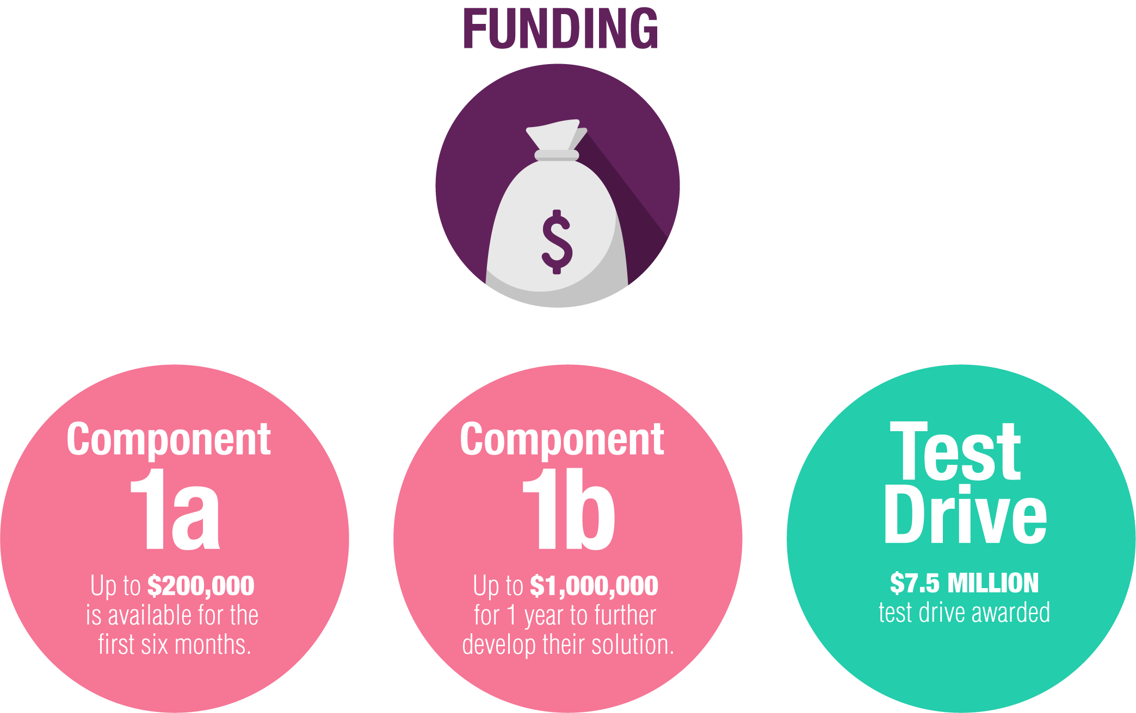
Pushing Technology Forward: Cyber Attribution
Attributing Cyber Threats:
DND launched a challenge using Competitive Projects to find innovative approaches to access, interpret, and compare all available evidence (e.g. technical, all-source intelligence) on how current cyberspace activities get attributed.
7 Innovators awarded Component 1a Funding
1 Innovator awarded Component 1b Funding
1 Innovator selected for funded Test Drive
Notes:
Our innovation ecosystem allows promising technology to advance quickly. Case in point: Our Cyber Attribution Challenge.
The Cyber Attribution Challenge was issued as part of our 1st Call for Proposals for Competitive Projects.
The program received 24 applications for this challenge and brought 7 innovations into the IDEaS innovation ecosystem.
These innovators advanced their solution over a period of 6 months, with up to $200K of funding from IDEaS, after which 1 was selected to continue and received up to $1M for 12 months of work.
Finally, CAF identified the most promising technology to be “test driven” in a real world environment, and that innovator was awarded a $7.5 contract.

Slide 9
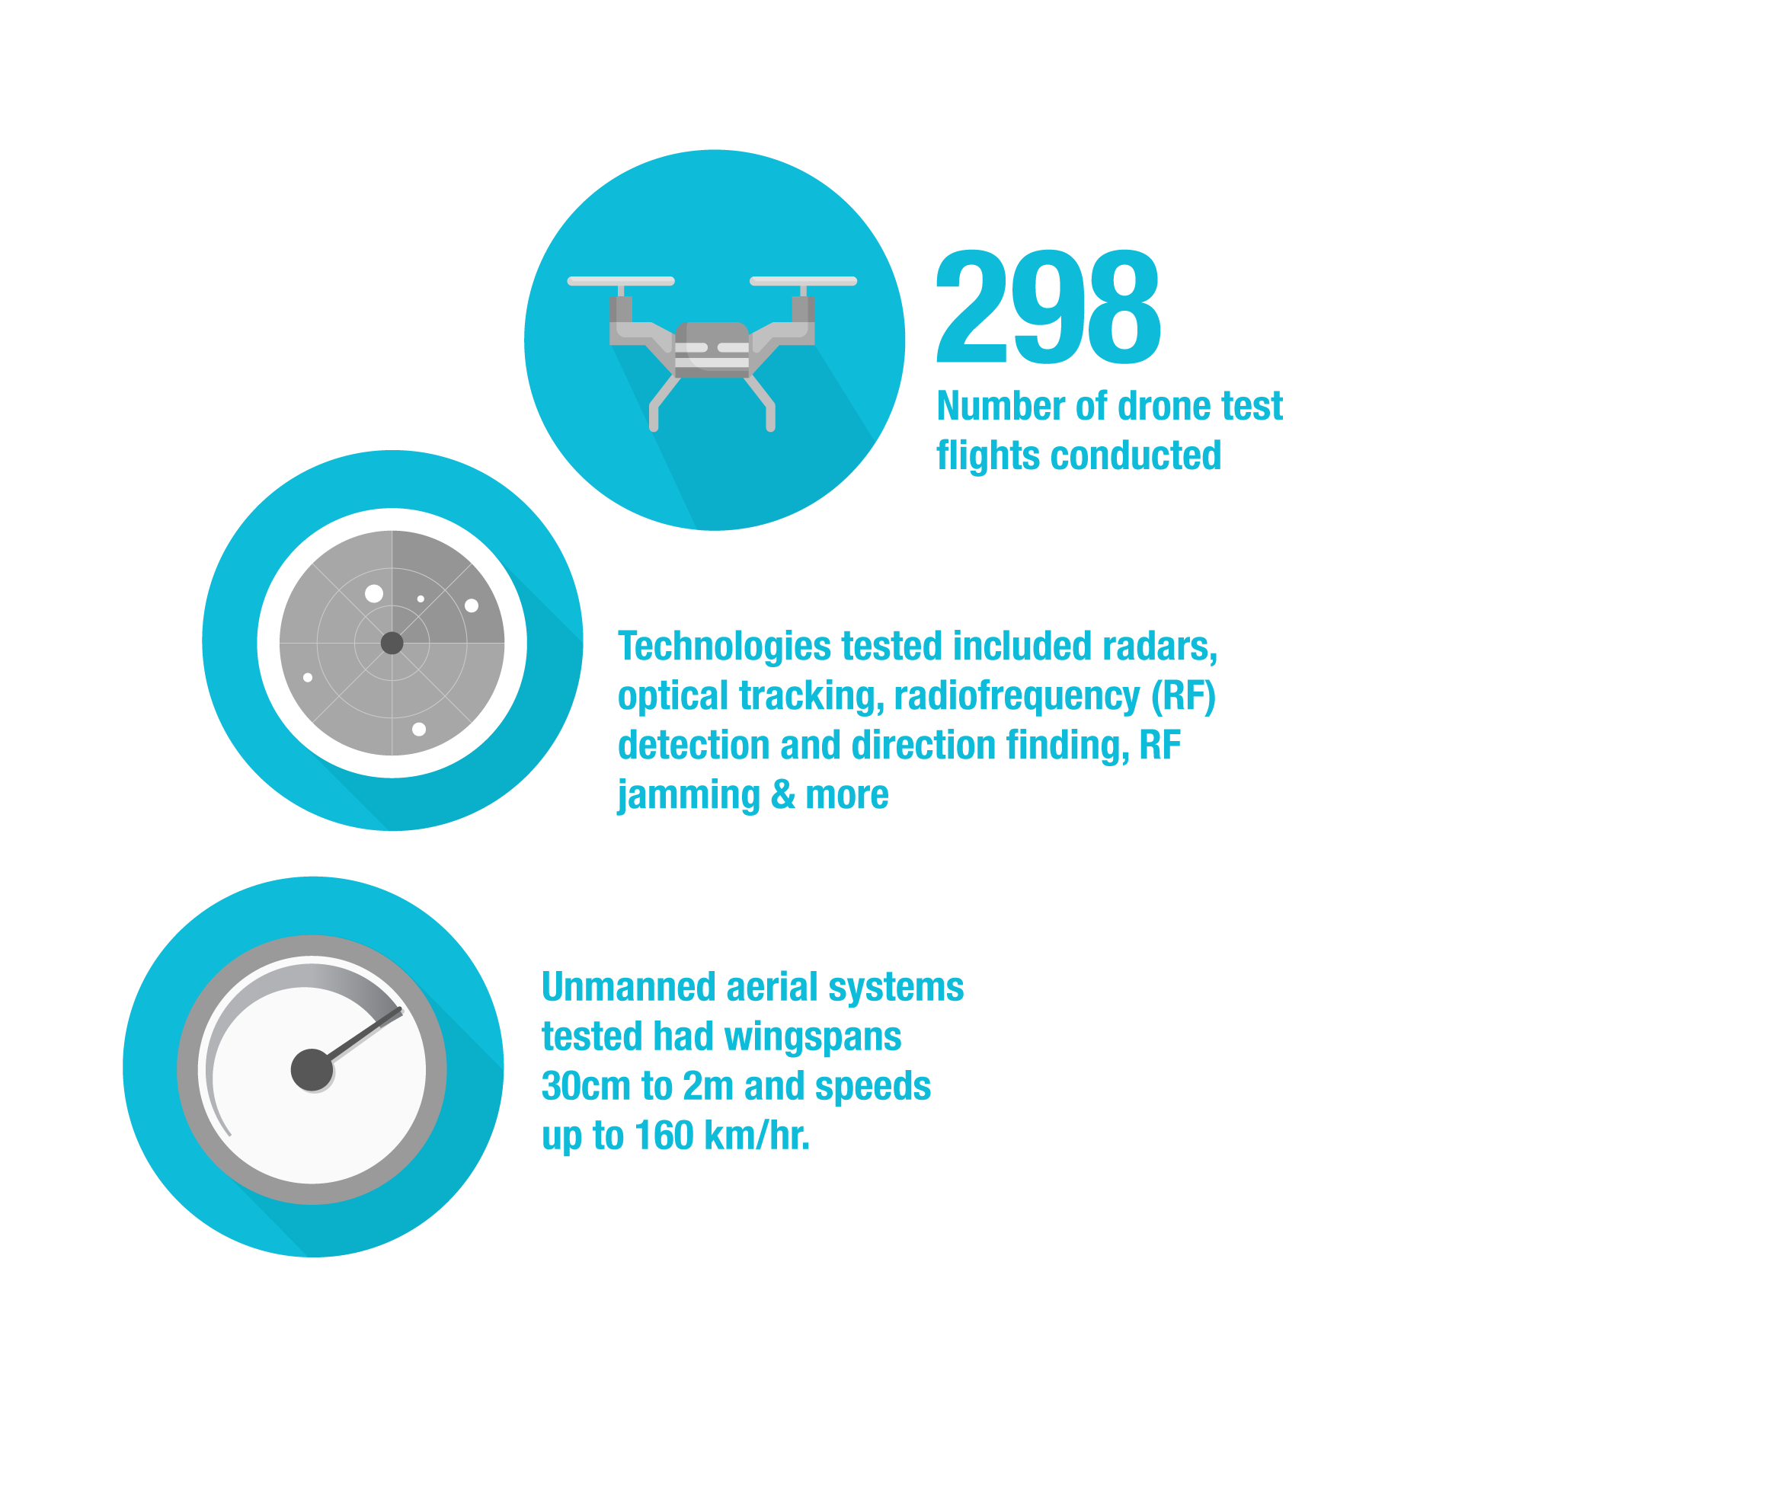
Pushing Technology Forward: Drones
Drone Wars:
Countering Unmanned Aerial Systems Sandbox
CAF needs new technologies and approaches to detect and defeat various threats from drones.
This Sandbox gave an opportunity for innovators to test and demonstrate their solutions to potential government and military clients in a real world environment.
Notes:
As part of the first challenges issued by IDEaS, the threat of drones used for surveillance or attacks was identified as an ongoing risk to operations.
The Countering Unmanned Aerial Systems Sandbox aimed to look at ways to detect and defeat a variety of different drone technologies, from jamming to physically knocking them out of the sky
A total of 12 companies from five different countries were invited to DRDC Suffield to demonstrate, test, and receive expert feedback
The sandbox brought new perspectives and insights into better ways to counteract drones and other aerial systems.

Slide 10

Pushing Technology Forward: Pandemic Response
Battling COVID-19
IDEaS was able to pivot to release four COVID-19 related challenges in May and June 2020 to address:
Early detection and community-based surveillance of outbreaks to permit rapid decision-making;
Finding ways to sanitize personal protective equipment for re-use;
Sanitizing sensitive equipment and workspaces; and
Identifying and treating moral trauma in frontline workers.
Additionally, IDEaS funded 3 projects via directed contributions as part of the government’s larger COVID-19 response.
Notes:
Being an innovation program, IDEaS has to be responsive to the current and future needs of the CAF. When the COVID-19 pandemic hit, we were able to pivot and participate to the battle against COVID using the tools available to us.
Working with the National Research Council, Health Canada and the Public Health Agency of Canada, we identified several promising technologies from Canadian innovators. The research focused on decontamination research, advanced ventilators, and new fast test kits.
As part of the larger pan-government pandemic response, the IDEaS program launched four COVID-19 specific challenges in May and June 2020. The challenges focused on:
Early detection and community-based surveillance of outbreaks to permit rapid decision-making;
Finding ways to sanitize personal protective equipment for re-use;
Sanitizing sensitive equipment and workspaces; and
Identifying and treating moral trauma in frontline workers.

Slide 11

Innovation can come from anywhere.
Canadian educational institutions
Canadian not-for-profit organizations
Provincial/Territorial or Municipal government organizations
Canadian for-profit companies or organizations
Individuals
SMEs
International organizations partnered with a Canadian recipient
Any group composed of eligible participants listed above
Not eligible – employees within DND/CAF or federal employees
Notes:
We are looking at solving challenges from every possible angle to bring new thinking to the Department of National Defence and the Canadian Armed Forces.
We welcome thinking from non-traditional sources such as agriculture, the automotive industry, Health care sector or any combination of technologies that could offer a breakthrough or new approach for defence and security.

Slide 12

Key Updates
Green Heat Test Drive and Competitive Projects Call for Proposals #5 closed in October
Sandbox Corrosion Detective in Ships (CDIS) re-launch in November
New Innovation Network Call focusing on 5G in November
New Classified Stream being developed under Competitive Projects
IDEaS 19/20 Annual Report available for download
Pop-Up City Contest moves to Round 4
Off-ramping opportunities with other federal funding organizations
Notes:
New Challenges: In Spring/Summer expect to see Competitive Projects CFP 5 released, as well as an Innovation Networks Call which will focus on 5G
IDEaS Classified Stream
The IDEaS classified stream launched a Request for Information (RFI) in February 2021. The intent of the call was to seek feedback from the innovation community on the development of a classified stream Call for Proposals (CFP). The RFI received 113 responses. The results are now being analyzed to potentially modify the draft design of this new tool based on the input from the innovation community.
2019-2020 Annual Report
IDEaS has released its 2019-2020 Annual Program Report. It showcases the program’s accomplishments in its 2nd year and is available on both DRDC NEXUS and www.canada.ca/defence-ideas/.
Contests
The Pop Up City contest held its Pitch Event on March 23, 2021. Six teams from across Canada were each awarded $50,000 for moving to Round 3 and pitched their solutions for a more efficient temporary camp for troops. Over 100 people attended the event, including representatives from DND/CAF, DRDC and other government departments.
Three lucky winners will receive $1.5M each to build a prototype of their solutions. Winners are expected to be announced in May 2021. Moving to Round 4.
Offramping Opportunities:
IDEaS has recently established strategic partnerships with other departments and crown corporations that offer innovation funding and financing to refer projects for consideration that are no longer of interest to DND for defence and security.

Slide 13

How to participate
Benefits to you: Intellectual Property
Visit our Website: Canada.ca/defence-ideas
Subscribe to our mailing list (on our homepage)
Follow DRDC Twitter/Linkedin and look for #defenceIDEaS
Email us with any questions: DND.IDEaS-MDN@FORCES.GC.CA
Don’t forget to read the applicant guide and apply when a challenge is right for you!
Notes:
Make sure you subscribe to our email distribution list to get the latest challenges emailed directly to you.
Our web site will have challenges as well as updates on the projects we have funded, background information on the program and future opportunities.
We do share on social as well.
Feel free to email us with your questions.

Slide 14

Great ideas have the potential to change the world.
Will the next one be yours?
Notes:
We know inspiration can come from anywhere.
That’s why we invite everyone to apply.
We are looking to advance projects at any stage, whether its ready to be tested for defense purposes, or a completely new concept that needs to be developed.
But most importantly, we want to bring you in to our innovation ecosystem.
Whether it be for funding, a partnership opportunity, battle testing your product, off-ramping to keep your journey going or simply being inspired by the amazing work of our innovators, we want to be sure you aren’t missing out. So email us. Apply for a call. Or reach out to fellow innovators. Because we are all in this together.

Slide 15

Benefits to you: Intellectual Property
Innovators own the IP they develop under this program
The Crown gets a license to use and have used for its own purpose but cannot exploit it commercially. Standard Government of Canada contract conditions apply.
You are able to further commercialize your products after they’ve been through the program
Support During IDEaS Project
Partnership with the Canadian Intellectual Property Office delivers training to our innovators on Intellectual Property, and helps innovators get their questions answered to protect their IP
Notes:
One of the innovative features of IDEaS is that Intellectual property stays with the innovators.
Along with DND/CAF benefiting, the company or organization can continue to profit from the technology developed.

Slide 16


Slide 17
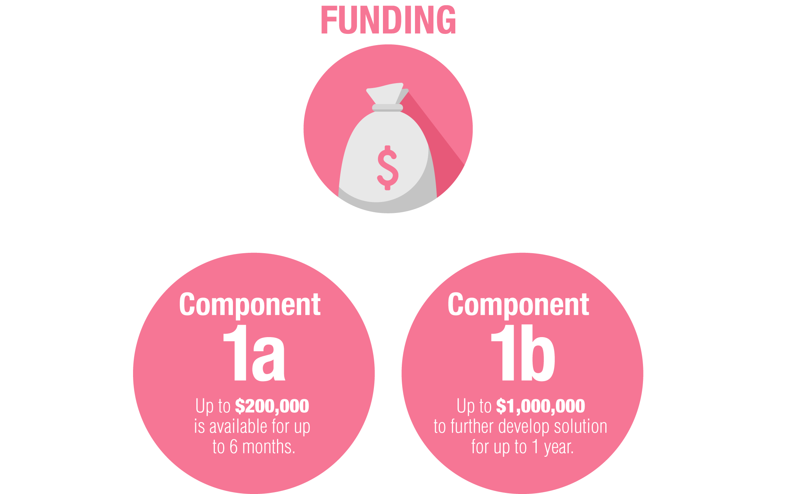

Competitive Projects
The Competitive Projects element funds projects fast. It advances promising technology quickly through a phased approach, which can quickly take your technology to new heights.
Notes:
Five Calls for Proposals have been launched to date (including COVID-19): 52 Challenges assembled in Themes were launched
More than 1800 proposals were received from all the Canadian Provinces and from all types of innovators
More than 300 contracts and 48 contribution agreements have been awarded for Component 1a, and now more than 89 contracts for Component 1b (up to $1M for 1 year)
All of these results for 4 CFPs and COVID-19 CFP can be found on the IDEaS Web Page

Slide 18


Contests
Contest brings innovators face-to-face in a competition with cash prizes for the best solutions.
The Pop Up City contest recently completed its pitch event, and will select three winners to receive $1.5M to build a prototype.
Notes:
The Pop up City: Integrating Energy, Water and Waste Management Systems for Deployed Camps Call for Proposals was launched on August 21, 2019
111 applications were received in round 1.
42 Round 1 winners each received a $10,000 prize, and the opportunity to form integrated proposals for the chance at three $1.5M prizes.
6 teams presented their innovative waste, water, or energy management solutions at a pitch event in March 2021.
3 winners will develop a working prototype of their concepts.
A $2 million dollar grand prize will be awarded after two years of testing the integrated prototypes.

Slide 19

Innovation Networks
12
MICRO-NETWORKS
ESTABLISHED IN
TWO TECHNOLOGY
DOMAINS
Academia collaborates with private sector to build a network of expertise that advances R&D in support of Canada’s current and future defence and security innovation challenges. Each research micro-net established receives up to $1.5M to advance their research over three years.
6
6
ADVANCED MATERIALS
Seeking innovation in
Detection Avoidance and Physical Protection
AUTONOMOUS
SYSTEMS
Trust and Barriers
to Adoption
Notes:
To date, two Calls for Proposals for the creation of Micro-nets have been published. Each challenge was allocated $9 Million to establish 6 micro-nets.
Advanced Materials for Defence & Security: Seeking Innovation in Detection Avoidance and Physical Protection
To stimulate the development of revolutionary advances in materials science for defence & security applications, with a focus on emerging and advanced materials, including advanced manufacturing methods.
Autonomous Systems for Defence and Security: Trust and Barriers to Adoption
To promote revolutionary advances in our understanding of autonomous systems for defence and security applications, with a focus on trust and barriers to adoption.

Slide 20
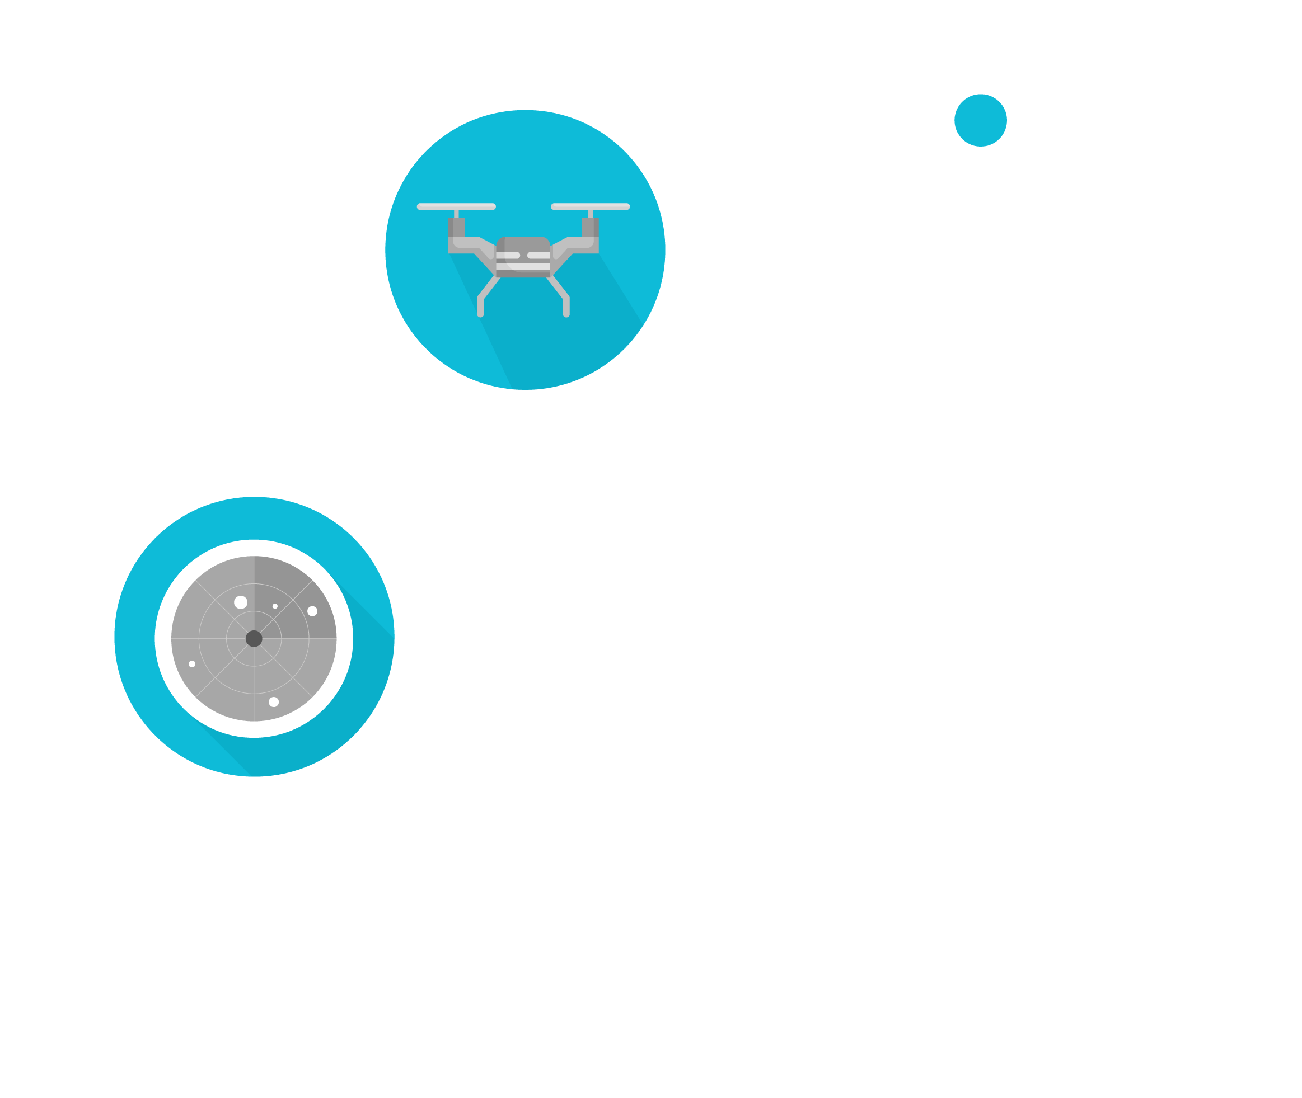

Sandboxes
In the IDEaS Sandbox, the scenario and environment are provided by the DND and the CAF. Innovators test and demonstrate their solutions in the presence of defence experts and potential users and receive observational feedback on their performance.
Counter Unmanned Aerial Systems (CUAS) and
Corrosion Detection in Ships
Notes:
Sandbox for Countering Unmanned Aerial Systems (Counter-UAS) was held in Suffield (AB) from Sept 9 to Oct 4 2019
Twelve companies were selected (out of 26) to participate
296 flights conducted
Representatives from five countries participated
3771 minutes of flight time was conducted
Sandbox for Corrosion on Ships – Rust Never Sleeps
Call For Applicants was re-released in the Fall 2020. Due to COVID-19, the Sandbox event has been postponed to Spring 2022.
The challenge will allow innovators to showcase their best solutions to find corrosion trouble spots for the Royal Canadian Navy (RCN)
Innovators will receive feedback for their solution from DND/CAF experts and potential users.

Slide 21


Test Drive
$7.5M
contract signed with Sapper Labs
Innovator solutions are evaluated by IDEaS, DND and CAF
Low Carbon Energy Generation for Heating Existing Buildings Test Drive – accepting applications in June 2021
Notes:
Sapper Labs is project is the first project to advance from Competitive Projects 1b to Test Drive and was awarded $7.5M. The company will test their advanced cyber attribution technology in a real world environment with support of CANSOFCOM. If successful, the solution would allow DND to achieve important cyber effects on networks of importance and directly address existing capability deficiencies.
Green Heat: Low Carbon Energy Generation for Heating Existing Buildings Test Drive was launched in January with an Advanced Procurement Notice. With the largest infrastructure portfolio in government, CAF/DND is looking for ways to reduce its environmental impact from building operations. IDEaS will acquire, install, and operate a large scale, low-carbon energy system integrated with an existing CAF building in Kingston, Ontario, to assess the effectiveness and costs of such a technology

Slide 22
Finding solutions
SOLUTION READINESS LEVEL (SRL)
1 - Inspiration strikes and concept is formulated
2 - Theorizing of practical applications begin
3 - Active research and development is initiated
4 - Components validated in a laboratory environment
5 - Basic solution components are integrated and tested
6 - Prototype validated in a relevant environment
7 - Prototype demonstration in an operational environment
8 - Actual system completed and qualified through test
and demonstration
9 - Solution Proven through successful mission operations
Notes:
One of the most exciting thing about the program is that there are many possible paths to success. We provide a continuum of support and guidance, and help your ideas, products and vision become the best they can be.
The various elements of the IDEaS program exist along the spectrum of Solution Readiness Levels from conceptual (SRL1) to Proven and Ready for real world application (SRL9)
An innovative solution that has entered our funding continuum could benefit from off-ramping opportunities and partnerships with other innovation programs within the federal government.

