Slide 1
Template for company one-pager descriptions
Each company submits a one-page description of their company and solution using this PowerPoint template. IDEaS then creates a briefing book of all applicants.
Instructions: page 2
Example: page 3
Template: page 4

Slide 2
Instructions
Purpose: To brief assorted audiences on which companies and technologies have applied to a sandbox, IDEaS uses a compendium of one-page descriptions and photos of all companies and solutions. It is important that these descriptions are provided and endorsed by the companies to ensure accuracy. It is the company’s opportunity to communicate their key messages, using a templated common look and feel for all companies.
Instructions:
Review the example on page 3.
Complete the template on page 4:
  All of your information must fit on a single page, even if your solution has multiple components.
  If your company is submitting multiple applications to the sandbox, each application package requires its own one-pager.
  Use the template as shown. Alternate layouts will not be accepted.
  Do not change the font or font size. Use Calibri 10.
  You can adjust the height of the boxes for the company description, solution description, and the area for photos at your discretion, but all three areas must be used.
  You must include at least one photograph. Captions are permitted and encouraged.
  Do not embed video files or any animations.
Submit the file as a PowerPoint file (not a PDF) with your application package:
  Your slide will be merged with all others to create a compendium of all applicants to the sandbox.
  During the merge we will validate and may adjust formatting where needed to ensure consistency.
  We do not edit your text in this process.

Slide 3
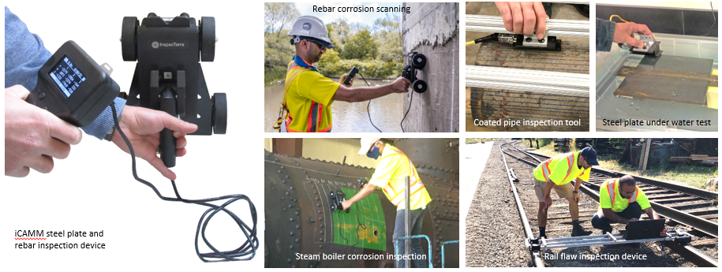
EXAMPLE
Company: InspecTerra Inc.
Solution: Steel Infrastructure Corrosion Assessment Magnetic Method (iCAMM)ert
Province/Country: Ontario, Canada
Website: www.inspecterra.com
Company description:
InspecTerra is a small company started from the University of Waterloo providing services in non-destructive testing for the condition assessment of infrastructure assets, such as reinforced concrete structures. Our goal is to develop and employ innovative non-destructive testing and monitoring technologies, while supporting academia, research and innovation, and the industry. We provide leading expertise in corrosion inspection and monitoring, risk assessment and life cycle management, and technical training. Our unique and proprietary NDT solutions reduce the economic and financial impact of infrastructure aging across a wide range of applications, while enhancing safety and environmental sustainability.
Solution description: iCAMM (Infrastructure Corrosion Assessment Magnetic Method) is a non-destructive testing (NDT) method invented and developed by InspecTerra Inc. for the condition assessment of ferromagnetic objects. The inspection platform consists of an array of highly sensitive synchronized magnetic sensors mounted on a portable and hand movable device, as well as the associated signal processing and analysis software. The scanning device detects changes in the magnetic properties of ferromagnetic objects caused by discontinuities, such as corrosion and cracking (defects). The method is unaffected by environmental conditions, such as temperature or salinity, and can detect corrosion and defects under any type of (non-ferromagnetic) cover (e.g., paint, coating, insulation or water). This method can also be applied under water. The iCAMM technology has been successfully used in many projects for identifying and measuring the degree of corrosion (e.g., embedded steel reinforcement in concrete, steam boiler inspection, steel plate under water, etc.).

Slide 4
Company: insert
Solution: insert
Province/Country: insert
Website: insert
Company description:
Solution description:
Include at least one image in this area.
DO NOT insert videos or animations

