Slide 1
The CAF Response to Sexual Misconduct

Slide 2
Overview
Background
Operation HONOUR
The Path to Dignity and Respect – The CAF Sexual Misconduct Response Strategy
Definitions
The Spectrum of Sexual Misconduct
Actions Upon Receiving a Report/Disclosure of an Incident
Operation HONOUR Tracking & Analysis System (OPHTAS)
Support Services
Questions
Notes:
OVERVIEW

Slide 3
Background
1998 – National media coverage on sexual harassment and assault within the CAF - Ombudsman office opens to review and investigate
Apr 2014 – Media allegations, victim testimonials - CDS responds by requesting former Justice of Supreme Court Madame Marie Deschamps to conduct an Independent External Review on Sexual Misconduct and Sexual Harassment in the CAF (Jun 2014 - Mar 2015)
26 Feb 2015 – The CAF Strategic Response Team on Sexual Misconduct (CSRT-SM) established to develop CAF-wide strategy and action plan
20 Aug 2015 – CDS gathers Senior Leadership and issues orders specific to Operation HONOUR
1 Sep 2015 – Sexual Misconduct Response Centre (SMRC) stood up, starts receiving calls and emails from CAF members two weeks later;
24 Jul 2017 – SMRC service expanded to 24/7
July 2019 – CSRT-SM is renamed the Directorate Professional Military Conduct - Operation HONOUR (DPMC-OpH), as it continues to fully integrate and institutionalize itself into the CAF
28 Oct 2020 – The Path to Dignity and Respect: Sexual Misconduct Response Strategy released
18 Nov 2020 – DAOD 9005-1, Sexual Misconduct Response
Notes:
- This is an issue the CAF has been dealing with for a very long time.
- The SMRC was initially stood up 6 mo prior to the original plan.

Slide 4
This is Operation HONOUR
DHRD
*SMRC
CDA
Members
Institution is
Leadership Driven
Membership Enabled
DMP
CFHS
ICCM
Victims Survivors
CDS
CFNIS
Outcome: Cultural Change
DGMPRA
DMCA
Commands
* The SMRC is an independent agency working under the DM, IAW the SLA from the CAF for victim support.
Partners Perspective
Notes:
Each of the key processes functions on the previous slide has a distinct entity(ies) within the CAF/DND that has a mandate or lead role in the management of those processes.
DHRD – Directorate of Human Rights and Diversity
DMP – Director Military Prosecutions
JAG – Judge Advocate General
CFNIS – Canadian Forces National Investigative Services
DGMPRA – Director General Military personnel Research and Analysis
DMCA – Director Military Career Administration
CFHS – Canadian Forces Health Services
SMRC – Sexual Misconduct Response centre
CDA – Canadian defence Academy
ICCM – Integrated Conflict and Complaint Mechanism
The DPMC-OpH coordinates and oversees these Operation HONOUR related functions on behalf of the CDS.
Outcome:
The CAF has set out to change more than just how individual members behave. All of the cogs are working together to change the CAF culture that let sexual misconduct grow, to reinforcing a culture of Duty with HONOUR.

Slide 5
Why do we need a culture change strategy?
“Any discussion of the causes and consequences of sexual harassment and assault in the armed forces — including the effectiveness of current policies and practices — must begin with an examination of the underlying cultural norms that inform the ways in which CAF members interact with each other, and what they perceive to be acceptable conduct.”
— External Review Authority, Former Supreme Court Justice Honourable Marie Deschamps (2015)
Notes:
ERA report
Finding: With respect to inappropriate sexual conduct, the culture of the CAF on the ground does not, in many ways, measure up to the professional standards established by the policies and described in Duty with Honour. Rather, the ERA found that there is a significant disjunction between the aspiration of the CAF to embody a professional military ethos which embraces the principle of respect for the dignity of all persons, and the reality experienced by many CAF members day-to-day.
Recommendation No. 2: Establish a strategy to effect cultural change to eliminate the sexualized environment and to better integrate women, including by conducting a gender-based analysis of CAF policies.
Conclusion: Cultural change is key. Without broad-scale cultural reform, policy change is unlikely to be effective. This requires the CAF to address not only more serious incidents of sexual harassment and assault, but also low-level sexual harassment, such as the use of sexualized and demeaning language, which contributes to an environment that is hostile to women and LGTBQ members.
OAG report
Specifically recommended a performance measurement framework. DND response indicated it would create a PMF and campaign plan.
Parliamentary committees
Various committees have studied Operation HONOUR and the issue of women in the CAF. Their questions and recommendations often speak to the need for culture change.

Slide 6
The Path to Dignity and Respect
A comprehensive four-part strategy focused on aligning organizational culture to prevent and address sexual misconduct, and improve support for those who have been affected
Part One
Part Two
Part Three
Part Four
ANALYSIS
Strategic Approach to Cultural Alignment
Understanding and shaping CAF culture
APPLICATION
Strategic Framework for Addressing Sexual Misconduct
Applying cultural analysis to sexual misconduct
IMPLEMENTATION
Operation HONOUR Strategic Campaign Plan
Setting mission and objectives
MEASUREMENT
Operation HONOUR Performance Measurement Framework
Establishing logic model and performance indicators
Notes:
What is The Path to Dignity and Respect?
The Path to Dignity and Respect (The Path) <insert link to Strategy> is a culture change strategy created to prevent and address sexual misconduct in the CAF. The Path is designed to align behaviours and attitudes in the Canadian Armed Forces (CAF) with the principles and values of the profession of arms in Canada. It shifts the focus of Operation HONOUR from an immediate response primarily concentrated on addressing incidents, to a long-term institutional approach aimed at preventing incidents from occurring in the first place.
What are we trying to accomplish with The Path?
We are striving for a CAF free of sexual misconduct, where everyone is treated with dignity and respect. To achieve our vision, we must ensure that sexual misconduct is never minimized, ignored or excused. This is how we will build a safer work environment and ensure trust in each other and in the chain of command. The Path provides us with a comprehensive, long-term strategy to guide and coordinate efforts across the CAF.
What elements are included in The Path?
The strategy has four elements:
Analysis: The Strategic Approach to Cultural Alignment identifies the elements that constitute and influence CAF culture, and introduces a cultural alignment model that we can apply to a broad range of issues.
Application: The Strategic Framework to Address Sexual Misconduct in the CAF applies the cultural alignment model to determine what aspects of CAF culture enable or hinder individuals from engaging in sexual misconduct. It also sets out the vision, guiding principles, strategic objectives and desired outcomes that will guide our efforts to prevent and address sexual misconduct.
Implementation: The Operation HONOUR Strategic Campaign Plan 2025 lays out how we will implement the strategy. It proposes a comprehensive, five-year plan for the next phase of activities and is designed to coordinate with other complementary efforts throughout the CAF.
Measurement: The Operation HONOUR Performance Measurement Framework establishes the measurement that the CAF will be used to assess the progress of Operation HONOUR over time.
Why will this strategy make a difference?
Sexual misconduct is a complex issue that requires a holistic, long-term approach. The Path is an evidence-informed strategy that considers the cultural dynamics of the CAF and how they can be leveraged, or targeted for elimination, to address sexual misconduct. It incorporates and builds on efforts already undertaken through Operation HONOUR and other complementary CAF initiatives, while introducing a prevention-based approach to help us target and implement our interventions. Furthermore, it includes a performance measurement framework, which will support a cycle of continuous learning and improvement.

Slide 7
Part One: Strategic Approach to Cultural Alignment
Summary of the approach for understanding and changing CAF culture.
Identify the individual factors that constitute and influence the culture of a military organization.
Implement a change management process
Apply a preventative approach to target interventions
Notes:
Part One of The Path outlines a strategic approach to sexual misconduct as a complex problem and identifies a holistic approach to addressing it via cultural alignment.
The approach begins with an analysis and evaluation of overall CAF cultural health, which enables the CAF to determine where cultural alignment efforts need to focus. In addition, the approach identifies those influences on culture that are within and outside the CAF’s span of control and presents a holistic approach for developing and targeting interventions to achieve the cultural alignment being sought.
The next step is to apply the Strategic Approach to Cultural Alignment to the complex problem of sexual misconduct in the CAF.

Slide 8
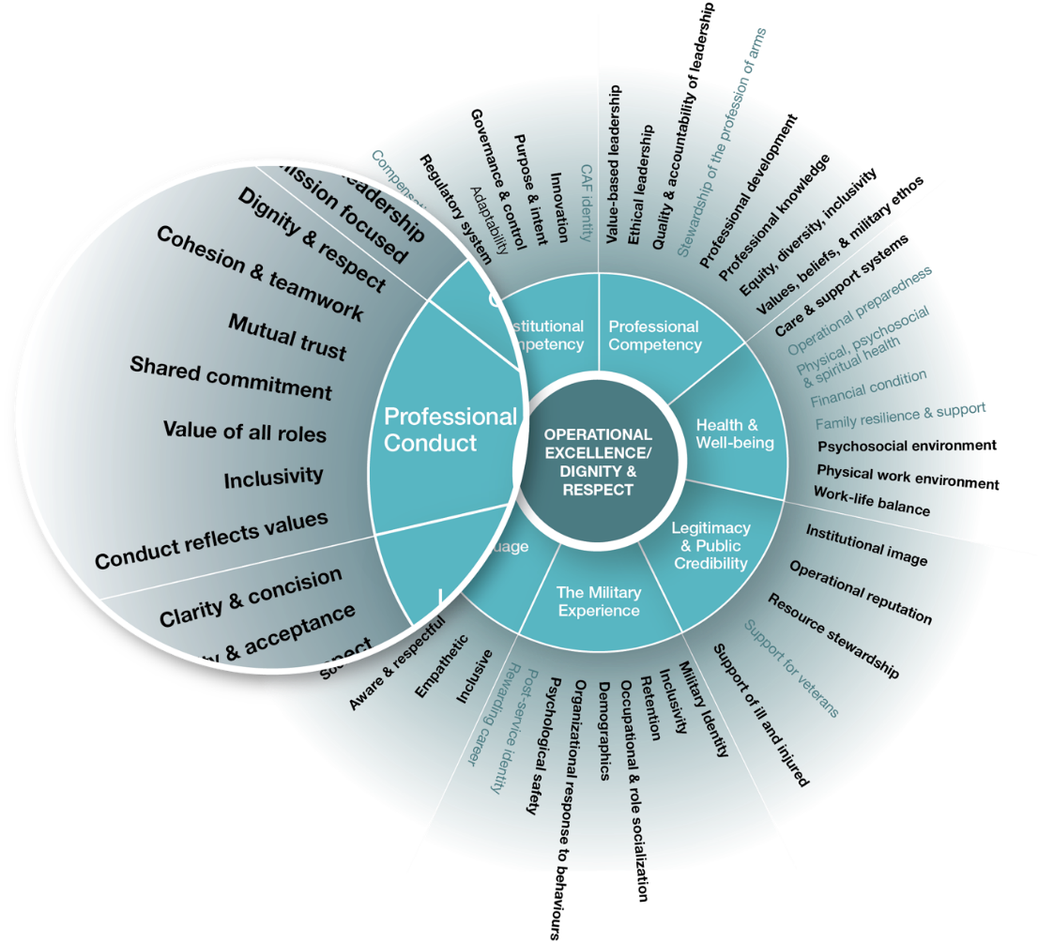
Part Two: Strategic Framework to Address Sexual Misconduct
Domains and determinants impacting sexual misconduct are identified.
Notes:
The CAF domains and determinants identified in Part One were analysed to inform the development of the strategic objectives and goals found within the Strategic Framework.
Following this analysis, it was determined that 43 of the 54 CAF determinants and all seven domains were either directly or indirectly implicated.
These domains and determinants are where the CAF must focus its cultural alignment efforts.

Slide 9
Part Two: Strategic Framework to Address Sexual Misconduct
Guiding principles, lines of effort, and strategic objectives are established to guide cultural alignment efforts.
Guiding principles
Lines of effort
1 Awareness and understanding
2 Support for affected persons
3 Response
4 Institutional leadership
1 Zero tolerance – Incidents are never ignored, minimized or excused.
2 Leader commitment at all levels.
3 CAF personnel will understand and embody the CAF military ethos.
4 Persons affected by sexual misconduct will be treated fairly, compassionately, and be empowered as supported partners.
5 Respondents will be treated fairly, proportionally and be assured due process.
6 The CAF learns from experience, maintains transparency, and remains aware and vigilant.
Notes:
Guiding Principles
The six guiding principles that follow are the set of established criteria to be used to guide all cultural alignment efforts. The guiding principles are drawn from the CAF Leadership Doctrine, the Department of National Defence (DND) and Canadian Forces (CF) Code of Values and Ethics, Duty with HONOUR : The Profession of Arms in Canada and the UN Women publication What Will It Take? Promoting Cultural Change to End Sexual Harassment.
Zero tolerance - Zero tolerance of sexual misconduct, manifested in policy and practice, must be woven into the culture of the CAF. Zero tolerance requires that all allegations be taken seriously and acted upon, and that no incident of sexual misconduct ever be ignored, minimized or excused. Leadership will support a positive command climate in which it is safe for those who witness or are affected by sexual misconduct to report incidents.
Leader commitment at all levels - Those in formal leadership roles at all levels shall be fully committed to, and held accountable for, the success of Operation HONOUR. Leaders, whether formal or informal, are the primary architects and sponsors of the cultural alignment efforts. They must embody and actively foster ethical behaviours and never actively or passively condone any form of sexual misconduct.
CAF personnel will understand and embody the CAF military ethos - Every member of the CAF is expected to understand and embody the values and obligations that form the foundation of the profession of arms. The Defence Ethics principles, which drive the expression of CAF values, will be reflected by each member in their everyday behaviours and attitudes. This standard is expected of each individual CAF member in order for them to become and remain an accepted member of the profession of arms. CAF members are educated and socialized into the profession of arms from their point of entry into the CAF and will be held to the highest standards throughout their careers.
Persons affected by sexual misconduct will be treated fairly, compassionately, and be empowered as supported partners - Leadership shall treat affected persons fairly and compassionately at all times and shall remain accountable and responsible for the overall welfare and support of affected persons. They shall foster a safe and supportive environment, ensuring affected persons are not subjected to ostracism, retaliation nor reputational harm. Priority will be given to the well-being of those affected, while ensuring the maintenance or re-establishment of team cohesion. Affected persons who disclose or report incidents will be offered expert response and support coordination services to assist them in accessing programs and services, advocacy support and information so that they are able to make informed decisions about their situation. Affected persons have the right to access the information they require about their cases throughout the process and, to the greatest extent possible, maintain control over the processes that involve them.
Respondents will be treated fairly, proportionally and be assured due process - Leadership shall treat respondents fairly and impartially during the resolution process, remain accountable and responsible for the overall welfare of the respondent, and ensure respondents do not suffer any undue reputational harm. CAF personnel found to have committed an act of sexual misconduct will be administered and/or disciplined in accordance with regulations and policy, taking into account the severity of the offence. Appropriate interventions will focus on preventing repetition of the behaviour and reintegrating the perpetrator back into the workplace, when appropriate.
The CAF learns from experience, maintains transparency and remains aware and vigilant - The CAF will systematically and continuously evaluate progress over time and course correct when required. To ensure a continuous cycle of learning and improvement, the CAF will regularly engage with internal and external stakeholders, sustain a progressive research program and maintain a robust performance measurement system. The CAF will report periodically on progress to ensure transparency and maintenance of trust within the institution. It will also share best practices with other organizations to contribute to national and international efforts to address sexual harassment and violence in the workplace.
There are four lines of effort and strategic objectives have been identifies under each line of effort.
LoE 1 – Awareness and Understanding
Strategic Objectives:
Enhance education and awareness programs throughout a career span.
Expand knowledge, engage with external partners and stakeholders.
Implement a robust performance measurement program.
LoE 2 – Affected Persons Support
Strategic Objectives:
Improve support for affected persons (main effort).
Optimize the accessibility and integration of support services.
LoE 3 – Response
Strategic Objectives
Improve leadership response to incidents of sexual misconduct (affected persons).
Improve remedial response to incidents of alleged sexual misconduct (respondents).
Renew institutional policies and guidelines.
Increase the inclusiveness of the CAF through recruiting and retention.
LoE 4 – Institutional Leadership
Strategic Objectives
Establish a governance model for Operation HONOUR.
Enhance leadership development, evaluation and succession planning.

Slide 10
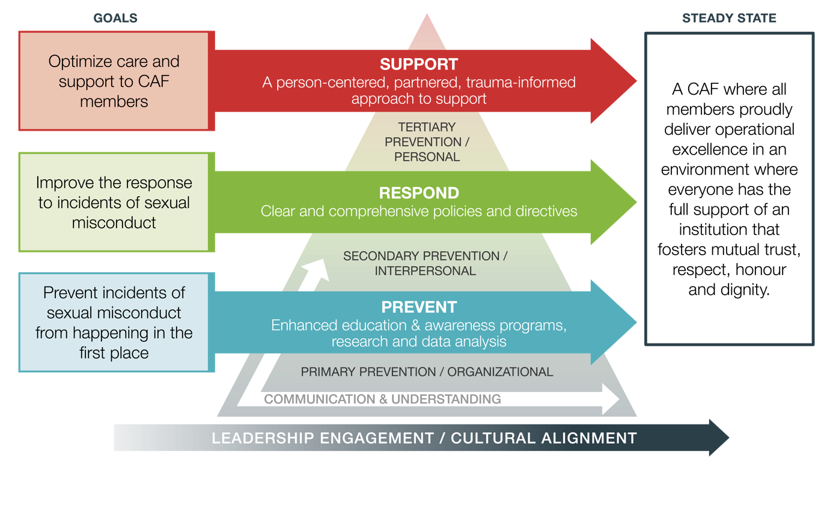
Part Three: Operation HONOUR Strategic Campaign Plan
Mission: To ensure sexual misconduct is never minimized, ignored or excused so that the CAF cultivates the inclusive and respectful work environment that embodies the ethical principles and core values of the profession of arms.
Vision
A CAF free of sexual misconduct where all are treated with dignity and respect.
Notes:
This is a visual representation of the Campaign Plan Framework.
The framework used to represent the Campaign Plan is structured around the prevention-based approach to cultural alignment.
The goal of each LOO is stated at the beginning of the arrow and each arrow includes an overview of the initiatives involved in the respective LOO.
Recognizing the enduring nature of Operation HONOUR, the Campaign Plan terminates in a steady state rather than an end state “where all members proudly deliver operational excellence in an environment where everyone has the full support of an institution that fosters mutual trust, respect, honour and dignity.”

Slide 11
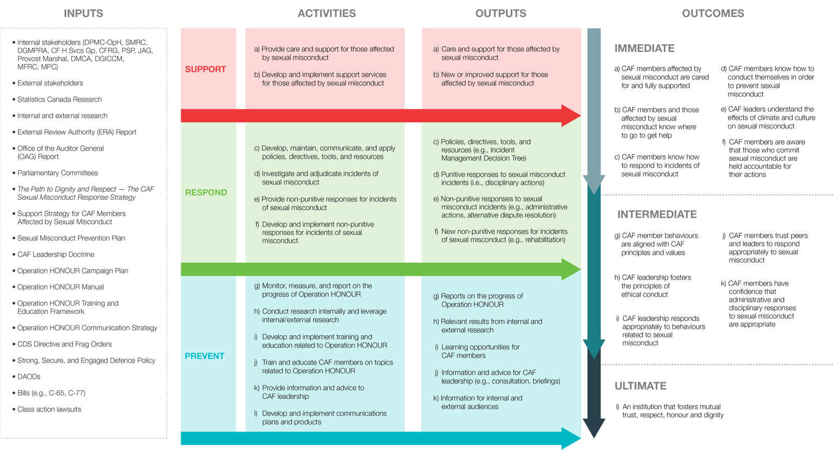
Part Four: Performance Measurement Framework
Activities, output and outcomes are established to ensure a continuous cycle of learning and improvement
Notes:
While ultimately we are striving to eliminate incidents, we know that incident data alone does not provide an accurate picture of progress on this issue.
Example: We must consider that increases and decreases in reporting can be indicators of trust in the reporting process, leadership and the organization.
The Operation HONOUR Performance Measurement Framework establishes the measurements that the CAF will be used to assess the progress of Operation HONOUR over time
The performance measurement framework drive a cycle of continuous learning and improvement.
The Operation HONOUR PMF draws input from a significant number of sources, both internal and external to the CAF.
It leverages resources that provide immediate information, such as data on reported incidents, as well as those that provide a multi-year perspective on progress, such as the Statistics Canada Survey on Sexual Misconduct in the CAF.
Combining long- and short-term resources into the PMF will provide the CAF the means to both react quickly to immediate indicators that an adjustment to the response is required, as well as assess the overall progress of the strategy implementation. The annual Campaign Plan review will be directly informed by the PMF, ensuring that any adjustments made.

Slide 12
Definitions
Sexual misconduct¹ is defined as conduct of a sexual nature that causes or could cause harm to others, and that the person knew or ought reasonably to have known could cause harm, including:
actions or words that devalue others on the basis of their sex, sexuality, sexual orientation, gender identity or expression;
jokes of a sexual nature, sexual remarks, advances of a sexual nature or verbal abuse of a sexual nature in the workplace;
harassment of a sexual nature, including initiation rites of a sexual nature, contrary to DAOD 5012-0, Harassment Prevention and Resolution;
viewing, accessing, distributing or displaying sexually-explicit material in the workplace; and
(cont’d next slide)
¹ DAOD 9005-1 (2)
Notes:
CANFORGEN 049/19, released in Apr 11th 2019, was an interim policy modification of DAOD 5019-5, Sexual misconduct and sexual disorders, and defined Sexual Misconduct. DAOD 5019-5 pre-dates Operation HONOUR and a new version has not yet been promulgated. This CANFORGEN will be superseded with the release of DAOD 9005-1.
The workplace is the physical work location and the greater work environment where work-related functions and other activities take place and work relationships exist. In the CAF context, the workplace includes places such as messes, on base clubs, quarters, dining halls, gyms, and sanctioned events such as holiday gatherings and course parties as well as office spaces, classrooms, garrisons, ships, hangars, vehicles, aircraft, online forums, etc. CAF members do not simply work for the CAF, but work, socialize and often live within institutional and social structures established by the military.

Slide 13
Definitions
Sexual misconduct (cont’d)
Any Criminal Code offence of a sexual nature, including:
section 162 (voyeurism, i.e. surreptitiously observing or recording a person in a place where the person exposes or could expose his or her genital organs or anal region or her breasts or could be engaged in explicit sexual activity, or distributing such a recording);
section 162.1 (publication of an intimate image without consent, i.e. publishing, distributing, transmitting, selling or making available an intimate image of another person without their consent, such as a visual recording in which the person depicted is nude, exposing his or her genital organs or anal region or her breasts, or is engaged in explicit sexual activity); and
section 271 (sexual assault, i.e. engaging in any kind of sexual activity with another person without their consent).
Notes:
Sexual misconduct can be addressed through the application of administrative measures, through the military justice system by charging an individual with a service offence, or, in the case of behaviour that is also captured in the Criminal Code, through the civilian criminal justice system.

Slide 14
Definitions
Consent ² : refers to the voluntary, ongoing and affirmative agreement to engage in the sexual activity in question. Submission or passivity does not constitute consent as a matter of law. For the purposes of the Criminal Code, no consent is obtained if:
the accused induces the victim to engage in the activity by abusing a position of trust, power or authority;
the victim is unconscious;
the victim is incapable of consenting to the activity for any reason other than being unconscious, including due to intoxication;
(cont’d next slide)
² DAOD 9005-1 (4.1)
Notes:
The courts decide whether there was consent or not.
There are however, a few simple messages that can help everyone better understand:
Consent has to be clear – it can be verbal or physical.
Consent has to be coherent – when alcohol or other drugs are involved consent may come into question.
Consent has to be willing – this is where the issue with “adverse personal relationships” comes into play (think instructor/student, supervisor/subordinate). The effects power differentials may have on validity of consent should not be underestimated. Most certainly -
-consent cannot be coerced through violence or threats or through emotional and psychological manipulation.
Consent has to be ongoing – it can be withdrawn at any point during the activity. Granting consent one minute doesn’t mean it is still there five minutes later. If someone gets uncomfortable with where things are going they may not articulate that in just words and we need to “check in” to avoid miscommunication.
-Unclear consent is one of the most frequent reasons in sexual assault.

Slide 15
Definitions
Consent (cont’d)
the victim submits or does not resist by reason of the application of force or threat of the application of force, or by reason of fraud;
the victim expresses, by words or conduct, a lack of agreement to engage in the activity;
the victim, having consented to engage in sexual activity, expresses, by words or conduct, a lack of agreement to continue to engage in the activity; or
the agreement is expressed by the words or conduct of a person other than the victim.
Clear, Coherent, Voluntary, Ongoing
Notes:
The courts decide whether there was consent or not.
There are however, a few simple messages that can help everyone better understand:
Consent has to be clear – it can be verbal or physical.
Consent has to be coherent – when alcohol or other drugs are involved consent may come into question.
Consent has to be willing – this is where the issue with “adverse personal relationships” comes into play (think instructor/student, supervisor/subordinate). The effects power differentials may have on validity of consent should not be underestimated. Most certainly -
-consent cannot be coerced through violence or threats or through emotional and psychological manipulation.
Consent has to be ongoing – it can be withdrawn at any point during the activity. Granting consent one minute doesn’t mean it is still there five minutes later. If someone gets uncomfortable with where things are going they may not articulate that in just words and we need to “check in” to avoid miscommunication.
-Unclear consent is one of the most frequent reasons in sexual assault.

Slide 16
Potential Service Offence
Healthy
Unacceptable Conduct
Toxic Environment
Criminal Conduct
Environment
Sexualized language/jokes
Visually displaying sexually explicit materials
Sexual assault
Dignity and respect for all
Sexual innuendos
Indecent exposure
Good order and discipline
Unwanted sexual attention
Child pornography
Pressuring for sexual activity
Criminal harassment, stalking, threats
Highest ethical standards
Sexist or sexually demeaning comments
Accountability
Sexually discriminatory conduct
Sexual exploitation
Online sexual misconduct
Safe and supportive environment
Inappropriate use of social media
Sexual interference
Unsolicited sexually explicit text/email/images
Voyeurism
Sharing private images without consent
Inappropriate work relationships
Sexual Harassment
THE SPECTRUM OF SEXUAL MISCONDUCT
Notes:
The list is extensive and may include behaviours some might not think of as sexual or offensive.
These behaviours are:
Inconsistent with the Profession of Arms.
Our first ethical principle is to respect the dignity of all persons … and that includes people at work.
All service offences, some are offences under the Criminal Code of Canada
Both require an investigation
Service offences may be dealt with through disciplinary actions, administrative actions, or both.
Criminal Code offences are dealt with through Court Martial or civilian criminal prosecution.
Not remaining in the green zone may result in administrative actions, disciplinary actions or both.
Leadership has a mandate to create and/or maintain the conditions so behaviour stays in the green zone
Where is the line?
There is a spectrum of unacceptable conduct and behaviours, this slide shows that all these inappropriate behaviors can lead to a service offence. Every instance will be addressed by the CoC.
The line is very clear… stay in the green!
Any of these inappropriate behaviours may lead to a toxic work environment.
A toxic work environment occurs when people’s behaviours make other people feel excluded, isolated and even have concerns for their safety.
Note: The placement of items in the Toxic Environment zone is for conceptual purposes to show there is a spectrum with increasing seriousness and those on the far right, in the red zone tend to be criminal.
The placements do not convey any value judgement, [[particularly as each type of issue may have a spectrum of its own.]]

Slide 17
The Pyramid of Sexual Misconduct
Sexual
Assault /
Violent Behaviour
Harassment / Threats /
Verbal Abuse
Stereotypes /
Devaluing Members Based on
Sex, Sexuality, or Sexual Orientation
Sexualized Language and Jokes /
Sexual Comments / Objectification
Notes:
None of these behaviours are acceptable and all may result in administrative, disciplinary actions or both.
The negative behaviours associated with the base of the pyramid (sexualized jokes, overtly sexual language, objectification, etc.) are behaviours that Mme Deschamps was referring to in her report when she said that CAF had “an underlying sexualized culture”⁵. If these behaviours are ignored, accepted, or even condoned, we create a toxic environment that, at a minimum, sets us up for more serious and even criminal behaviour. The more individuals are allowed to engage in at the pyramid’s base level, the more personnel will move on to the next level of more serious behaviours, and so on up the pyramid.
-----------------------------------------------------------------------------------------------------------------------
⁵ External Review into Sexual Misconduct and Sexual
Harassment in the Canadian Armed Forces, 27 March 2015

Slide 18
Duty to Report
All CAF members have a duty to report to the proper authority any infringement of the pertinent statutes, regulations, rules, orders and instructions governing the conduct of any person subject to the Code of Service Discipline.³
It is expected that all CAF members will report to the proper authority any sexual misconduct committed by any person in the workplace or on a defence establishment.⁴
³ QR&O 4.02 (1) e. and QR&O 5.01 e.
⁴ DAOD 9005-1 (5.2)
Notes:
In other words: All members, of any rank, have a duty to report incidents of sexual misconduct if they become aware of them.

Slide 19
Duty to Report – Considerations
DND employees and other civilians are not generally required to report sexual misconduct incidents. This includes civilians who work for DND, such as those at the SMRC, CCMS and CF Health Services. (Some professionals have an obligation, in certain circumstances, to report in accordance with their professional code of conduct and certain provincial legislation, for example, if there is an imminent risk of harm or risk to children.)
Officers who can deal adequately with a sexual misconduct incident are not required to report.
Discretion requires that an officer:
Act in good faith, not abuse their powers or exercise them dishonestly or arbitrarily, or to achieve an improper purpose;
Must consider only relevant information and not discriminate on any inappropriate basis; and
Can seek advice from their local legal advisor as to whether or not they can deal adequately with the matter.⁵
⁵ DAOD 9005-1 (5.3-5.10)
Notes:
From DAOD 9005-1, Sexual Misconduct Response
Reporting of Sexual Misconduct – Exceptions
5.3 DND employees and other civilians are not generally required to report sexual misconduct incidents. This includes civilians who work for DND, such as those at the SMRC, CCMS and CF Health Services.
Note – Some professionals have an obligation, in certain circumstances, to report in accordance with their professional code of conduct and certain provincial legislation, for example, if there is an imminent risk of harm or risk to children.
5.4 Officers who can deal adequately with a sexual misconduct incident are not required to report.
Reporting Considerations – Officers
5.5 Upon becoming aware of alleged sexual misconduct, an officer must determine whether they are required to report it to a proper authority or if they can adequately deal with the matter. If an officer determines that a disciplinary investigation is required, the matter must be reported by the officer.
5.6 The determination of whether an officer can deal adequately with a matter involves an exercise of discretion. It requires that an officer act in good faith and not abuse their powers or exercise them dishonestly or arbitrarily, or to achieve an improper purpose. An officer must consider only relevant information and not discriminate on any inappropriate basis. An officer can seek advice from their local legal advisor as to whether or not they can deal adequately with the matter.
5.7 In order to determine whether alleged sexual misconduct can adequately be dealt with, an officer must take into account all relevant factors, including, but not limited to:
the views of the victim;
the mental health and physical safety of the victim;
the interest in ensuring that the victim receives the needed support;
safety concerns about possible reprisals;
the need to ensure the operational readiness and effectiveness of the CAF;
the safety of CAF members and the public;
the gravity of the conduct alleged;
the safety of any children or dependants potentially affected by the alleged incident;
the disciplinary interests of the respondent’s unit;
the difference between the ranks of the victim and the respondent;
consistency in the response to sexual misconduct; and
whether the officer has the authority to implement necessary measures.
5.8 The following factors should not be considered when an officer decides if a matter can be adequately dealt with or whether it must be reported to a proper authority:
the possible effect of their decision on the personal or professional circumstances of those responsible or any other DND employee or CAF member, regardless of their rank or position;
any consideration based on a prohibited ground of discrimination under section 3 of the Canadian Human Rights Act, including:
race;
national or ethnic origin;
colour;
religion;
age;
sex (including pregnancy and childbirth);
sexual orientation;
gender identity or expression;
marital status;
family status;
genetic characteristics;
disability (mental or physical); and
conviction for an offence for which a pardon has been granted or in respect of which a record suspension has been ordered;
personal opinions about any of the parties involved; and
a possible or perceived political advantage or disadvantage to the Government of Canada, the DND, the CAF or any political group or party.
5.9 If an officer has determined that they are not able to deal adequately with the matter, the matter must be reported. If an investigation is required, a unit disciplinary investigation may only be conducted once it is determined that all police with jurisdiction to investigate the matter have declined to investigate. Before proceeding to investigate, the unit legal advisor should be contacted.
5.10 Generally, the more serious the alleged sexual misconduct, the more likely that the interests of operational effectiveness and public safety will require that the matter be reported to the proper authority. Further, if it is suspected that the victim is a child, the matter must be reported to the MP, CFNIS or civilian police agency, without exception.

Slide 20
Actions Upon Receiving a Report/Disclosure of an Incident
Common pitfalls
Disbelief, confusion, shock, questioning/curiosity, anger/mixed loyalties, protective
Helpful reactions
Believe, listen, remove guilt, provide options, avoid being inquisitive, allow space for expressions of feelings
Notes:
If a SMRC representative is present, they shall present this slide.
Step 1: Acknowledge and Listen
Acknowledge: The leadership has a responsibility to acknowledge the event: “Something bad just happened.” Or “That was a tough one.” It is okay to make a global statement about how the group is feeling. It is important to be calm, straight forward and clear.
Listen: Your job is not to fix it (you can’t). However, you can listen by providing an opportunity for discussion. Expect that some members will not want to talk about the event, while others may only wish to discuss it with other subordinates not with you. This is okay. Each person will cope with an event in their own way, and we do not want to interfere with people’s natural coping strategies.
Step 2: Inform (intervene) -
After acknowledging the event and providing the opportunity to talk, you should remind them how important it is for them to take care of themselves (we will talk about strategies for self-care in a few slides). For some, they may not be bothered at all but for others some symptoms of distress may continue over the next few days or even weeks (behaviours from the yellow or reacting zone such as irritability, difficulty concentrating, loss of sleep, physical stress symptoms or social isolation – behaviours we have talked about in previous slides). Hearing that these reactions are normal may help members cope.
Step 3: Respond - Observe, follow up, model
Observe and follow-up with members later on to see how they are doing, and model healthy coping. Should you notice that your subordinates are not bouncing back from an event or are overly distressed, refer them to the Mental Health services.
* People want to hear leader's negative emotions or thoughts after a distressing event. They don't need you to pretend that everything is okay.

Slide 21
Support Services
Services for CAF members
Health care services
Sexual Misconduct Response Centre (SMRC)
CAF Member Assistance Program
Military Family Resource Centre (MFRC)
The Family Information Line (Morale and Welfare Services)
CAF Chaplain Services
Services for veterans
VAC Assistance Service
Services for civilians
Health Care Services
Employee Assistance Program
Community Resources
Notes:
Services for CAF members
The following list of services are available for use by CAF members. Some of the services are provided by civilian service-providers that are not required to report sexual misconduct incidents to the CAF.
Health care services
If you need any type of medical attention (for example, treatment of injuries, sexually transmitted infections (STI) screening, pregnancy prevention, or other related services to your physical health), you may choose to visit a CAF medical centre near you. If you prefer to visit a civilian hospital or sexual assault centre, try using our resources search tool or the Respect in the CAF Mobile Application to locate the resources near you.
Personal and spiritual support
If you want to talk to someone or receive counselling following an incident of sexual misconduct, there are a number of civilian and CAF-specific resources available to you.
Sexual Misconduct Response Centre The Sexual Misconduct Response Centre (SMRC) was created by the Department of National Defence but is independent from the CAF chain of command and is not required to report incidents of sexual misconduct to the CAF. Counselors are available 24/7 to provide confidential supportive counselling, provide assistance and information on options available to you and refer you to appropriate resources should this be needed. You have the choice to either provide your personal information or remain anonymous.
CAF Member Assistance Program This program offers confidential, voluntary, short-term counselling to help members and families with issues affecting their well-being or work performance 24/7, 365 days a year.
Military Family Resource Centres These centres are located across Canada and in Europe and the United States. Their frontline service providers are responsible for connecting military families to a wide range of programs and services. Their goal is to build strong, resilient individuals, families and communities.
The Family Information Line (Morale and Welfare Services) This team of trained professionals provides a wide range of services to the extended military community, including counselling, referrals, information on programs and services and crisis support.
CAF Chaplain Services Chaplains provide religious and counseling services and support and help you understand theological, moral and ethical views. They can also provide information on a wide range of topics and provide help in various ways, including crisis intervention, support and counselling, and referring you to other care providers.

Slide 22
Contact Information
Sexual Misconduct Response Centre (SMRC) - Hours: 24/7/365
1-844-750-1648 (North America), 613-996-3900 (collect calls)
DND.SMRC-CIIS.MDN@forces.gc.ca
Canada.ca/defence-sexual-misconduct-response-centre
Directorate Professional Military Conduct - Operation HONOUR (DPMC-OpH)
613-996-3096
++DPMC-OpH - DCMP-OpH@VCDS@Ottawa-Hull
Integrated Conflict and Complaint Management (ICCM) (Contact one of 16 Conflict and Complaint Management Services across Canada or):
Toll Free: 1-866-GRIEVOR (1-866-474-3867)
++CF Grievance Inquiries-Demandes de requête des griefs FC@VCDS DCFGA@Ottawa-Hull
DMCA
613-901-8292
++DMCA 2-2 DACM@CMP DMCA@Ottawa-Hull
And… Your Unit Legal Advisor

Slide 23
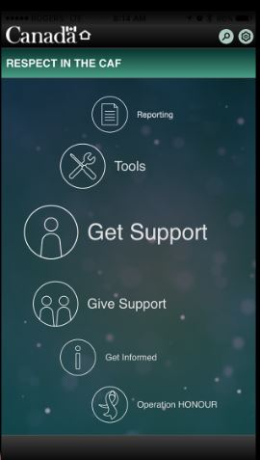
Respect in the CAF – Mobile App
Design is intuitive to use, which is critical to a victim in crisis
Bilingual app (toggle between English and French)
Provides tailored solutions depending on a user’s needs
Content is based on latest research and consultations with experts and affected persons
Provides considerable depth on a broad range of topics in one place
Geo-referenced support resources
For more information on Operation HONOUR see canada.ca/caf-operation-honour
Notes:
This free downloadable app will assist and enable CAF members to deal more confidently and knowledgeably with an incident of sexual misconduct.
Includes downloadable tools, educational information, and resources to support anyone who is dealing with an incident.
App provides:
Guidance and support for victims/survivors, leaders, commanders, bystanders, friends and family
Access to geo-referenced support resources world-wide direct from device (police stations, medical facilities, rape crisis centres, etc.)
A search function that is intelligent and predictive
A software architecture that allows for easy update and expansion
A deliberate design that keeps its use private and confidential
The app is routinely updated to ensure it contains the latest information and to add additional functionality or resources.
If you allow it, the app can use your location to find services nearest you… even when deployed.
These geo-referenced support resources include:
Police, hospital, SMRC, crisis centers, etc.
There are is 227 resources (domestic and overseas) in the database.
Call or get driving directions direct from device.
Info includes: name of resource, location, phone(s), email address, language(s) of service, civilian/military, and links to websites.
Entire list can also be accessed offline or downloaded for sharing.

Slide 24
Questions?
++DPMC-OpH – DCMP-OpH@VCDS@Ottawa-Hull

