Slide 1
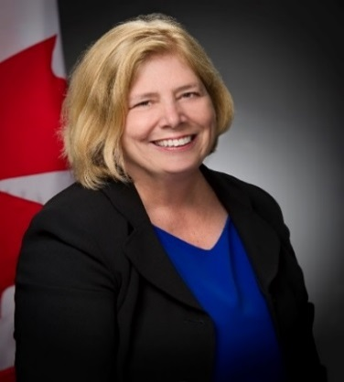
Unclassified
Assistant Deputy Minister (Finance) and Chief Financial Officer – Cheri Crosby
Appointed in June 2019.
Wide range of experience in the Public Sector including; Privy Council Office, Special Advisor to the Deputy Secretary to the Cabinet, Citizenship and Immigration Canada, and Assistant Deputy Minister of Corporate Services and Chief Financial Officer at Natural Resources Canada.
MANDATE
Provide the Minister of National Defence with timely strategic financial advice and guidance on key departmental direction to better support Defence’s mandate and operations.
Be a trusted partner that provides financial support services and advice to enable sound decision-making and accountability across the department.
Lead the departmental financial community by creating a vision for the finance of the future, which further enables the business of Defence.
Key facts
Total Employees:
450
Budget:
$45M per year and $98M for corporate accounts, for a total of $143M
Primary location(s):
National Defence Headquarters (Pearkes Building)
National Defence Headquarters (Carling)
KEY PARTNERS
Internal:
All Defence Team
External: (including other government departments)
Treasury Board Secretariat
Privy Council Office
North Atlantic Treaty Organization
Five-Eyes Partners
Allied countries
Industry
Academia, including Chartered Professional Accountants Canada
L1 picture
TOP ISSUES for Assistant deputy minister (finance)
Treasury Board Submission Plan
2019-20
The Treasury Board Submission Plan is determined by funding availability, project readiness, Departmental and Governmental priorities, and Treasury Board agenda capacity. The 2019-20 Plan proposes 13 Treasury board submissions due for approval by April 2020, requiring close coordination with your office.
Due to the pause in Treasury Board meetings resulting from the election period, the forward agenda is heavily subscribed. There is a risk that not all DND submissions will be considered as planned. If submissions are not approved, it could result in significant financial pressures and project schedule and delivery delays.
Funding through the Estimates Process 2019-20
National Defence funding is comprised of multi-year reference levels approved by Treasury Board each year whereby cash is accessed through the Parliamentary Estimates process.
Due to the election, there is a risk that the Estimates process will not unfold as per the normal budget cycle. Should there not be an opportunity to access the funding in 2019-20, in order to operate within authorities, there is a risk that the department may have to defer or cancel planned spending. This action may impact the execution of departmental priorities.

