Slide 1
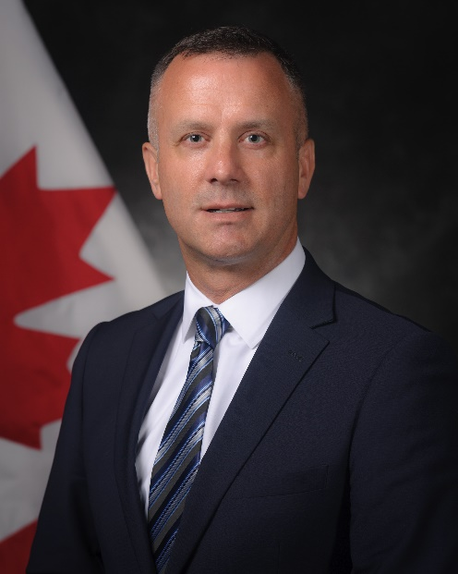
unclassified
Assistant Deputy Minister (Infrastructure & Environment) – Rob Chambers
Appointed in June 2019.
20 years in the Public Service, serving in central agencies such as the Privy Council Office, Treasury Board Secretariat and the Department of Finance, and line departments such as Employment and Social Development Canada and Crown-Indigenous Relations and Northern Affairs Canada.
Former Army Reservist
MANDATE
Managing the full life-cycle of Defence real property
Providing direction and leadership to support DND/CAF’s compliance with environmental obligations
Delivering military housing through the Canadian Forces Housing Agency
Providing guidance and leadership in fulfilling Canada’s obligations and commitments to Indigenous Peoples
Managing fire safety and protection
Ionizing radiation regulation and safety
Key facts
Total Employees: Approximately 3,100
Civilian: 2,700
Military: 400
Budget (FY 18/19): $1.9B
Operating: $1.2B
Capital: $663M
Primary location(s):
National Defence Headquarters (Carling); all Defence establishments
National Defence is the largest and most varied real property portfolio in the federal government with an estimated replacement cost of $26B, as well as largest contributor to the federal Green House Gas emissions baseline (50%)
KEY PARTNERS
Internal:
Treasury Board Secretariat
Crown-Indigenous Relations and Northern Affairs Canada; Indigenous Services Canada
Public Services and Procurement Canada
Environment and Climate Change Canada
Canada Lands Company
Defence Construction Canada
External:
Local Communities
Indigenous Peoples
Other Levels of Government
Industry Associations
Bargaining Agents
NATO & Five-Eyes Partners
L1 picture
TOP ISSUES FOR ASSISANT DEPUTY MINISTER (INFRASTRUCTURE & ENVIRONMENT)
Real Property Portfolio Sustainability
Challenge: There is a growing gap between the condition and suitability of Defence’s real property (RP) portfolio and its current and future capability requirements.
Next Steps: ADM(IE) is working towards identifying the longer-term, strategic RP investments that are required to support the Defence Team’s objectives. The branch is also developing a Portfolio Strategy to improve efficiency and guide the modernization of RP management. As part of the modernization process, an assessment of current RP programme needs will be undertaken to ensure that Defence resources are sufficient to support the organization’s mandate.
Indigenous Affairs Strategy
Challenge: Defence has operational practices that intersect with Indigenous rights ranging from recruitment to military exercises on Indigenous lands to procurement, land remediation and real estate transactions.
Next Steps: A unified approach to Indigenous relations is under development and will help establish departmental priorities for the medium-term. Among others, key activities include:
Review real property policies and procedures to ensure optimal alignment with broader government priorities in Indigenous affairs;
Review procurement policies and procedures to optimize support for Indigenous business in a manner that is consistent with broader procurement priorities.
Environment Strategy Refresh
Challenge: New federal targets on greenhouse gas reduction, plastics and adaptation to climate change will require significant shifts in DND/CAF planning and operations. All these expectations must be met while also addressing legacy liabilities (contaminated sites, UXO) and ensuring that operations meet new and existing regulatory requirements for the environment.
Next Steps: Building on the Defence Energy and Environment Strategy of 2016, ADM(IE) is leading the development of a 3-year strategy that reflects and supports DND/CAF objectives and the Federal Sustainable Development Strategy for 2019-2022. This exercise will help establish departmental environment-related priorities for the medium-term.

