Slide 1
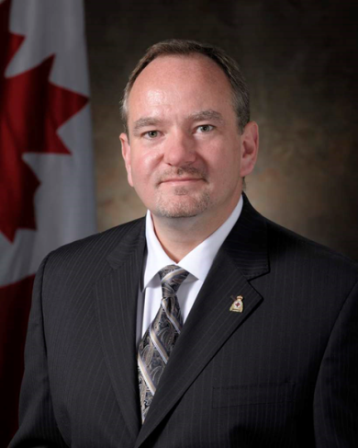
Assistant Deputy Minister (Information Management) and Chief Information Officer - Len Bastien
UNCLASSIFIED
Appointed in 2012
20 years in the Information Technology industry, including 12 years in the Public Service
MANDATE
Deliver timely, trusted and secure information capabilities
Accountable for Cyber Command and Cyber Operations including, Force Generation of Cyber Forces and the Force Development of capabilities to contribute to CAF missions
Oversee the Defence Major Capital Program for digital and digitally enabled capabilities, including cyber, space and command and control capabilities
Operate and maintain all corporate enterprise systems supporting finance, human resources, materiel and infrastructure
Key facts
Total Employees:
3,339 (1823 Civilians, 1516 Military)
Budget:
Fiscal Year 2019/20 $427.8M
Responsible for the management of more than 40 Major Capital Projects with a total value of over $12B
Primary location:
National Capital Region
Operations update:
[redacted]
KEY PARTNERS
Internal:
Vice Chief of Defence Staff
Army, Navy, Air Force
Chief of Military Personnel/ Assistant Deputy Minister (Human Resources - Civilian)
Assistant Deputy Minister (Data, Innovation, Analytics)
Assistant Deputy Minister (Materiel)
Assistant Deputy Minister (Finance)
External (including other government departments):
Shared Services Canada
Communication Security Establishment
Treasury Board Secretariat
Public Safety Canada
U.S. Department of Defense
Five Eyes partners
North Atlantic Treaty Organization
L1 picture
TOP ISSUES for assistant deputy minister (information management)
Major Capital Program
Four projects will seek Expenditure Authority approval from the Minister between November 2019-June 2020:
Cyber Defence – Decision, Analysis and Response ($312M)
Secure Command and Control Mobile Devices ($333M)
Secure Radio Modernization project
Identity, Credentials and Access Management ($47M)
The Minister’s endorsement is required [redacted] to extend a Memorandum of Understanding that ensures DND/CAF’s access to a US protected military satellite until 2034 ($38M)
Evolving Cyber
DND/CAF’s cyber domain will continue to evolve with a focus on:
Clarifying the role of the CAF in the National Cyber Security Strategy
[redacted]
Continuing to improve the Cyber Mission Assurance Program
Shared Services Canada
Assistant Deputy Minister (Information Management) will continue to work closely with Shared Services Canada to:
Evolve a service delivery framework that is mutually-beneficial to the Department of National Defence and Shared Services Canada
Enable digital services and a cloud-by-default culture within DND/CAF
Enabling Analytics within DND/CAF
Assistant Deputy Minister (Information Management) has delivered a corporate analytics capability that continues to evolve and add value to DND/CAF by:
Collaborating with Assistant Deputy Minister (Data, Innovation, Analytics) to establish a data-driven culture within DND/CAF
Defence Resource Business Modernization
The corporate supply chain, real property and financial system, known as the Defence Resource Management Information System has capability deficiencies that need to be addressed to optimize business processes.
The system will undergo a major upgrade over the next seven years with significant department wide effects
Notes:
*As of 22 August 2019 – Total Employees
** As of 22 August 2019 – Operations Update

