Slide 1
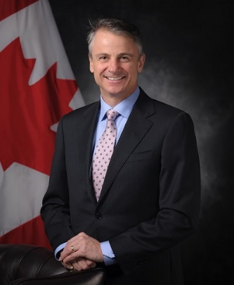
UNCLASSIFIED
Assistant Deputy Minister (Public Affairs) – Chris Henderson
X
Appointed in October 2017.
Head of Communications for the department.
Over the previous 10 years, held senior leadership positions at Canada Border Services Agency, the Privy Council Office, and Coast Guard in program areas and in strategic communications.
Had a distinguished 20-year career with the Royal Canadian Navy.
MANDATE
Provide communications advice, guidance, services and products in support of the Government and its defence priorities
We focus on:
understanding the views of Canadians and defence stakeholders through public opinion research and consultations;
developing and implementing strategic communications plans and products;
leading defence internal and external communications channels;
monitoring and responding to the media;
implementing strategic marketing and advertising related to recruitment.
Key facts
Total Employees:
283 civilian and military
Budget:
$32.4M (2019-20)
Primary location(s):
National Defence Headquarters (Pearkes Building)
National Defence Headquarters (Carling) by March 2020
Has a decentralized model in DND and CAF, with slightly more than 55% of public affairs resources residing and reporting to other senior leaders.
KEY PARTNERS
Internal:
All Defence Team
External: (including other government departments)
Central agencies
Various Other Government Departments (including, Global Affairs Canada, Public Services and Procurement Canada, etc.)
North American Aerospace Defence Command
Defence and security experts community, incl. academia
Defence industry
NATO, Five-Eyes Partners, United Nations
Diversity partners and stakeholders
TOP ISSUES FOR ASSISTANT DEPUTY MINISTER (PUBLIC AFFAIRS)
Communicating About Personnel
Care for CAF personnel and their families is a major institutional priority. Public affairs challenges include:
transition to civilian life;
mental health;
issues related to sexual misconduct, diversity and inclusion, and hateful conduct; and,
institutional progress milestones do not resonate as loudly as examples of individual failures; negative attention will persist.
Communicating About Operations
Stakeholders and media focus on each CAF operation separately, and not as one part of a larger contribution. This results in limited coverage that does not capture the reality of the CAF presence in operations domestically and internationally.
The sum of contributions can be better communicated with routine media briefings on operations.
Adversaries create disinformation and leverage misinformation to disrupt CAF operations. Detecting and correcting is difficult to achieve within legitimate government restraints.
Recruitment, Advertising and Attractions
Support for the CAF is high, but familiarity with CAF operations and career opportunities is low, especially among those in the younger age group.
In an economy with low unemployment, the CAF faces significant competition in attracting qualified and motivated applicants in the 18 to 34 range.
To increase applications from women and individuals with diverse backgrounds, DND/CAF is working to overcome traditional perceptions of the military as a non-inclusive work environment.
Perception of Procurement
Defence procurement is a highly complex process, involving many internal and external stakeholders.
Ongoing public affairs issues:
Major procurement projects with complex histories, such as the Interim Fighter Capability, the Future Fighter Capability, and the Canadian Surface Combatant;
Some negative perceptions of the procurement system (including equipment requirements and number of steps/approvals);
Deviations from initial cost and scheduling estimates that occur with complex projects.
Perception of Defence Spending
Defence spending is a significant portion of federal program spending.
Most of defence spending is on personnel and procurement.
Ongoing communications challenges include:
Negative perceptions of stewardship, transparency and favouring certain companies;
Spending on capital projects;
Spending relative to GDP (NATO 2% guideline) and percentage of spending on equipment (NATO 20% guideline often mentioned in media).

