Slide 1
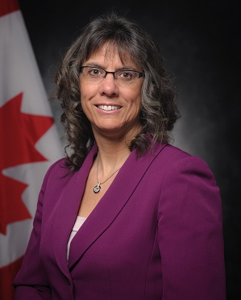
UNCLASSIFIED
Assistant Deputy Minister (Review Services) – Julie Charron
Appointed Assistant Deputy Minister (Review Services) in August 2019 and joined Defence in 2017.
Former Associate Assistant Deputy Minister (Finance), and Acting Assistant Deputy Minister (Finance)/Chief Financial Officer with National Defence, as well as various senior executive positions across government.
Certified Public Accountant, Chartered Accountant, Auditor.
MANDATE
Provides the Deputy Minister and Chief of Defence Staff with independent, objective and timely assurance services concerning:
The integrity of the Department’s financial management and reporting processes;
The effectiveness and adequacy of the Department’s risk management, internal controls, governance and accountability processes;
The compliance with governmental legislation, regulations, policies, and program effectiveness; and,
Performance management.
Serves as Chief Audit Executive, Chief Evaluation Executive, Senior Departmental Internal Disclosure Officer and Senior Ethics Officer for the Department of National Defence and Canadian Armed Forces.
Key facts
Total Employees:
~160
Budget:
Vote 1: $19M
Vote 5: $113K
Primary location(s):
National Capital Region
National Defence Headquarters (Carling)
KEY PARTNERS
Internal:
All Defence Team
External:
Office of the Auditor General
Treasury Board Secretariat (Results sector)
Office of the Public Sector Integrity Commissioner
Institute of Internal Auditors
International Society for Military Ethics
Five-Eyes Defence Fraud and Anti-Corruption Network
L1 picture
TOP issues for Assistant Deputy Minister (REVIEW SeRvices)
Internal Audit Reports
The Office of the Minister of National Defence is briefed on all internal audits and evaluations prior to publishing.
For awareness, the following reports have the potential for high media/political interest:
Business Practices – Public Relations Operations – Fall 2019
Management of Civilian Pay Administration – Winter 2020
Suicide Prevention – Spring 2020
Office of the Auditor General Reports
National Defence is regularly the subject of planned audits from the Office of the Auditor General.
Review Services is the liaison between the Office of the Auditor General and the Department.
There are two upcoming audits that involve the Department of National Defence / Canadian Armed Forces:
Spring 2020: Supplying the Canadian Armed Forces - Focus on timeliness and cost in supplying selected materiel to Canadian Armed Forces members; and,
Fall 2020: National Shipbuilding Strategy - A government wide review - Objective to be scoped during Fall 2019
Publication of Internal Audit and Evaluation Reports
Treasury Board Secretariat policy requires approved audit and evaluation reports to be published publicly within 90/120 days of approval.
As web publication has been suspended over the election period, there is a risk that these standards will be difficult to achieve until the backlog of reports is cleared after publication resumes.

