Slide 1
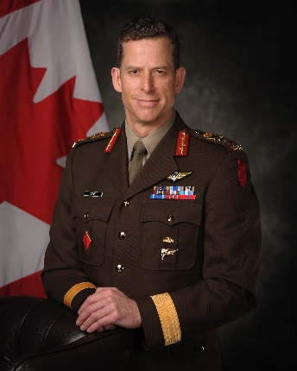
SECRET
Canadian Special Operations Forces Command (CANSOFCOM) – Major-General Pete Dawe
Assumed command of CANSOFCOM (2018)
Previously Deputy Commander CANSOFCOM
Appointed Officer of the Order of Military Merit (2015)
29+ years of service in the Canadian Armed Forces
Deployed to Cyprus, Bosnia, and Afghanistan (x2)
MANDATE
CANSOFCOM provides the Chief of the Defence Staff with agile, high-readiness Special Operations Forces (SOF) capable of conducting special operations in defence of Canada at home and abroad.
Its unifying purpose is the pursuit of operational excellence in the conduct of high-risk, high-value and often politically-sensitive strategic missions.
CANSOFCOM’s new strategic plan, CANSOFCOM 2020: Strategic Relevance. Strong Relationships. Innovative Solutions, will be soon released.
Key facts
Total Employees: 2550
Budget: $218 million
[N.B. An additional $54.2 million is allocated to CANSOFCOM as National Procurement funds]
Units: Joint Task Force 2 (JTF 2); Canadian Special Operations Regiment (CSOR); Canadian Joint Incident Response Unit (CJIRU); 427 Special Operations Aviation Squadron (427 SOAS); Canadian Special Operations Training Centre (CSOTC)
KEY PARTNERS
Internal:
Canadian Joint Operations Command, Canadian Forces Intelligence Command, Canadian Army, Royal Canadian Air Force, Royal Canadian Navy, and Assistant Deputy Minister (Policy).
Inter-agency:
Canadian Security Intelligence Service
Communications Security Establishment
Global Affairs Canada
Public Safety
Royal Canadian Mounted Police
External:
Five Eyes (United States, United Kingdom, Australia, New Zealand) and French SOF
L1 picture
TOP ISSUES FOR CANADIAN SPECIAL OPERATIONS COMMAND
[REDACTED]
CSOR Infrastructure Project
This infrastructure project is designed to provide CSOR – CANSOF’s versatile, multi-mission force – with upgraded facilities able to meet today’s demands.
[REDACTED]
[REDACTED]
Operational Authorities
The dynamic and specialized nature of CANSOF operations often require Ministerial approval.
[REDACTED]
Global Archer 20 (GA 20)
In February/March 2020, national security partners will conduct an exercise focused on [REDACTED]
GA 20 will test and assess whole-of-government policies, protocols, and authorities [REDACTED]
This exercise will build on Exercise Vital Archer 17 [REDACTED]

