Slide 1
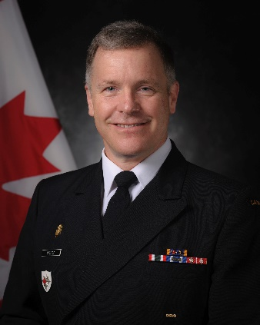
UNCLASSIFIED
Commander Canadian Forces Intelligence Command – Rear Admiral Scott Bishop
Appointed Commander Canadian Forces Intelligence Command and Chief of Defence Intelligence in June 2016 after having served as Director General International Security Policy.
36 years of service with the Royal Canadian Navy, commanded both the Atlantic and Pacific fleets.
Numerous staff appointments, including in the Chief of Defence Staff’s office and the Strategic Joint Staff.
MANDATE
To provide credible, timely and integrated defence intelligence capabilities, products and services to the Canadian Armed Forces, Department of National Defence, Government of Canada and Allies in support of Canada’s defence and national security objectives;
Develop and promulgate policy, processes and governance as the Functional Authority for Defence Intelligence; and
Coordinate and generate intelligence capabilities across the Defence Intelligence Enterprise.
Key facts
Total Employees:
[redacted]
Budget:
Vote 1: $85M
Vote 5: $43.3M
Primary location(s):
National Capital Region
Kingston
Winnipeg
Gagetown
KEY PARTNERS
Internal:
Strategic Joint Staff
Canadian Joint Operations Command
Canadian Special Operations Command
Canadian Army
Royal Canadian Navy
Royal Canadian Air Force
Assistant Deputy Minister (Information Management)
Assistant Deputy Minister (Policy)
External:
Public Safety Canada
Global Affairs Canada
Communications Security Establishment
Canadian Security Intelligence Service
Five-Eyes Allies and North Atlantic Treaty Organization Allies and partners
L1 picture
TOP ISSUES FOR CANADIAN FORCES INTELLIGENCE COMMAND
Defence Intelligence Enterprise Renewal
Joint Chief of the Defence Staff / Deputy Minister Directive (8 May 2019) directing an in-depth review of the Defence Intelligence Enterprise in order to determine how to satisfy current and future demands.
Recommendations may necessitate significant changes to Defence Intelligence Enterprise governance framework, organizational structure, and functional processes.
Avoiding Complicity in Mistreatment
In June 2019, Bill C-59, the Avoiding Complicity in Mistreatment by Foreign Entities Act, became law.
Directions for avoiding complicity in mistreatment by foreign entities have been issued through an Order-in-Council to the Deputy Minister and Chief of the Defence Staff.
Canadian Forces Intelligence Command is finalizing a revised policy suite that clarifies related direction to all Department of National Defence employees and Canadian Armed Forces.
Ministerial Directive on Defence Intelligence
Canadian Forces Intelligence Command is in the process of updating the Ministerial Directive on Defence Intelligence; finalization is expected in 2019.
The new Ministerial Directive will update authorities, responsibilities and accountabilities pertaining to defence intelligence.
External Review
The National Security and Intelligence Committee of Parliamentarians has reviewed defence intelligence and is expected to re-iterate an earlier recommendation that defence intelligence activities be legislated in its forthcoming Special Report on the collection, use, retention and dissemination of information on Canadians.
The National Security and Intelligence Review Agency has signalled its interest in reviewing the Canadian Forces National Counter-Intelligence Unit and the implementation of the Ministerial Directive on Avoiding Complicity in Mistreatment by Foreign Entities Act.

