Slide 1
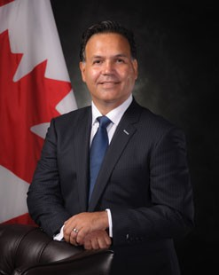
UNCLASSIFIED
Department of National Defence / Canadian Forces’ Legal Advisor - Michael Sousa
Mr. Sousa became Legal Advisor and Senior General Counsel on August 14, 2017.
Previously, Mr. Sousa headed the Departmental Legal Services Units at Public Safety, and Environment Canada.
He has extensive experience managing teams of legal counsel and administrative staff to provide legal services to client departments in relation to their policy, operational and corporate activities.
MANDATE
The Office of the National Defence and Canadian Forces Legal Advisor (DND/CAF Legal Advisor) provides objective and strategic legal advice and services to the Department of National Defence and to the Canadian Armed Forces in all areas of the law, except military law, military discipline and the military justice system, for which the Judge Advocate General is responsible.
Key facts
Total Employees:
71 (28 Civilian, 5 Military, 48 Department of Justice)
Budget:
$25.6M
Primary location(s):
National Defence Headquarters (Pearkes Building)
KEY PARTNERS
Internal:
The Office of the Judge Advocate General
Chief Military Personnel
Assistant Deputy Minister (Materiel)
Assistant Deputy Minister (Infrastructure & Environment)
Assistant Deputy Minister (Public Affairs)
External: (including other government departments)
Department of Justice
L1 picture
TOP issues for Department of national defence / Canadian forces’ legal advisor
[redacted]
[redacted]
[redacted]
[redacted]
[redacted]

