Slide 1
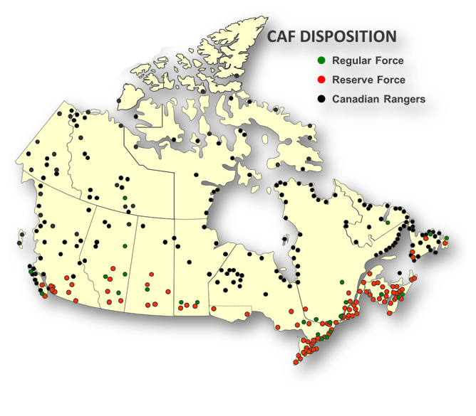
L1 organization (in Arial font, size 19, bold)
CANADIAN ARMED FORCES/DEPARTMENT OF NATIONAL DEFENCE FOOTPRINT
UNCLASSIFIED
UNCLASSIFIED
As at 9 Aug 19
Canadian Armed Forces / Department of National Defence Footprint
Defence Team comprised of Canadian Armed Forces members and civilians of the Department of National Defence
Represented in more than 3,000 communities, DND/CAF have a significant presence in every province and territory
68,000 Regular Force
27,000 Reserve Force
5,183 Rangers in 187 Patrols

Slide 2
L1 organization (in Arial font, size 19, bold)
CANADIAN ARMED FORCES/DEPARTMENT OF NATIONAL DEFENCE FOOTPRINT
UNCLASSIFIED
UNCLASSIFIED
As at 9 Aug 19
Canadian Armed Forces / Department of National Defence Footprint
CAF MILITARY INSTALLATIONS / INSTALLATIONS MILITAIRES DES FAC

Slide 3
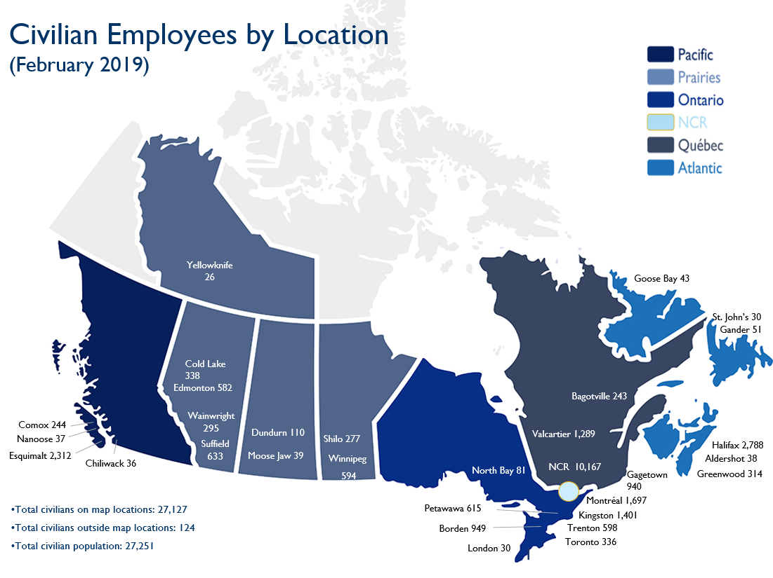
CANADIAN ARMED FORCES/DEPARTMENT OF NATIONAL DEFENCE FOOTPRINT
UNCLASSIFIED
UNCLASSIFIED
An integrated civilian-military team work together to deliver defence objectives
Over 27,000 civilian employees across the country support the CAF

Slide 4
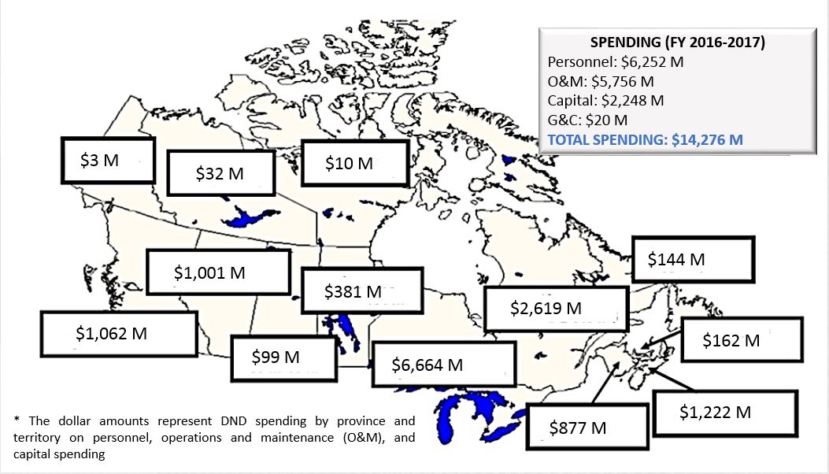
CANADIAN ARMED FORCES/DEPARTMENT OF NATIONAL DEFENCE FOOTPRINT
UNCLASSIFIED
Economic Presence
UNCLASSIFIED

