Slide 1
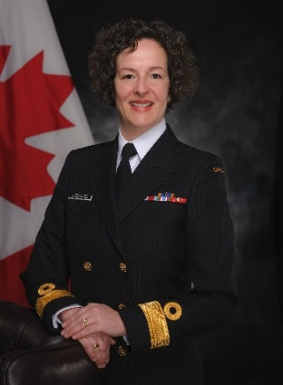
UNCLASSIFIED
Office of the Judge Advocate General – Commodore Geneviève Bernatchez, OMM, CD
SOLICITOR-CLIENT PRIVILEGE
Commodore Bernatchez was appointed as the 15th Judge Advocate General (JAG) by the Governor-in-Council on June 27th, 2017 and is the first woman appointed to the role.
She enrolled in the Naval Reserve in 1987, where she served as a naval warfare officer. In 1997, she transferred to the Regular Force and joined the Office of the JAG.
She previously deployed with the Canadian Air Component during the Kosovo conflict in 1999.
MANDATE
The JAG reports to and is responsible to the Minister in the performance of her duties and functions.
The JAG acts as legal adviser to the Governor General, the Minister, the Department and the Canadian Forces in matters relating to military law, including military justice, operational and international law as well as administrative law.
The JAG is responsible for the superintendence of the administration of military justice in the Canadian Armed Forces (CAF).
Key facts
Total CAF Members & DND Employees: 350
Budget: $10.7M
Primary location(s):
National Capital Region
Halifax
Montreal
Toronto
Winnipeg
Edmonton
Victoria
Colorado Springs (USA), and
Geilenkirchen (Germany).
KEY PARTNERS
Internal:
DND/Canadian Forces Legal Advisor
All Defence Team. JAG is also a member of Armed Forces Council and Defence Management Committee.
External (including other government departments):
Department of Justice
Privy Council Office
Global Affairs Canada
Communication Security Establishment
Canadian Security and Intelligence Service
International Committee of the Red Cross
Canadian Red Cross
JAGs of the Five Eyes Community.
L1 picture
TOP issues for office of the judge advocate general
[redacted]
[redacted]
[redacted]
[redacted]
[redacted]

