Slide 1
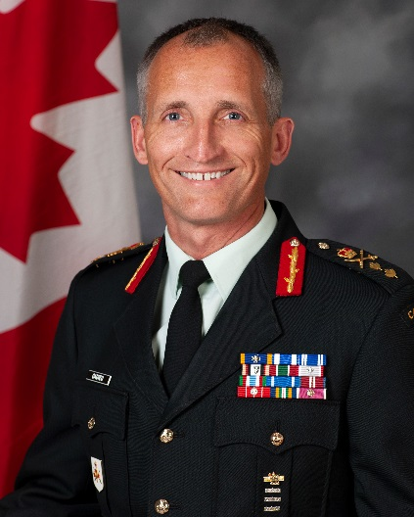
UNCLASSIFIED
Strategic Joint Staff – Major General Trevor Cadieu
Appointed Director of Staff (DOS) 24 June 2019
28 years in the Canadian Armed Forces (CAF) with Operational tours to Bosnia-Herzegovina, Afghanistan and Israel.
Commanded at all levels of the organization.
MANDATE
Provide situational awareness, military analysis and decision support to the Chief of Defence Staff (CDS)
Conduct strategic level engagement with other government departments, allies, and partner nations
Conduct strategic analysis to achieve military strategic effects
Develop and distribute CDS directives and orders
Plan and support Force Posture and Readiness
Synchronize CAF strategic sustainment and support
Arms control verification
Integrate Gender Based Analysis Plus into CAF policies and operations.
Key facts
Total Employees: 212 CAF / 117 civilian
Budget: $58 Million
Primary location:
National Defence Headquarters (Pearkes Building)
Carling Campus
KEY PARTNERS
Internal:
Privy Council Office
Canadian Security Intelligence Service
Public Safety and Portfolios
Canada Border Services Agency
Communication Security Establishment
Other DND/CAF organizations (ADM (Policy), Judge Advocate General, ADM Science & Technology)
Chief of Staff to Minister
External:
North Atlantic Treaty Organization
Five-Eyes Partners (US, UK, NZ, AU)
North American Aerospace Defence Command
United Nations
TOP ISSUES For the strategic joint staff
Command Support to the CDS
Lead the Strategic Command and Control program that directly enables the CDS to make command decisions for the planning and execution of CAF operations. This includes the development of CDS directives and orders, military analysis, and decision support to the Chief to enable their role as principal military advisor to the Government of Canada. This also involves planning the CAF’s activities across the globe that ensure operational sustainability of CAF operations.
Threats to Canada, North America, and Allies
Develop strategy, policy, advice and plans for the CDS on efforts to address threats stemming from terrorism and the actions of violent extremist organizations, including in ungoverned spaces.
This effort is done in close coordination and collaboration with the Government of Canada’s national security team, and with allies and partner nations. The CAF remains ready to respond on short notice for global response.
Force Posture and Readiness
Develop an analytical tool that measures CAF posture and readiness to conduct domestic and international operations in order to fulfill the CAF core mission mandate and concurrent operations target identified in Canada’s defence policy − Strong, Secure, Engaged.
Defence supply chain management
CAF lead for Defence Supply Chain Governance which includes upkeep and modernization, as well as interoperability with allies, key partners, and industry.
Provide sustainment and support statement advice to the CDS, coordinate logistic support across the CAF and ensure balance between operational effectiveness and strategic resource management.
Strategic Effects and Targeting
CAF lead for the coordination of strategic effects and targeting in support of CAF operations.
This includes using an outcome based decision making methodology as the primary means for synchronizing effects, setting priorities for strategic capabilities and resources in pursuit of Government of Canada and CAF objectives.

