Slide 1
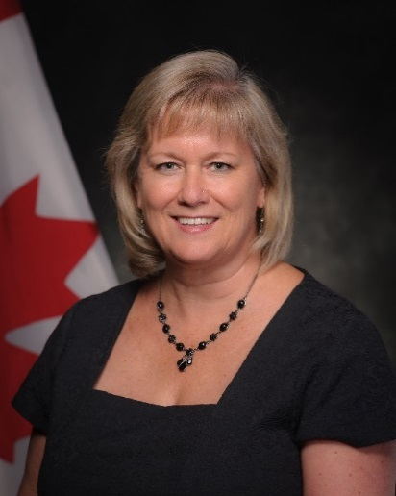
UNCLASSIFIED
Sexual Misconduct Response Centre – Executive Director, Dr. Denise Preston
Joined the Department of National Defence as Executive Director of the Sexual Misconduct Response Centre in May 2017
Previously worked for the Parole Board of Canada for 8 years, and as Psychologist for the Correctional Service of Canada for 19 years
She is a graduate of Queen’s University, with a Ph.D. in Psychology, is registered with the College of Psychologists of Ontario, and is a member of the Canadian Psychological Association
MANDATE
The Centre provides support services or refers to support services for Canadian Armed Forces members who are affected by sexual misconduct (since 2015)
The Centre provides guidance and recommendations to the military that shape the development and implementation of policies and programs to eliminate sexual misconduct in the military (new since April 2019)
The Centre monitors progress of military policies and programs, providing independent, external analysis of their effectiveness and recommendations for improvement (new since April 2019)
KEY FACTS
Total Employees: 58 (Permanent, Casual, Students and Military staff)
Budget:
Fiscal Year 2019-20 $5,014,525
Operating & Maintenance $1,195,317
Civilian Salary $3,077,685
Case Management System $151,855
Grants & Contributions $500,000
Reserve Pay $189,668
Primary location(s): Ottawa. Regional presence to be planned.
KEY PARTNERS
Internal:
Vice-Chief of the Defence Staff
All Level 1s (heads of branches and services)
Directorate of Professional Military Conduct – Operation HONOUR
Judge Advocate General
Canadian Forces Health Services
Military Police/Canadian Forces National Investigative Service
Integrated Conflict and Complaint Management (includes harassment investigation)
Chaplain General
National Defence/Canadian Forces Ombudsman
External (including other government departments):
External Advisory Council to the Centre
Department of Justice
Women and Gender Equality Canada
Five-Eyes partners (United States, United Kingdom, Australia, New Zealand)
L1 picture
TOP issues for the sexual misconduct response centre
Resource Capacity
Implications of Expanded Mandate (approved April 2019): More demands on our personnel and higher profile
Budget: Significant increase recently approved by the Investment and Resource Management Committee ($2,738,786 in two phases for 21 more positions)
Specialized skillsets: New positions require special skills that may be difficult to find, particularly within government
Program/Project Delivery
Contribution Program: Approved in December 2018, provides 4 years of funding to sexual assault centres in communities near 10 most populated bases. Launched August 2019.
Independent Legal Advice: Funding provided in 2019-20 to establish a program to provide legal advice (not representation) to victims; to be modelled after provincial examples
Prevention and Training: Developing comprehensive prevention plan to support the military’s culture change strategy
Auditor General Fall 2018 Report: Management Action Plan
National Victim Support Strategy: Will set standards and objectives for support to victims across all military partners and stakeholders. Implementation plan to be completed this Fall-Winter
Response and Support Coordination: New program providing case coordination, accompaniment, advocacy, and in-person support to victims (in addition to other supports already offered). 1st phase launched in Aug 2019. Rolling out over next 18-24 months
Heyder-Beattie Sexual Misconduct Class Action Settlement
Restorative Engagement Program: For class members to share their experience of sexual misconduct with senior defence representatives with the help of restorative practitioners
Victim/Survivor Support Consultations: The Centre, along with parts of the military, will meet class member representatives to seek input on enhancing Defence Team resources and support programs
External Review: Of progress on sexual misconduct, to be conducted in 5 years
Policy / Legal
New Military Policy on Sexual Misconduct Response: Military consulting the Centre on this as it will be major part of the policy framework on sexual misconduct
Duty to Report: Military consulting the Centre on this issue; will require changes to Queen’s Regulations and Orders to exempt victims and service providers from being obligated to make a formal report to authorities.
Enhanced Reporting Options: Examining options for alternative reporting mechanisms for victims; known as restricted or third-party reporting

