Slide 1
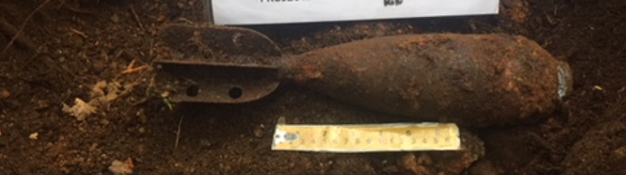
UXO Safety for Kids
OFFICE OF THE DEPUTY MINISTER
ASSISTANT DEPUTY MINISTER (INFRASTRUCTURE AND ENVIRONMENT)
Former Blair Rifle Range, North Vancouver

Slide 2
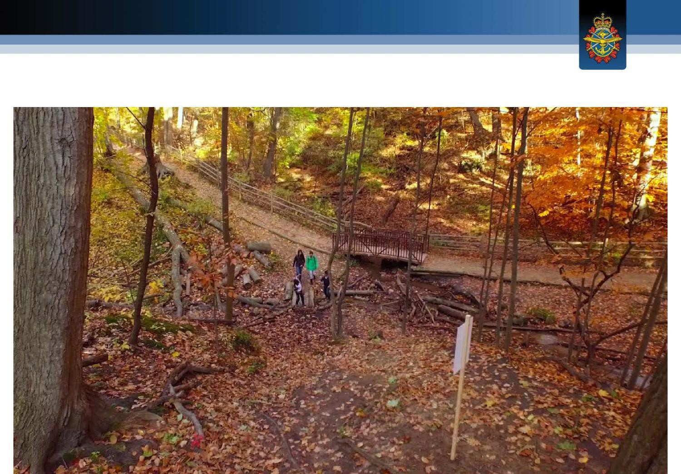

UXO safety video
Notes:
Click to play.
Note: The video was made with the old UXO signs, the new UXO signs used at the former Blair Rifle Range are shown in the presentation.

Slide 3
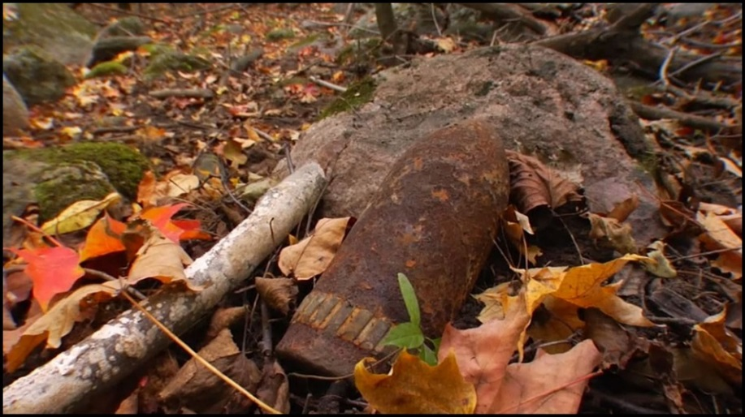
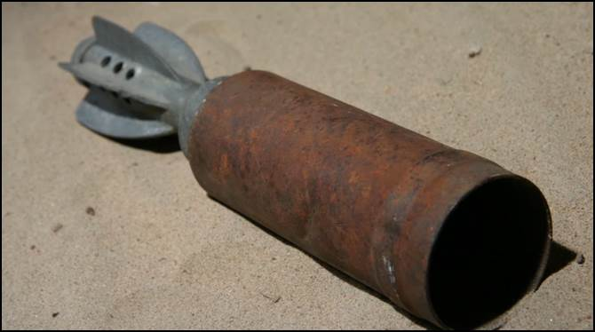
What is UXO?
UXO = Unexploded eXplosive Ordinance
UXO is an old bomb that didn’t explode when it was supposed to. It can still be very dangerous.

Slide 4
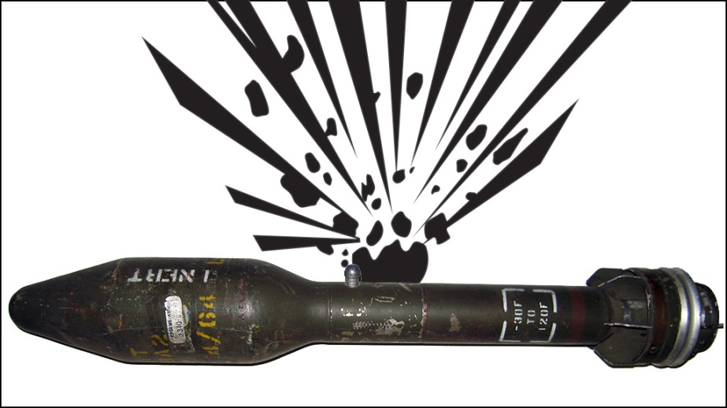
UXO is very dangerous!
UXO is dangerous: Don’t touch it!

Slide 5
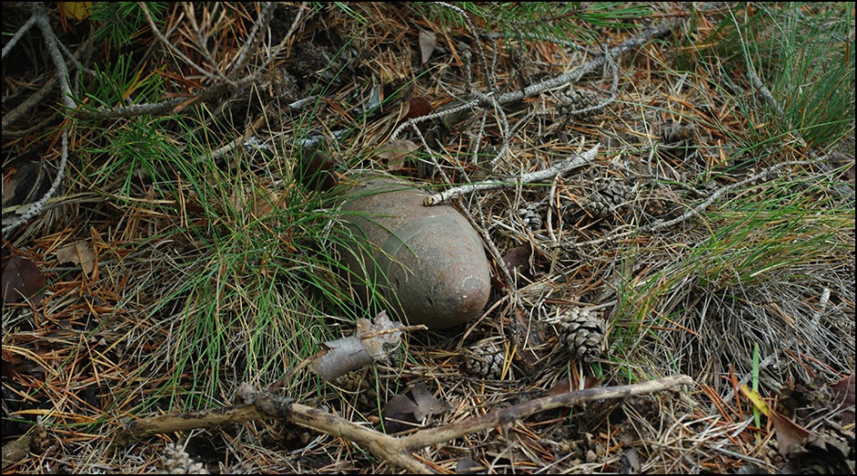
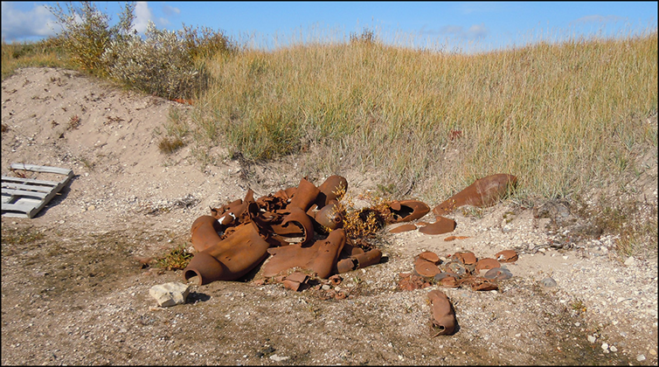
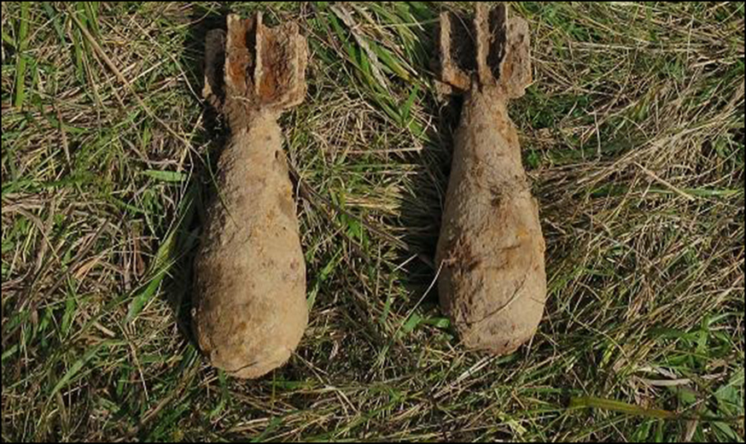
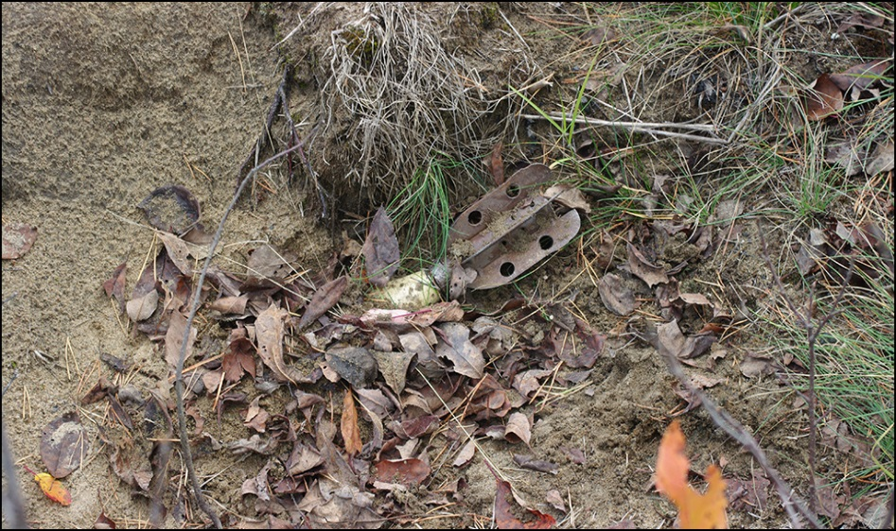
What does UXO look like?
UXO can look like scrap metal, rusty pipes, or garbage. They come in all different shapes, colours and sizes.

Slide 6

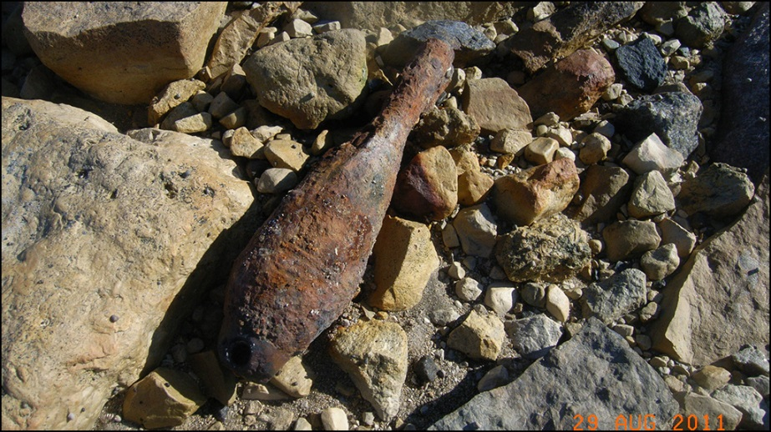
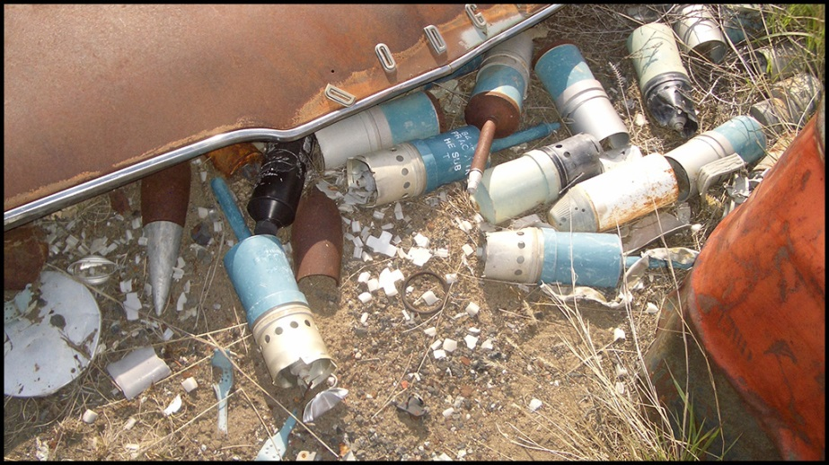
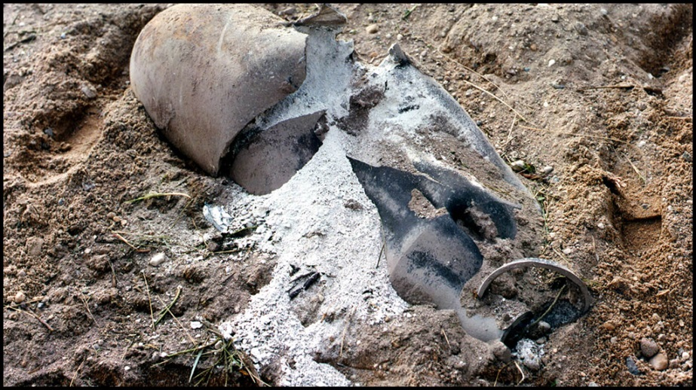
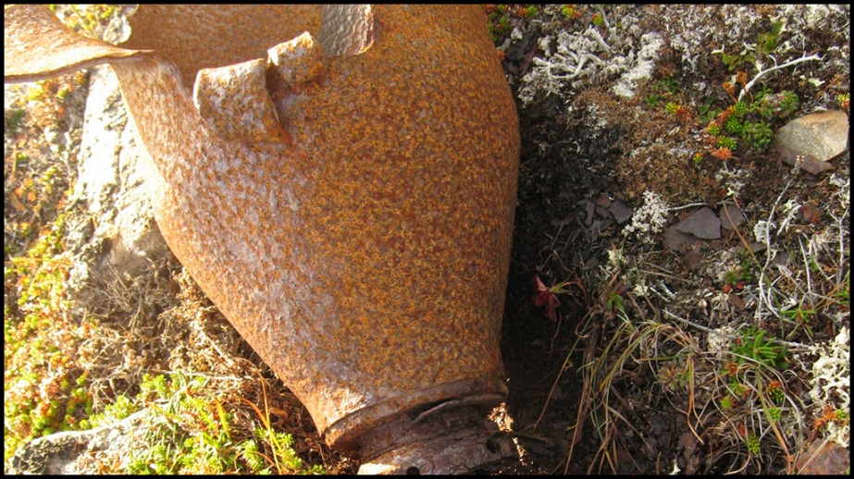
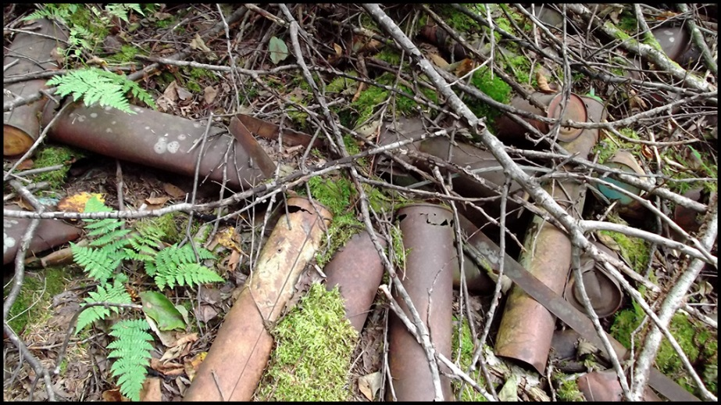
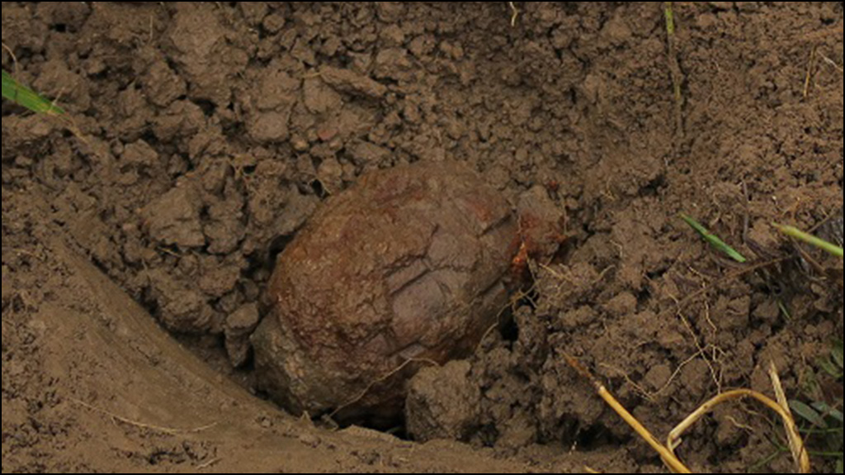
Is this UXO?
5
1
2
6
4
3
Notes:
Discuss the visual nature of the six items and ask the group by show of hands if they think each item is a UXO.

Slide 7







They are all UXO!
1
2
3
4
5
6
Notes:
These images show that UXO isn’t always easy to spot. All these items look different, but they can all be very dangerous. We need to remember that UXO comes in all sorts of different shapes, sizes, and colours.
Looks like a rusty bowling pin or bottle
Pointy and blue, looks like a car part
How many think this item can still be dangerous even though it’s broken?
Looks like an old rusty light bulb
Looks like rusty pipes – let’s say you are out hiking and you find a pile of rusty pipes, how many think that is suspicious? Should we be finding rusty pipes lying around?
Looks like an old rock covered in mud
All of these items are in fact UXO.

Slide 8
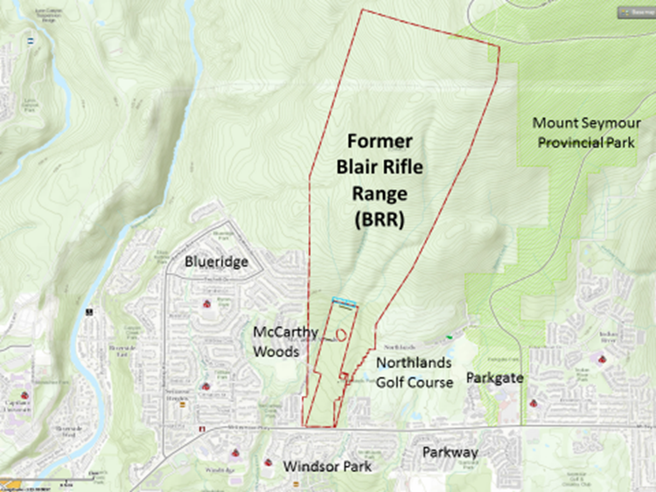
The former Blair Rifle Range

Slide 9
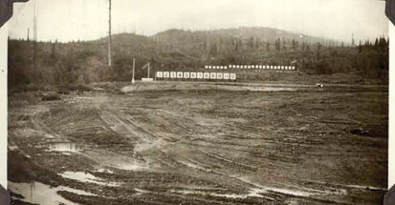
Former Blair Rifle Range – Then
A long time ago, soldiers used to train in this area before they went to war.
Some of the bombs they were practicing with didn’t explode like they were supposed to.
A photo of the old military training area at the Blair Rifle Range.
Notes:
The former Blair Rifle Range was a training area for Canadian military troops from 1931 to the late 1960s.
Soldiers practiced firing rifles, pistols, mortars and grenades.

Slide 10
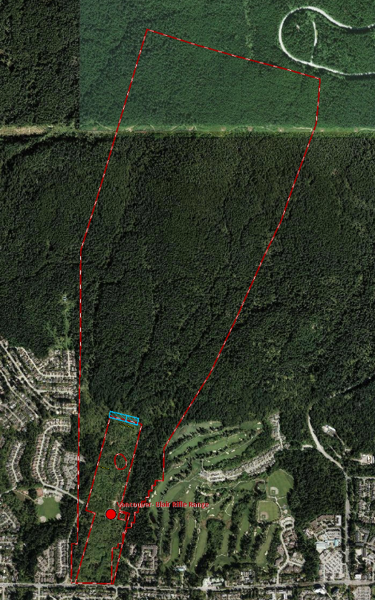
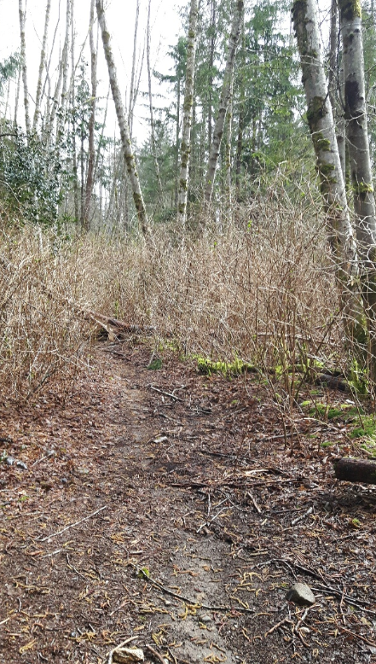
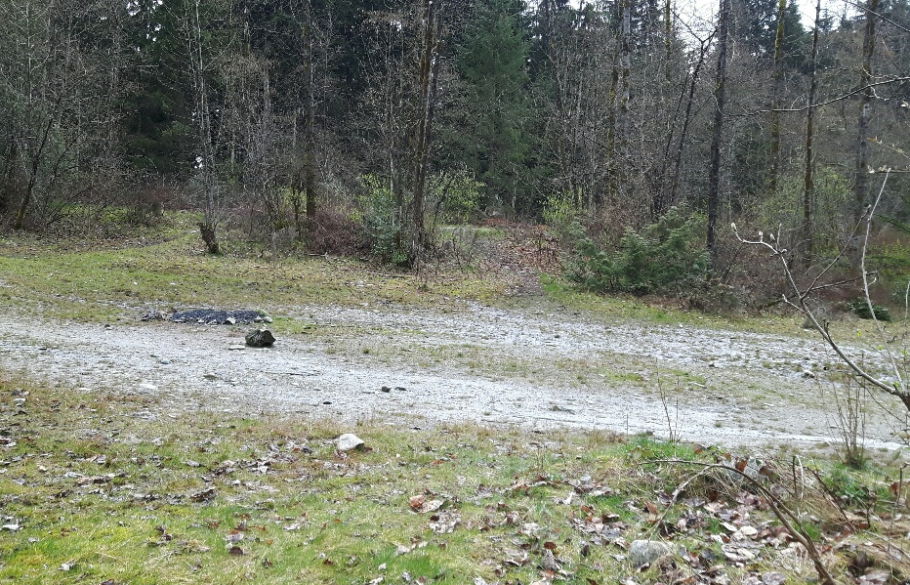
Former Blair Rifle Range – Today
Today, this area is used for hiking, biking, dog walking, and gatherings.
Photos of what the area looks like today.

Slide 11
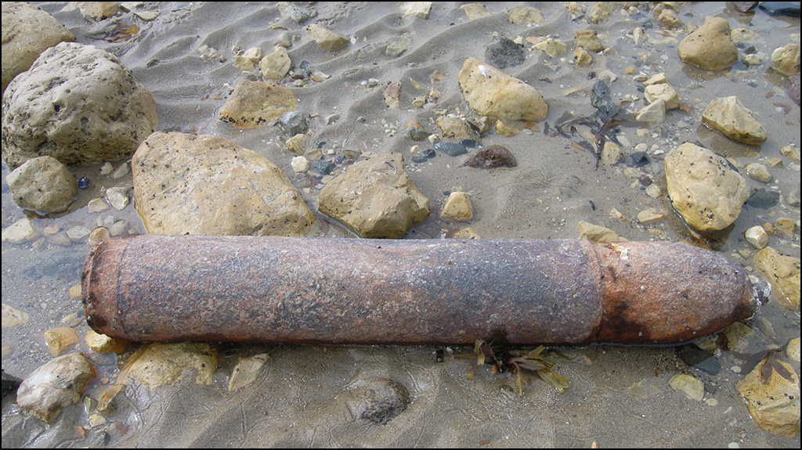
True or false?
UXO can still be dangerous even if it’s 100 years old?
True – It doesn’t matter if it’s 20, 50 or even 100 years old. UXO can always be very dangerous!
True

Slide 12
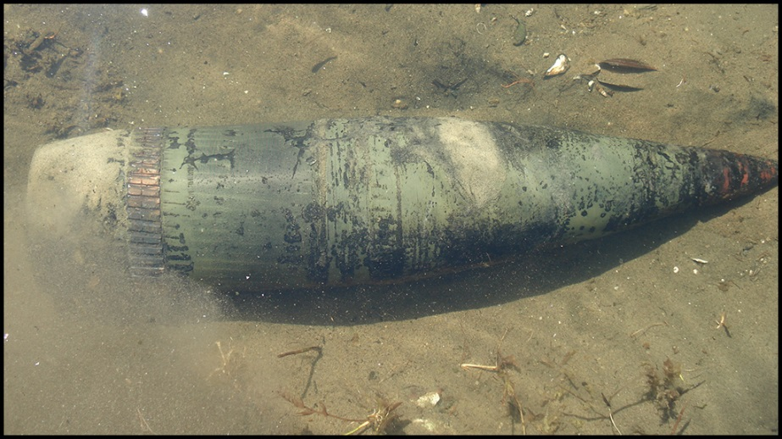
True or false?
All UXO looks the same and is easy to spot.
False
UXO comes in many different shapes, sizes and colours. Remember those 6 photographs we just saw? They all looked completely different but they were all UXO.

Slide 13
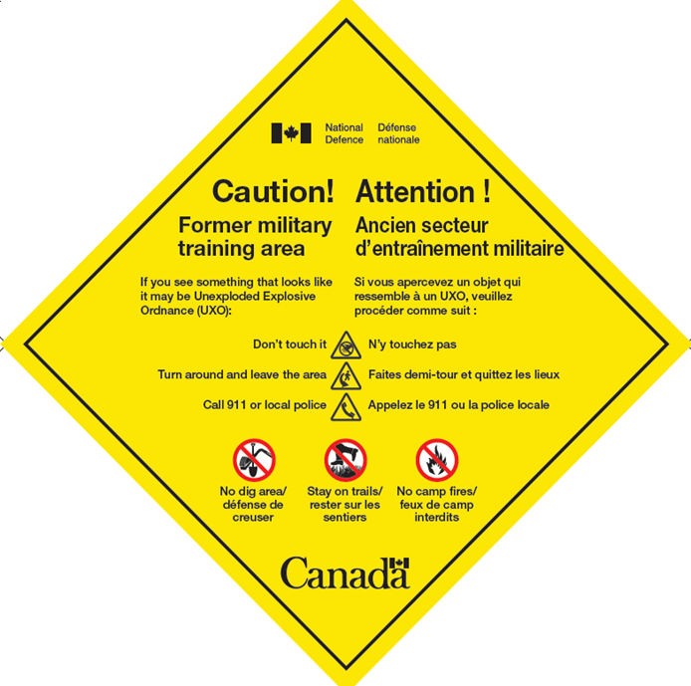
UXO warning signs
UXO can still be found here in the North Vancouver area, so you might see this sign.
It lets you know you’re entering an old military training area and it’s possible to find UXO here.
Remember the three safety steps.

Slide 14

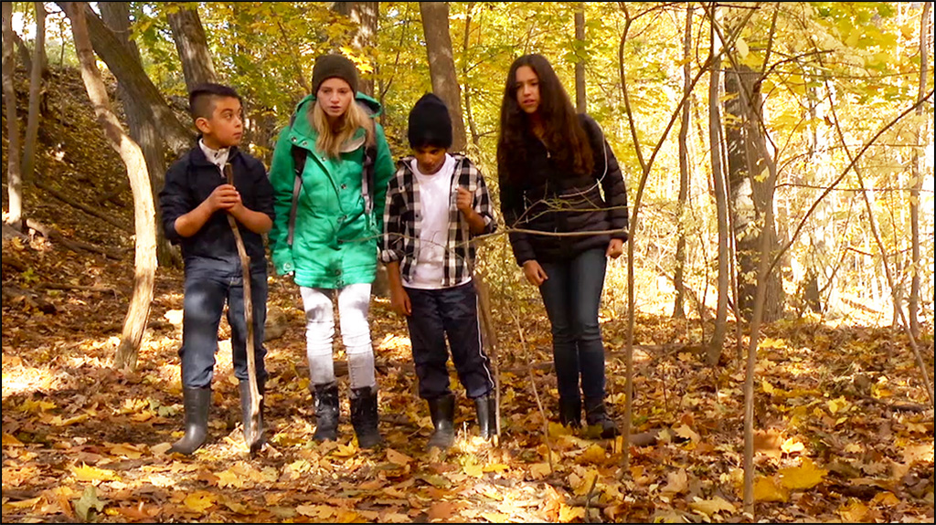
1. Don’t touch it!
1

Slide 15

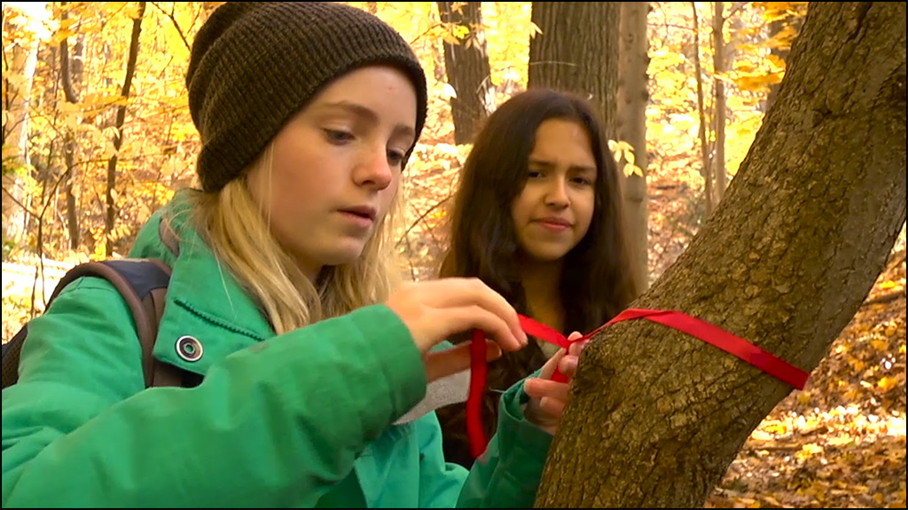
2. Remember where you found it and go back the same way you came
2

Slide 16

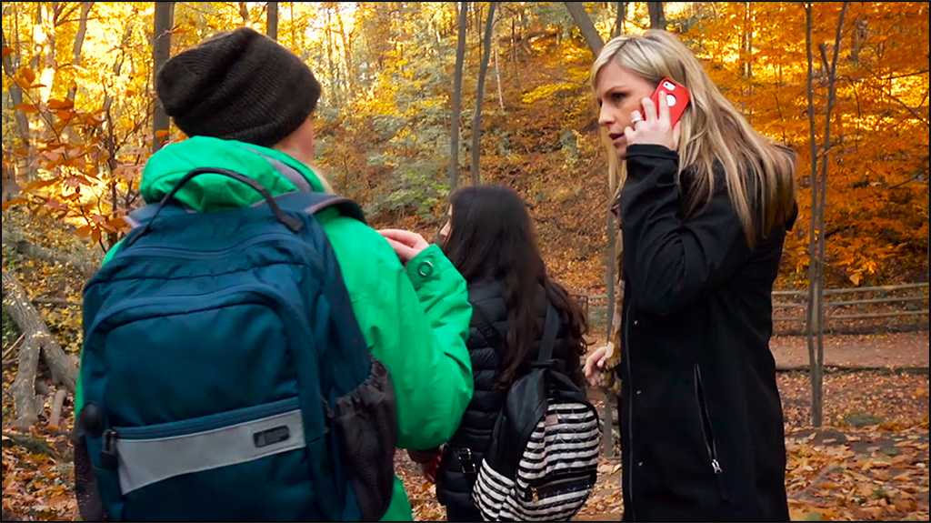
3. Tell an adult
3

Slide 17

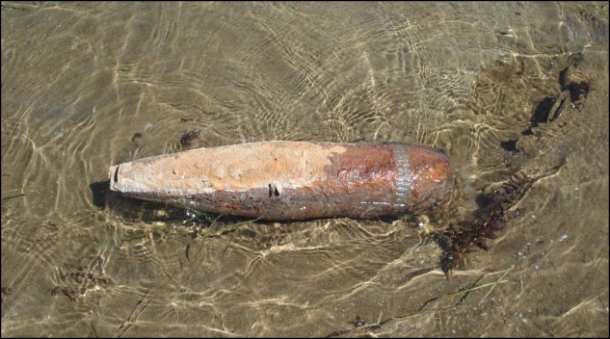
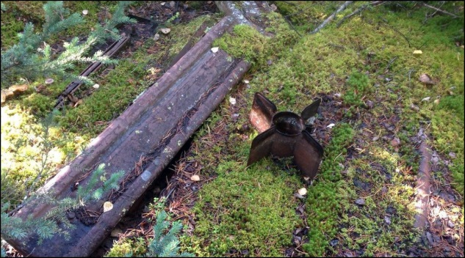
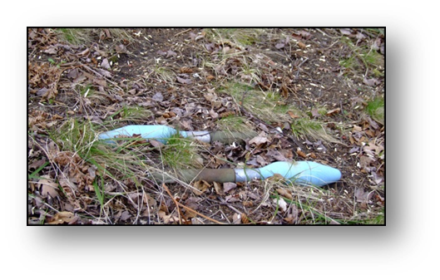
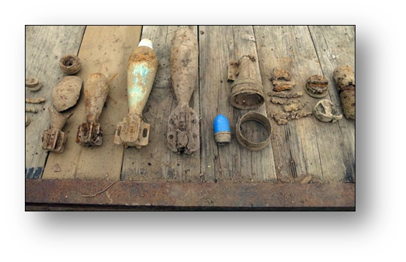
Remember: All UXO is very dangerous
1

Slide 18
For more information
1
For more information visit:
www.Canada.ca/UXO-Safety

