Slide 1
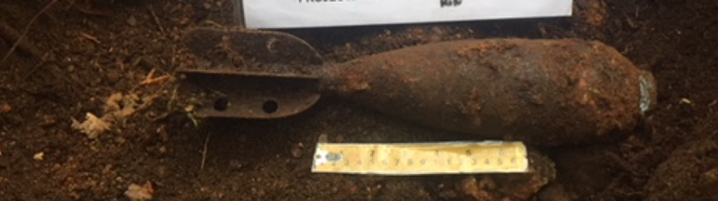
UXO Safety for Teens
OFFICE OF THE DEPUTY MINISTER
ASSISTANT DEPUTY MINISTER (INFRASTRUCTURE AND ENVIRONMENT)
Former Blair Rifle Range, North Vancouver

Slide 2
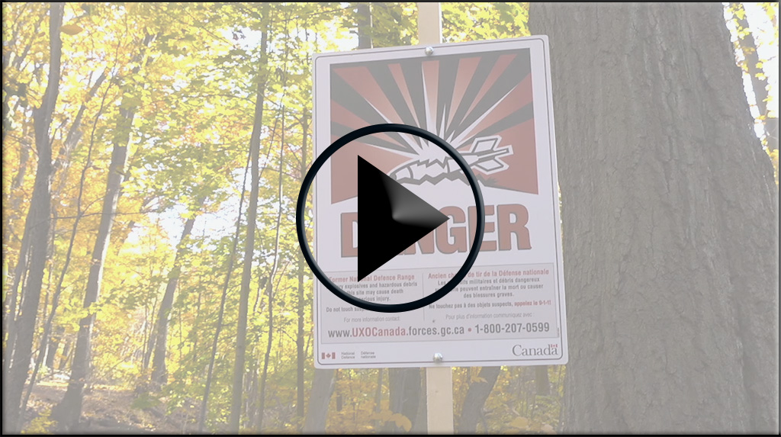
UXO safety video
Notes:
Click to play.
Note: The video was made with the old UXO signs, the new UXO signs used at the former Blair Rifle Range are shown in the presentation.

Slide 3
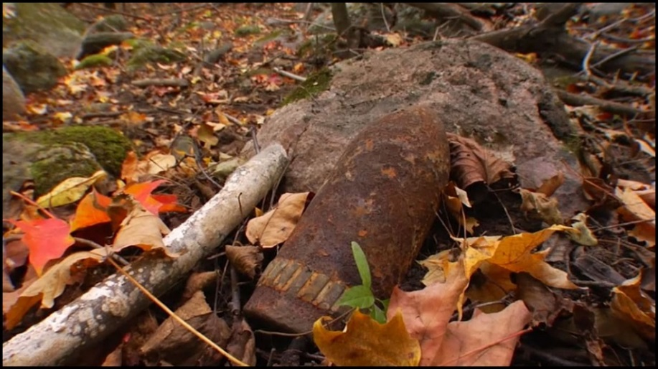
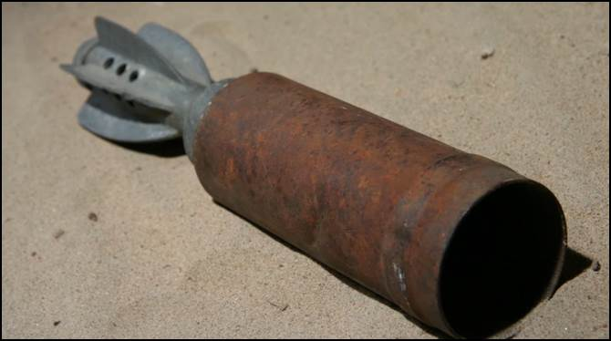
What is UXO?
UXO = Unexploded eXplosive Ordnance
UXO is a live munition that was armed and fired but did not function as designed. Even today, it remains dangerous.

Slide 4
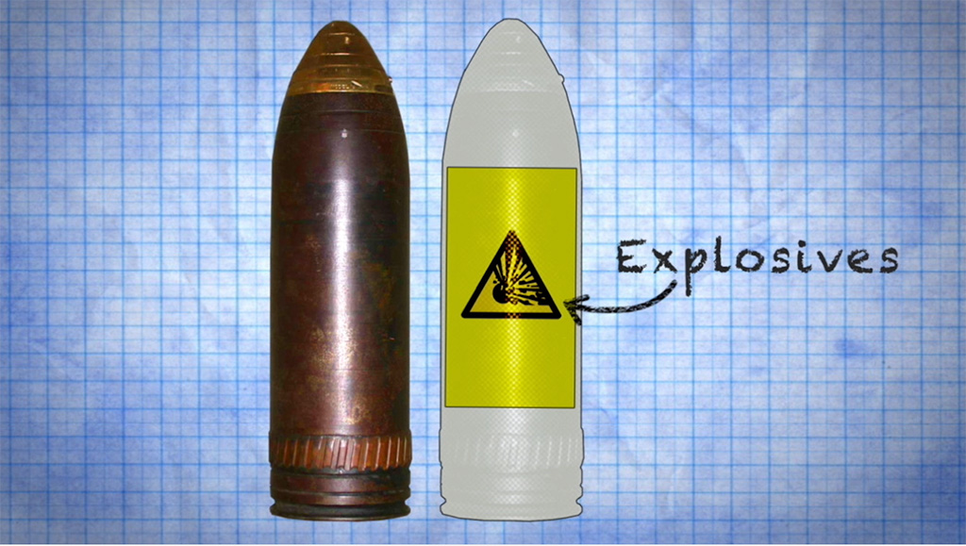
Why is UXO dangerous?
1- UXO contains explosive/energetic material.

Slide 5
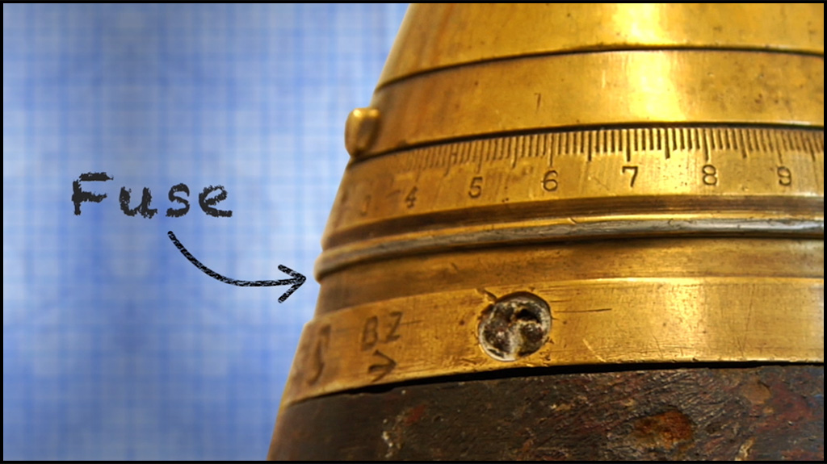
Why is UXO dangerous?
2- Fuses may not have worked properly when fired and remain very sensitive years later.

Slide 6
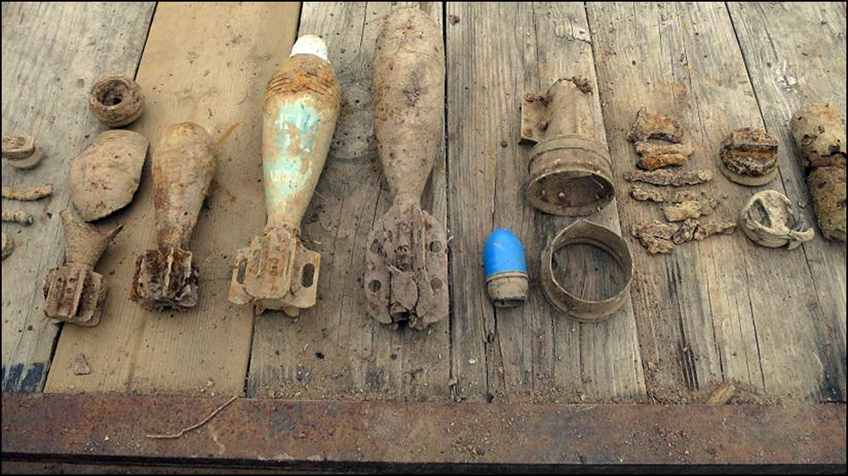
Why is UXO dangerous?
3- Items may be rusty, and found in multiple parts, or they can look like old scrap.

Slide 7
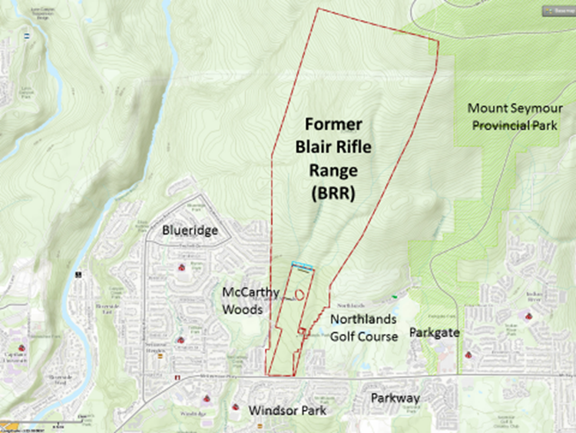
Former Blair Rifle Range

Slide 8
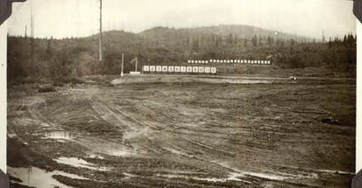
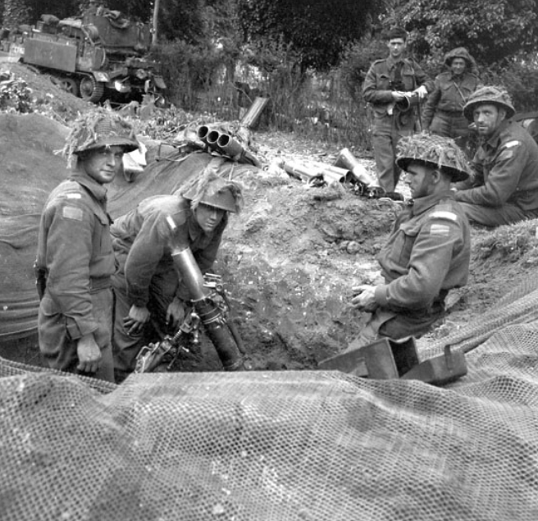
Former Blair Rifle Range – Then
The former Blair Rifle Range was a training area for the Canadian military from 1931 to the late 1960s.
Soldiers practiced firing rifles, pistols, mortars and grenades in preparation for war.
Top: a photo of the old military training area.
Bottom: soldiers firing mortars at another site.

Slide 9
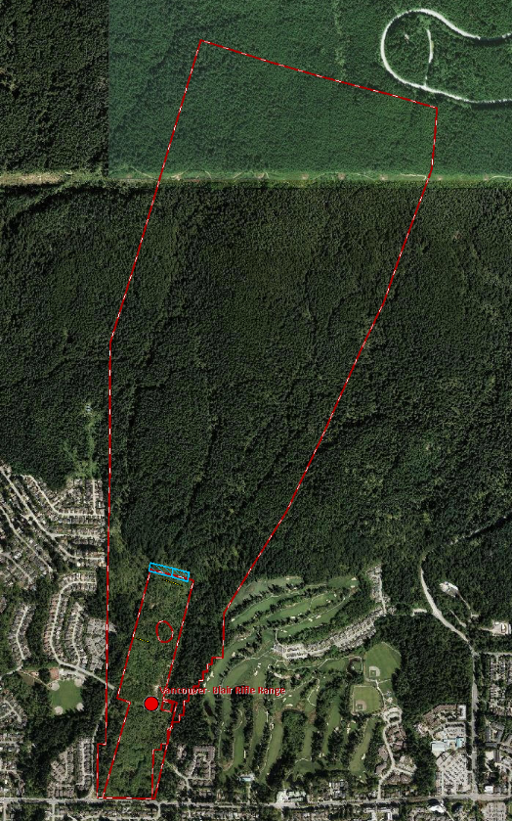
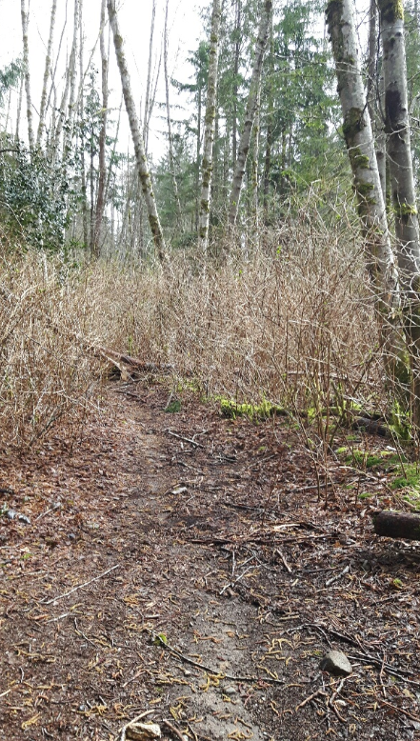
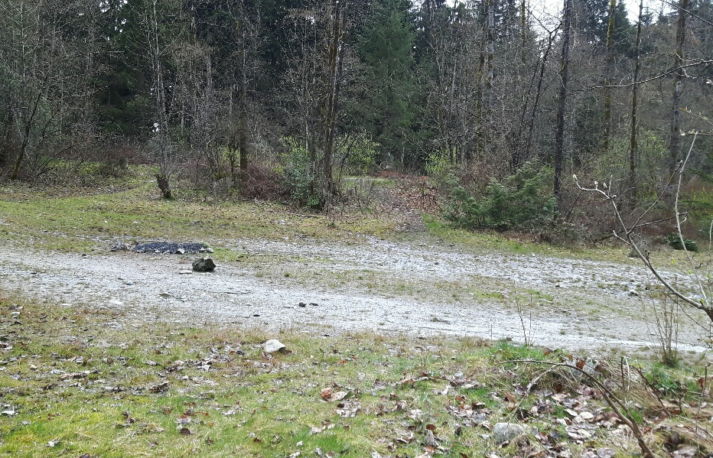
Former Blair Rifle Range – Today
Today, this area is used for hiking, biking, dog walking, and gatherings.
Photos of what the area looks like today.

Slide 10
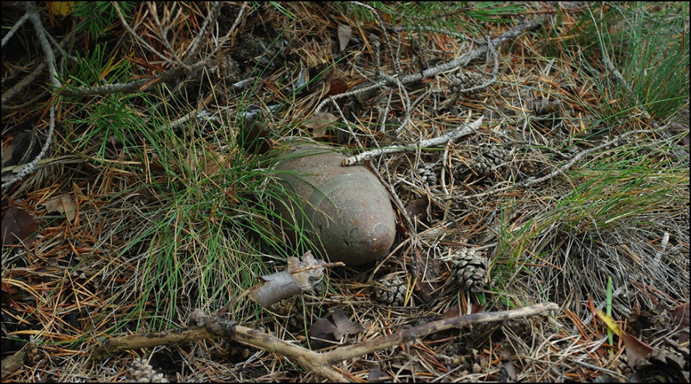
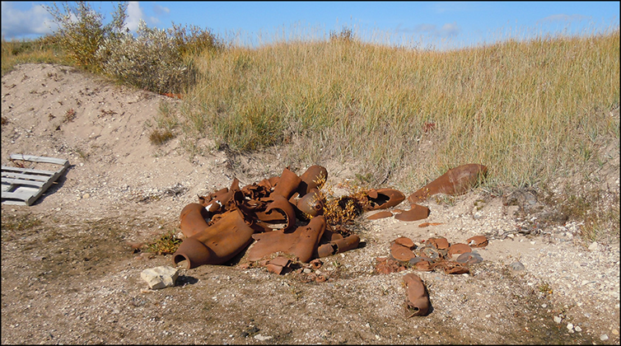
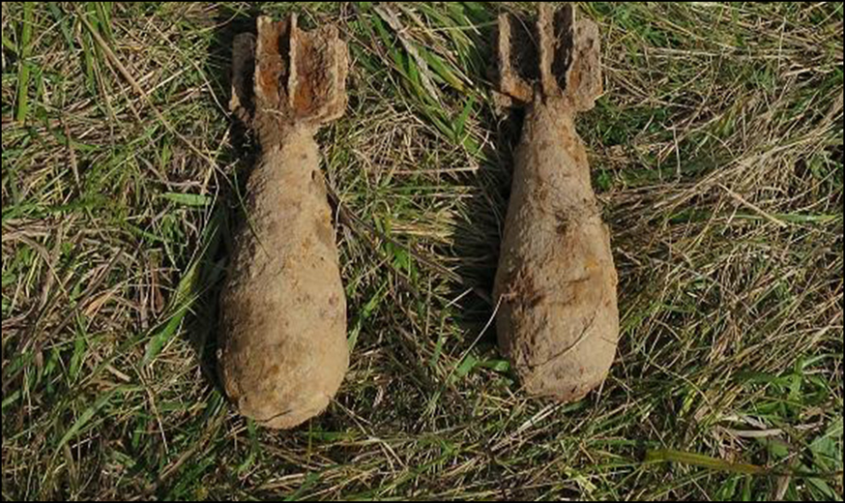
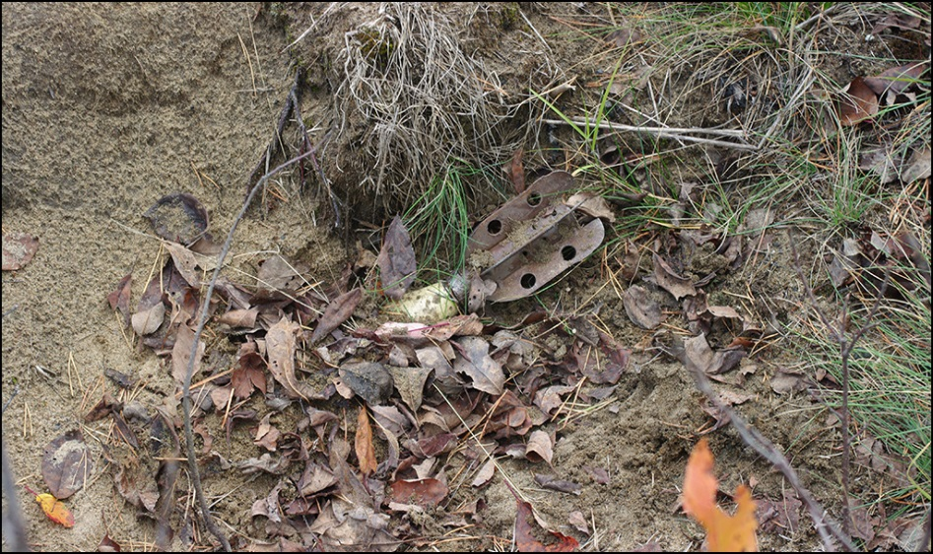
What does UXO look like?
UXO can look like scrap metal, rusty pipes, or garbage. It comes in all different shapes, colours and sizes.

Slide 11

All UXO is very dangerous
There have been instances where people who found and touched UXO were seriously injured.
UXO might look old and harmless but it can still be very dangerous.

Slide 12
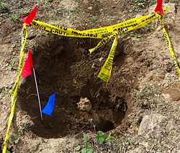
Finding and removing UXO
Finding UXO is sometimes like finding a needle in a haystack.
UXO are found and removed by qualified military and UXO technicians through the following steps.
James, please find images to add here!! Thanks

Slide 13
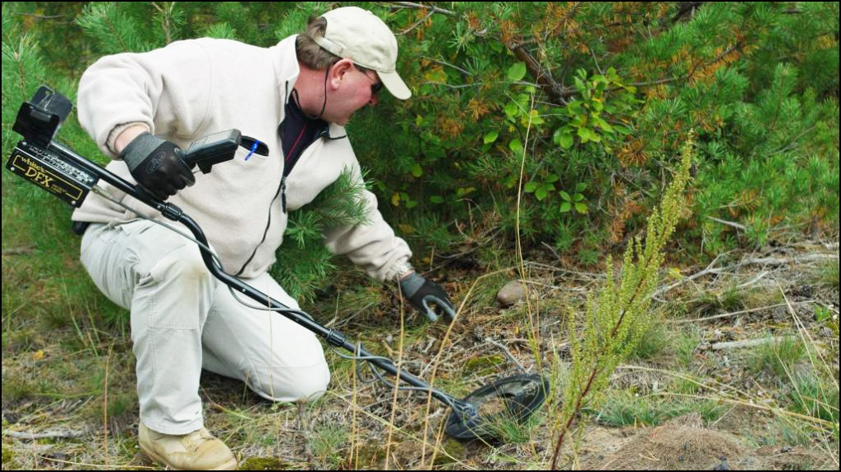
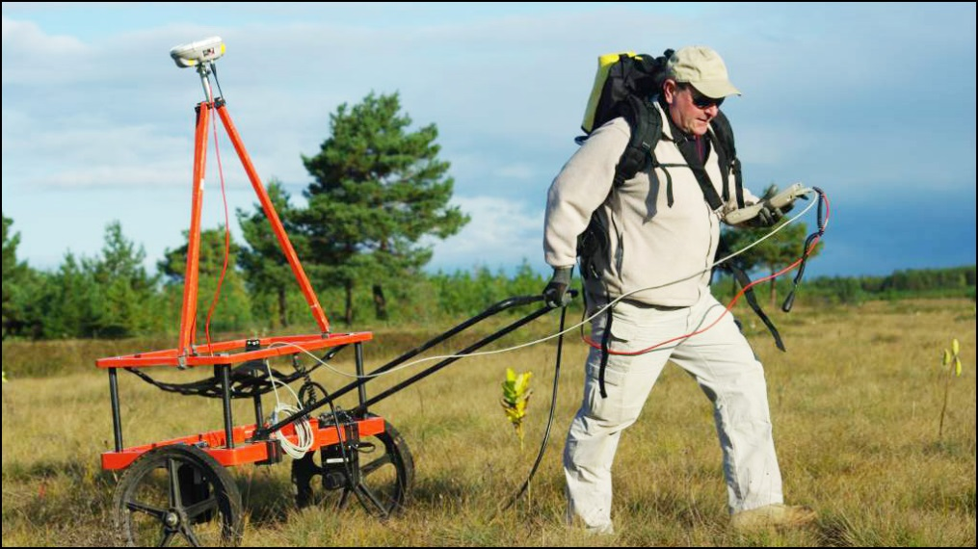
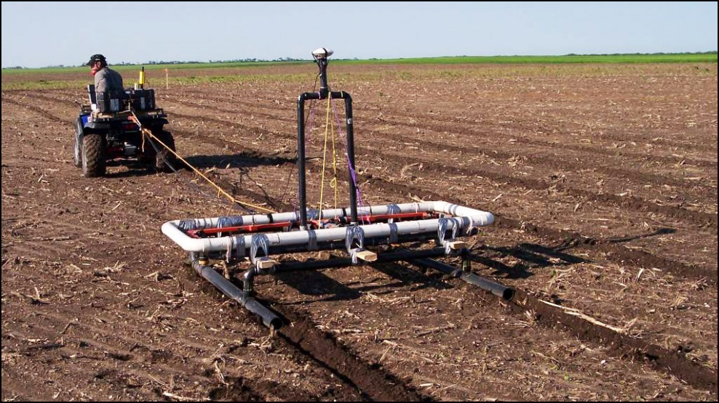
UXO survey and removal
STEP 1: UXO experts use special equipment to survey the land and identify areas in the ground where UXO may be located.
Notes:
Images:
Top left – Handheld equipment
Bottom left – Carts
Bottom right – Geophysical mapping system

Slide 14
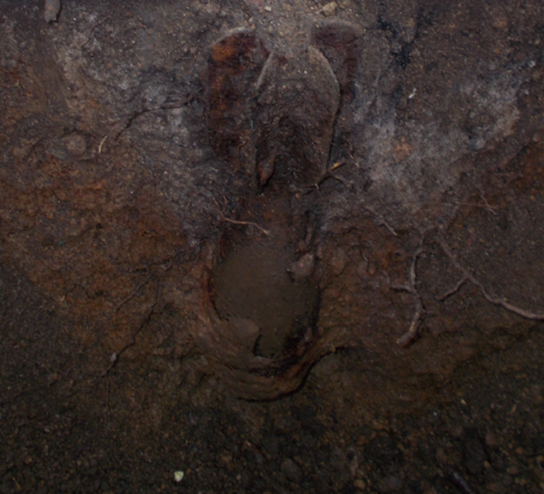
UXO survey and removal, cont’d
STEP 2: Crews dig around these areas to see if UXO is buried there.
Usually, it’s only pieces of munitions scrap or metal that are found.
Thick brush and forested areas generally make this process more difficult.

Slide 15
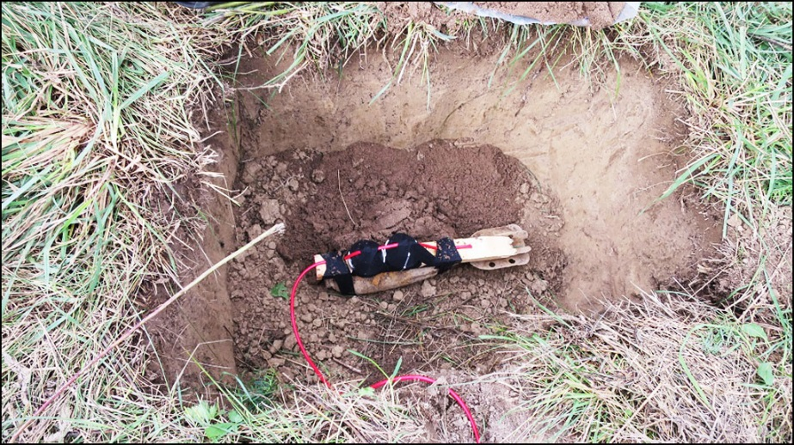
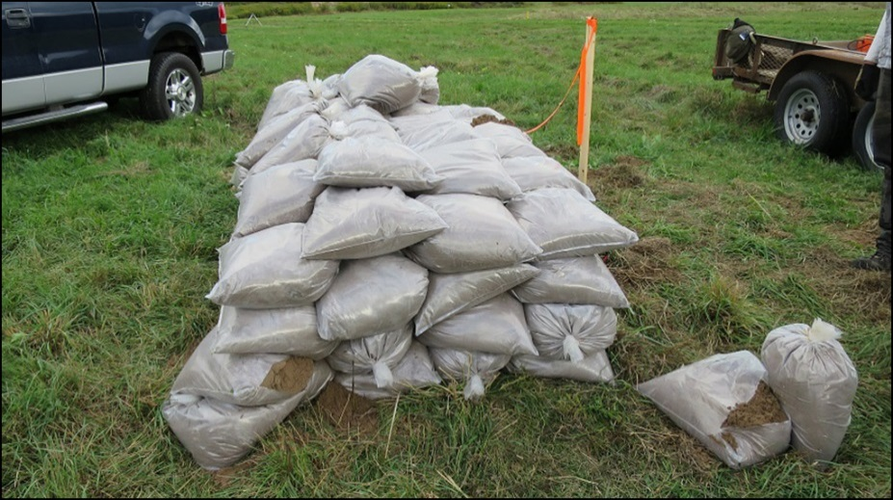
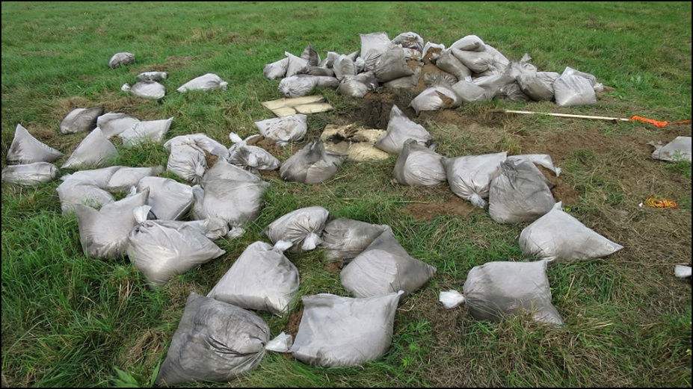
UXO survey and removal, cont’d
STEP 3: In some cases, on-site detonation is the safest way to dispose of UXO. This involves adding explosives to the item and covering it with sandbags to reduce the noise and sound of the blast.
Notes:
Images:
Top left – C4 added to item
Bottom left – Adding sandbags
Bottom right – After detonation

Slide 16
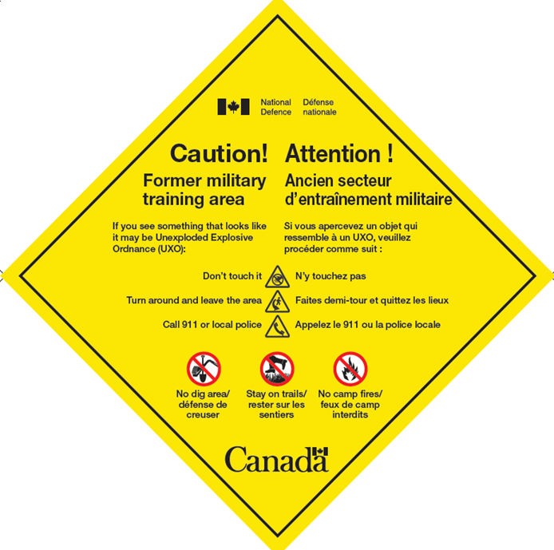
UXO warning signs
This sign lets you know you’re entering an old military training area, and that it’s possible to find UXO here.
Always use good judgement and caution in areas where you see this sign.
Notes:
When you see this sign, you should always keep the safety steps in the back of your mind in case you see something that looks suspicious.

Slide 17



UXO warning signs
These signs include steps to keep you safe.
Notes:
These signs identify the steps to stay safe while in the area:
Stay on marked trails – Work has been done on the trails and open areas to keep them safe.
Do not dig in the area – UXO at the site are found below the ground.
Do not make campfires in the area – Heat from a campfire can warm the ground and make UXO explode.

Slide 18


What to do if you find UXO?
If you see something that looks like it may be UXO:
Don’t touch it.
Remember the location and leave the area the same way you came in.
Call 911 or local police.

Slide 19
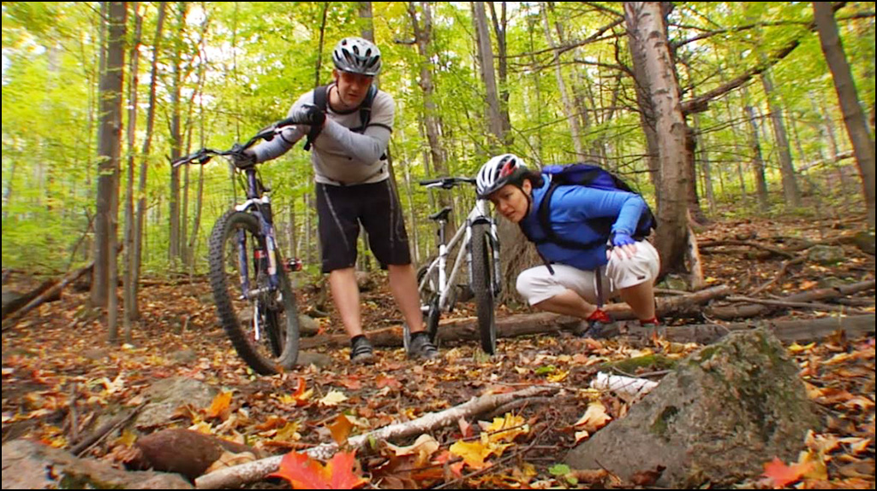
1. Don’t touch it!
The most important thing to remember is we shouldn’t touch or disturb these items.

Slide 20
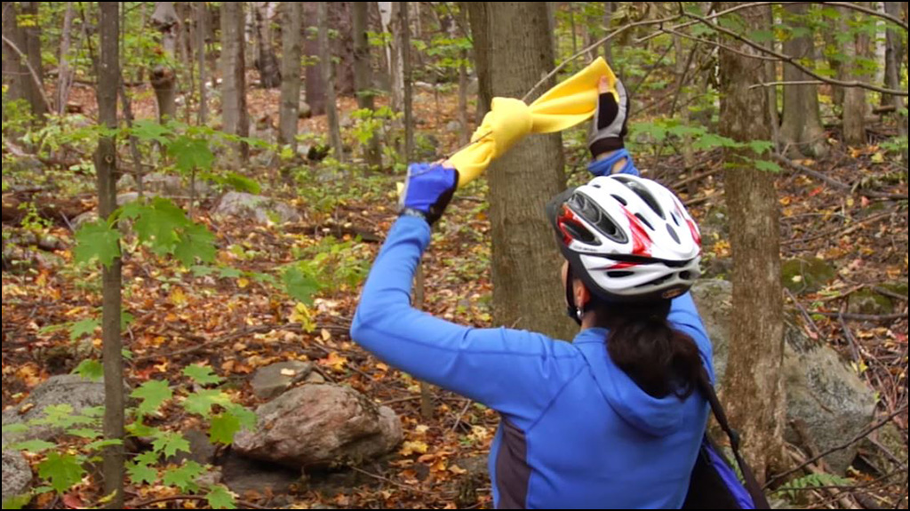
2. Remember the location and leave the area the same way you came
Ways to mark the area:
Tying something to a tree
Dropping a GPS pin on your phone
Make a note on a piece of paper

Slide 21
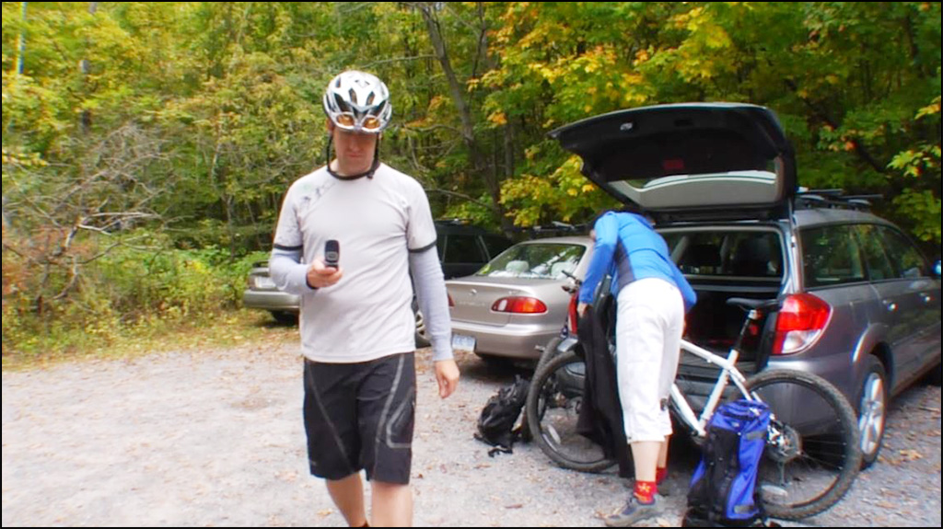
3. Call 911 or local police
Call the local authorities – 911 or police.

Slide 22

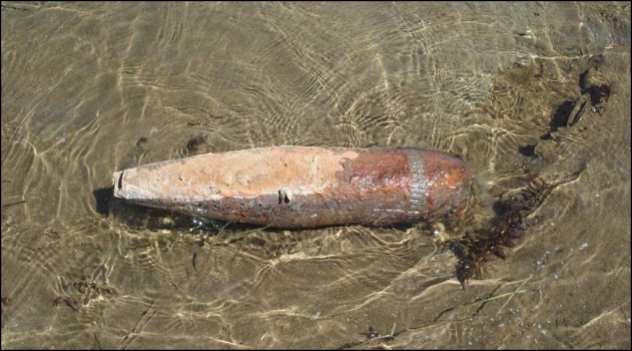
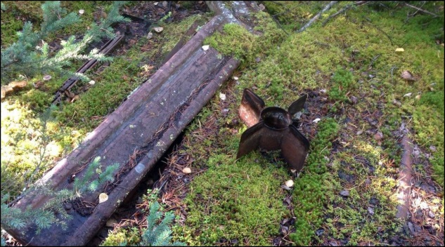
Remember: all UXO are very dangerous
1
For more information visit:
www.Canada.ca/Blair-UXO-Safety

