Slide 1


What’s your money personality?
STUDENT
QUIZ
#TalkMoney

Slide 2

Quiz intro
Money choices are part of everyday life, and everyone approaches them differently.
  This quiz helps you learn more about your money mindset and identify strengths you can build on as you grow.
#TalkMoney
  www.canada.ca/money

Slide 3

QUESTION 1
You receive $50 for your birthday.
What do you do?
A. Save most of it for something I really want later.
B. Spend some and save some.
C. Look for a way to make it grow or earn more.
D. Buy something fun right away.

Slide 4

QUESTION 2
Your friends want to
go out, but it's more expensive than you expected.
A. Use money I've set aside for emergencies.
B. Compare options before buying a new one.
C. Look for deals or creative solutions.
D. Hope someone else can help me figure it out.

Slide 5

QUESTION 3
When you think about the future,
which sounds most like you?
A. I like having fun.
C. I'm excited about big ideas and opportunities.
B. I have some goals, but I'm flexible.
D. I prefer to focus on today.

Slide 6

QUESTION 4
If your phone suddenly stopped working, what would you do?
A. Use money I've set aside for emergencies.
B. Compare options before buying a new one.
C. Look for deals or creative solutions.
D. Hope someone else can help me figure it out.

Slide 7

QUESTION 5
You see an ad for something you really want.
A. Wait a few days before deciding.
B. Compare prices and reviews first.
C. Ask myself if it helps me reach my goals.
D. Buy it if I can.

Slide 8

QUESTION 6
Someone messages
you saying you've won
a prize, but it seems suspicious.
A. Ignore immediately.
B. Double-check if it’s real.
C. Ask someone I trust for advice.
D. Click the link to find out more.

Slide 9
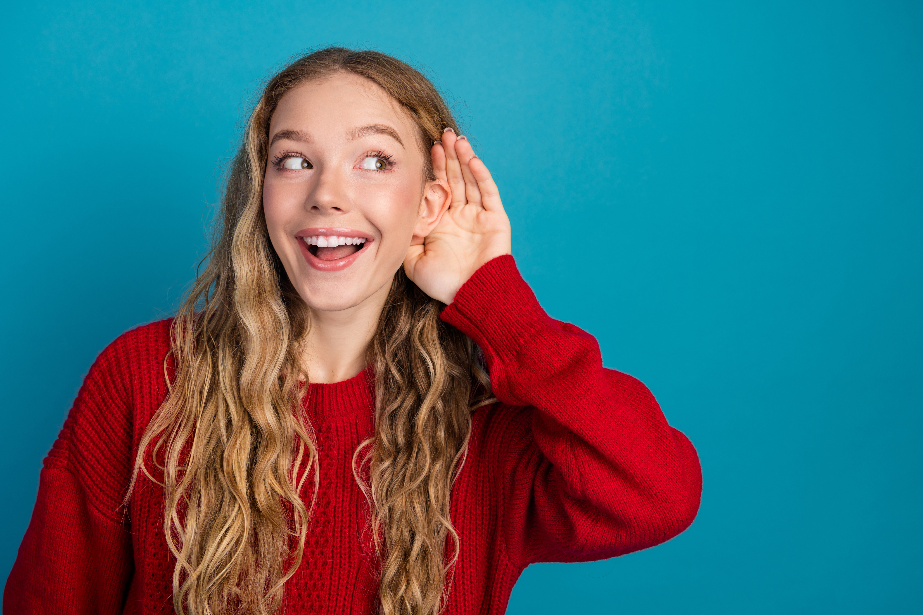
QUESTION 7
Which activity sounds most interesting?
A. Saving up for something important.
B. Finding smart ways to spend money.
C. Learning how money works.
D. Trying new experiences with friends.

Slide 10

QUESTION 8
You see influencers or friends online showing off something that everyone seems to have.
What do you do?
A. Think about whether it fits my goals before deciding.
C. Ask friends or family what they think before making a choice.
B. Research it and decide if it's worth the money.
D. Want it right away because everyone else seems to have it.

Slide 11

QUESTION 9
If you had a question about money, what would you most likely do?
A. Ask a parent, caregiver, or trusted adult for advice.
B. Look for information from reliable sources before deciding.
C. Ask questions and explore different ideas to learn more.
D. Figure it out as I go.

Slide 12
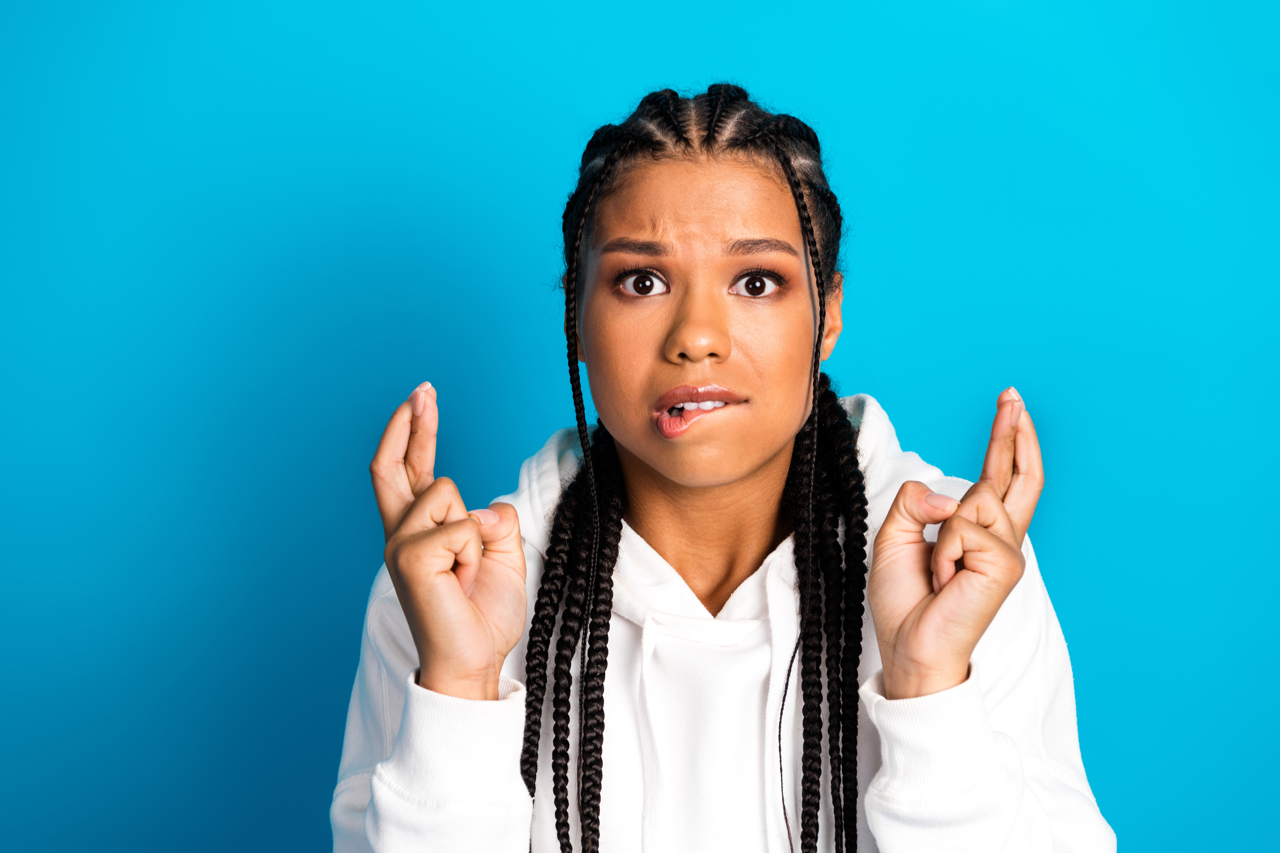
QUESTION 10
A game you're playing offers a chance to win a rare item if you spend money. What do you do?
A. Save my money for something I know I want.
B. Think about the chances of winning before deciding.
C. Ask questions or learn more about how it works first.
D. Give it a try because it might be exciting.

Slide 13
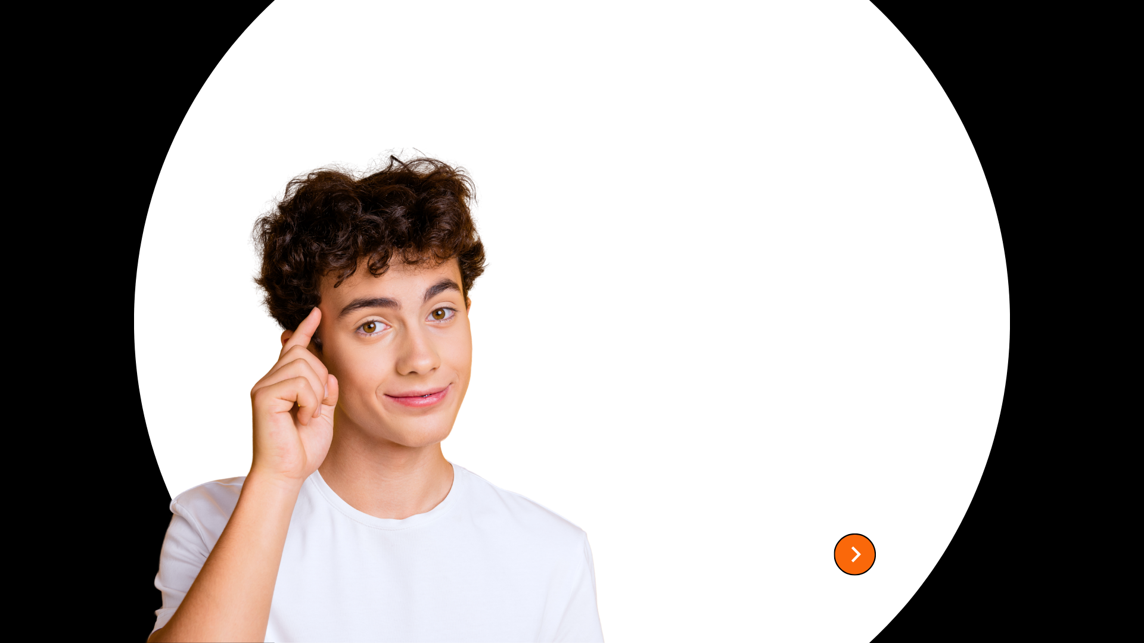
Quiz results
What’s your money personality?
STUDENT
QUIZ
RESULTS

Slide 14


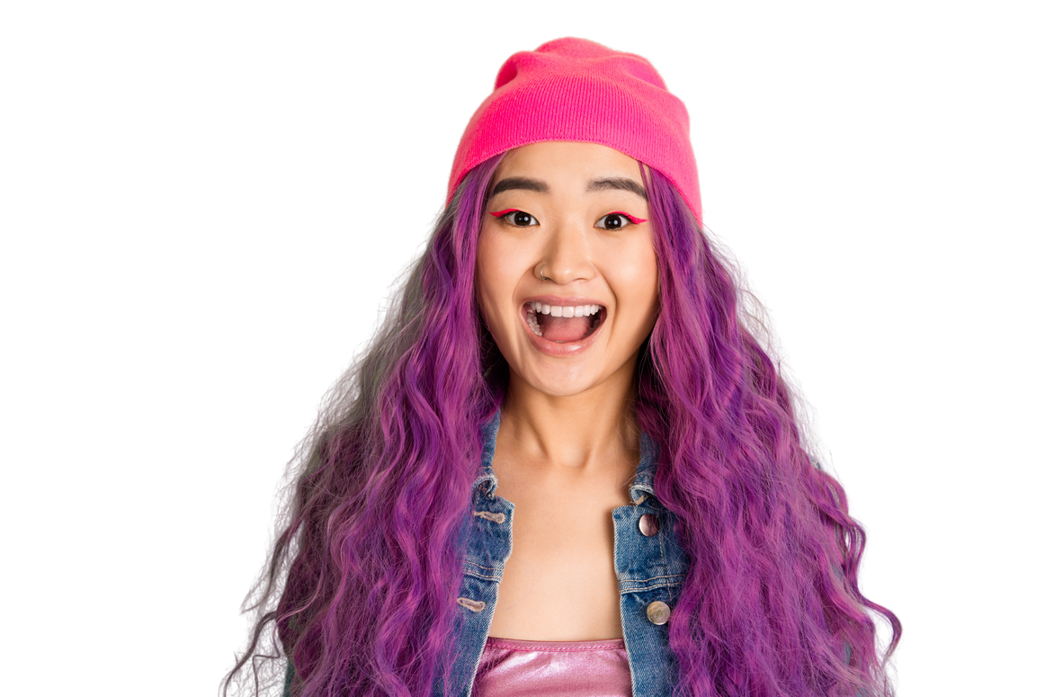
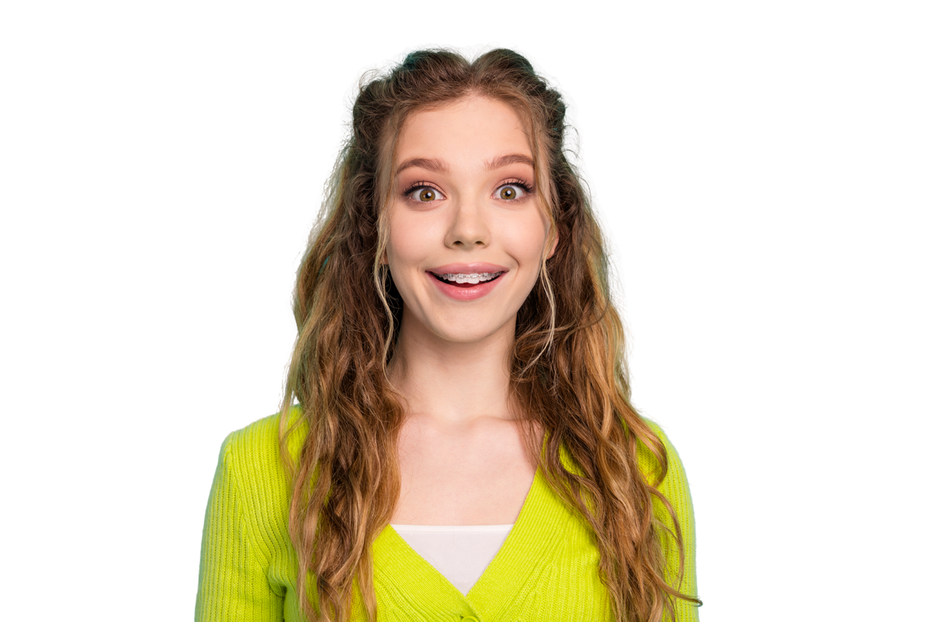
How to read your results
WHAT’S YOUR MONEY PERSONALITY?
MOSTLY A
MOSTLY B
MOSTLY C
MOSTLY D
You like planning ahead and working toward goals. You're good at thinking about the future and making choices that help you stay on track.
You like balance.
You think carefully about your choices and often try to make the most of your money.
You're curious, creative, and interested in possibilities. You enjoy learning new things
and finding ways to make your money work for you.
You value fun, experiences, and living in the moment. You bring energy and excitement to everything you do.
OPPORTUNITY SEEKER
EXPERIENCE EXPLORER
MONEY STRENGTHS:
  Saving for goals
  Thinking ahead
  Being prepared
MONEY STRENGTHS:
  Making thoughtful decisions
  Comparing options
  Managing spending
MONEY STRENGTHS:
  Problem-solving
  Setting ambitious goals
  Looking for opportunities
MONEY STRENGTHS:
  Enjoying the present
  Being open to new experiences
  Staying positive
MONEY MANAGER
GOAL GETTER

Slide 15

  DISCUSSION QUESTIONS
Were you surprised by your result?
What is one money strength you already have?
What is one money skill you would like to build?
Who could you talk to if you had a question about money?

Slide 16

Key message
Every money personality has strengths.
  The goal isn't to be one type over another.
  Understanding how we think about money can help us make informed choices, plan for the future, and protect ourselves from financial risks.
#TalkMoney
  www.canada.ca/money

