Slide 1





Let’s talk about risk.
sell class notes
work extra shifts
follow an influencer’s advice
play online casino games
stream on Twitch
join local talent contest
tutor younger student
create
YouTube channel
buy scratch tickets
HIGHER RISK
SOME RISK
LOWER RISK
invest in
crypto
join paid gaming tourney
bet on the Leafs
resell concert tickets
flip used phones
create paid SM content
start clothing brand
shovel driveways
sell on Marketplace
go viral on TikTok
join fantasy sports pool
Not all money opportunities involve the same level of risk.
Talk it through before you take the chance.

Slide 2
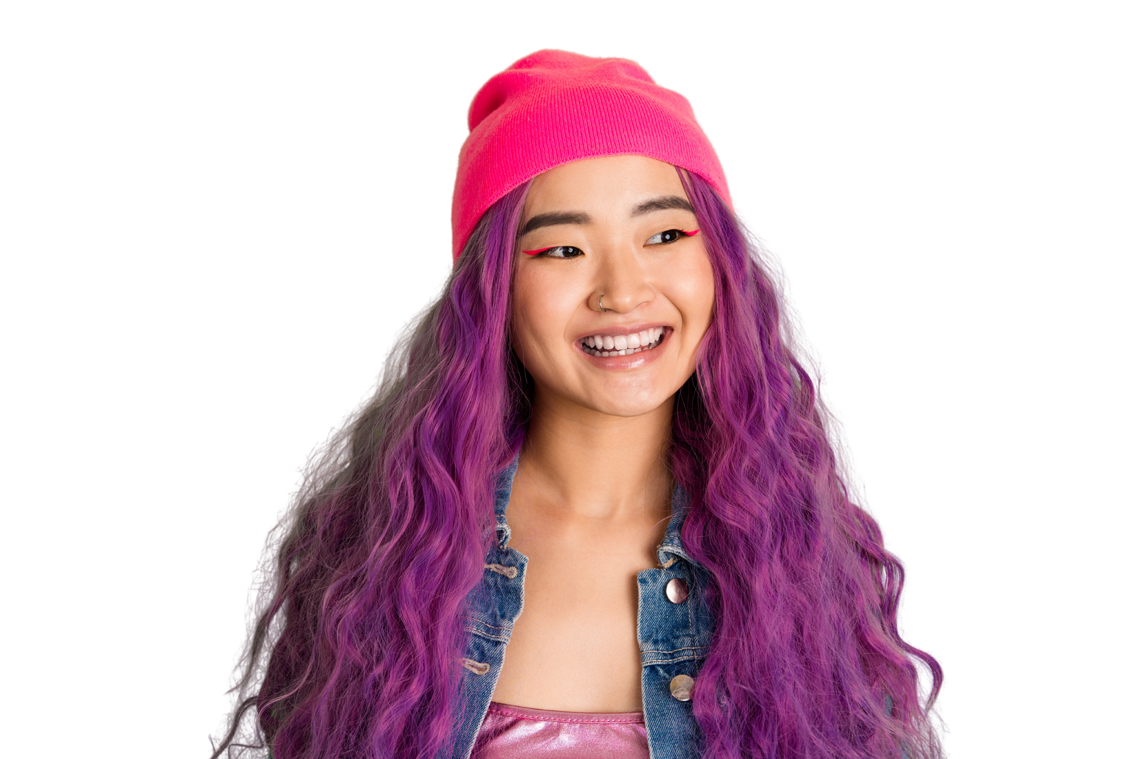
DISCUSSION QUESTIONS
  What information helped you determine the level of risk?
  Why do people sometimes underestimate risk when money is involved?
  How do social media, advertising, and success stories influence our decisions?
  Who could you talk to if you were unsure about a money opportunity?

Slide 3

How can you make decisions that support your financial confidence and well-being?
Ask questions.
Weigh your options.
Save with a goal in mind.
Plan ahead.
Know the risks.
Protect your money.
Talk to someone you trust.

Slide 4

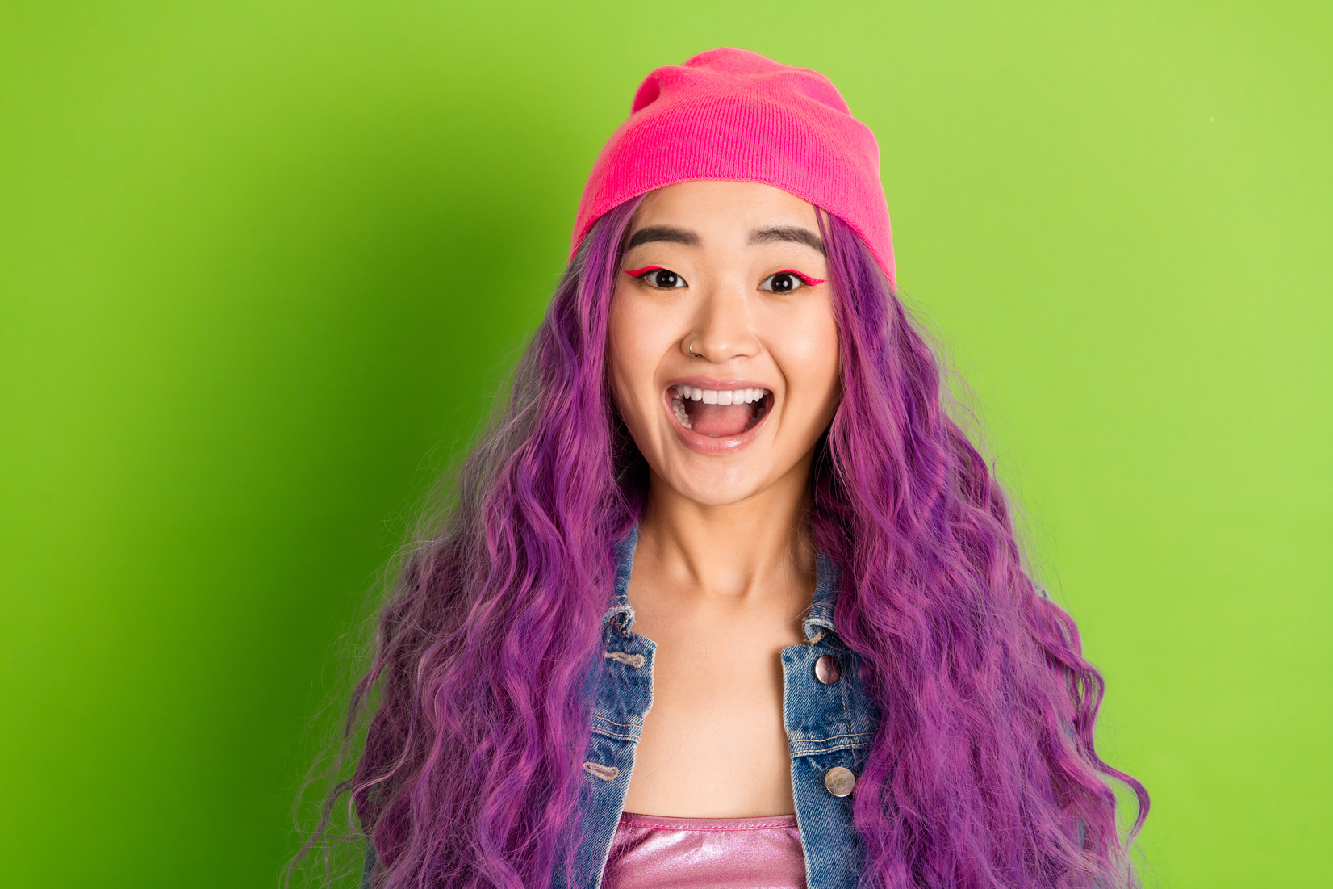


Talking about money helps build confidence.
Asking questions and talking to someone you trust can help you better understand your options, recognize risks, and make informed decisions that support your financial well-being.
#TalkMoney
#FLM2026

