Slide 1
Does Financial Education Impact Financial Literacy and Financial Behavior?
November 2, 2017
Dr. Andrea Hasler
Assistant Research Professor in Financial Literacy
Global Financial Literacy Excellence Center (GFLEC)
at the George Washington School of Business

Slide 2
Section 1
Financial Literacy Around the World
Findings from Various Surveys and Studies

Slide 3
A Simple Measure of Financial Literacy
The Big Three
“Suppose you had $100 in a savings account and the interest rate was 2% per year. After 5 years, how much do you think you would have in the account if you left the money to grow?”
“Imagine that the interest rate on your savings account was 1% per year and inflation was 2% per year. After 1 year, with the money in this account, would you be able to buy…”
“Do you think the following statement is true or false? Buying a single company stock usually provides a safer return than a stock mutual fund.”
✓
More than $102
Exactly $102
Less than $102
Don’t know
Refuse to answer
More than today
Exactly the same as today
Less than today
Don`t know
Refuse to answer
✓
True
False
Don`t know
Refuse to answer
✓
2

Slide 4
Financial Literacy Around the World (FLAT World)
Evidence from 15 countries:
USA
The Netherlands
Germany
Italy
Russia
Sweden
New Zealand
Japan
Australia
France
Switzerland
Romania
Chile
Canada
Finland
3
3

Slide 5
Findings: The World is flat
Financial illiteracy is widespread in the population
Less than half of the population can answer three basic questions
Even in countries with well developed financial markets
People lack knowledge of fundamental financial concepts (even among «investors»)
Risk diversification is most difficult concept to grasp
Similar pattern of response across countries
Prevalence of “do not know” answers
Some groups are less likely to answer correctly
Vulnerable groups, for example women and the young, are similar across countries
These findings are robust
Evidence from bigger surveys and different questions
Similar patterns across countries
4
4

Slide 6
The S&P Global FinLit Survey (GFLS)
The largest, most comprehensive, global measure of financial literacy
Interviewed more than 150,000 adults age 15+ in 148 countries
S&P Global partnered with Gallup, GFLEC, and the World Bank
The measure has to be applicable to every country, irrespective of economic structure and financial market development
The survey covers four topics:
Numeracy
Interest compounding
Inflation
Risk diversification
Being financially literate:
Able to answer 3 out of these 4 topics correctly
5

Slide 7
Financial Literacy Across the Globe
% of financially literate adults
Source: S&P GFLS
Only 1 in 3 adults worldwide responded correctly to three out of four topics
6

Slide 8
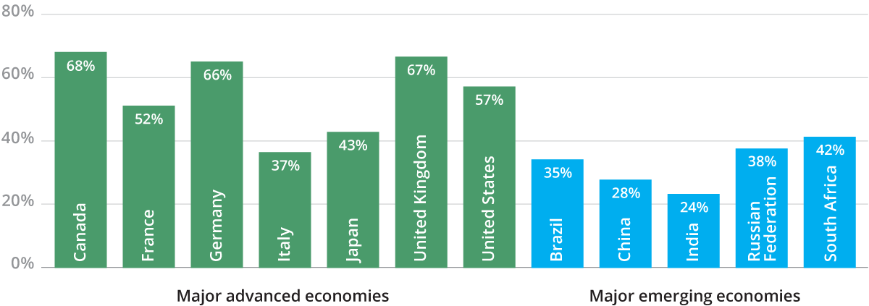
Financial Literacy in Advanced Countries and in Emerging Economies
% of adults who are financially literate
Source: S&P GFLS
Financial literacy is low among the BRICS and even in advanced countries (e.g. Italy)
7

Slide 9
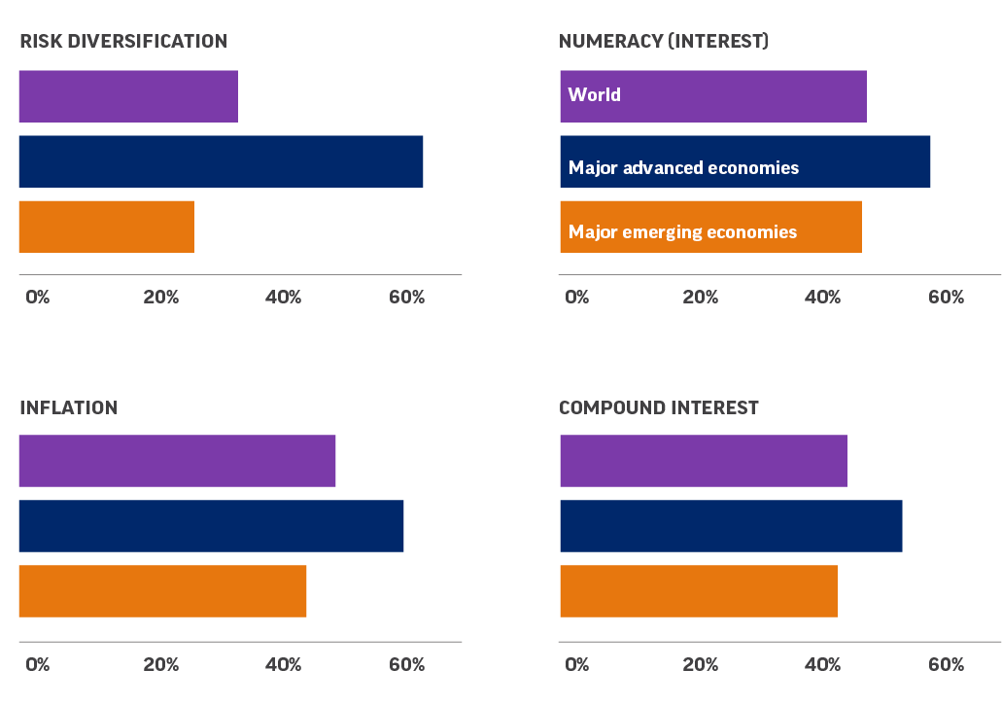
Financial Literacy by Topic
% of adults answering correctly
Inflation and simple interest/numeracy is what people know most across countries.
Risk diversification is what people know the least.
Large differences across countries, but similar findings as in the FLAT World Project.
Source: S&P GFLS
8

Slide 10
Evidence of Learning by Experience
% of adults who answer the financial literacy questions correctly
Source: S&P GFLS
Respondents in countries that experience hyperinflation know more about inflation
9

Slide 11
Financial Literacy across Age in the U.S.
% answering Big 3 questions correctly
Source: 2015 NFCS
Financial knowledge increases very slowly with age/cohort
Less than 1/3 know the 3 basic concepts by age 40 even though most important decisions are made well before that age
10

Slide 12
Planning Ahead: Most Workers Don’t
Have you ever tried to figure out how much you need to save for retirement?
Have you set aside an emergency or rainy day fund?
Note: Respondents age 23 to 61 and employed at the time of the survey. 2015 NFCS.
2
11

Slide 13
Section 2
The Link to Financial Behavior
The Effects of Low Financial Literacy Levels
2
12

Slide 14
Financial Behavior: Retirement Planning and Wealth Accumulation
FLAT World project
Those who are more financially literate are more likely to plan for retirement
Hence, financial literacy is critical to retirement security around the world
Federal Reserve Case Study
Participation and contribution
Financially literate employees are most likely to participate in and contribute to their employer-sponsored defined contribution (DC) retirement plans
Higher levels of financial literacy is found to have a beneficial impact on retirement saving patterns
Portfolio composition
Financially knowledgeable investors hold more equity in their pension accounts, earn higher excess returns (adjusted for risk), have a higher portfolio volatility, and hold more diversified portfolios
Portfolios change significantly with differences in financial literacy levels
2
13

Slide 15
Financial Behavior: Debt and Debt Management
Low levels of financial literacy are correlated with higher use of Alternative Financial Services (AFS)
26% of Americans have used at least one of these methods within the past 5 years: Pay-day loan, pawn shop, auto title loan, rent-to-own store (2015 NFCS)
Highest use among Millennials (18-34 year olds), those with low income, and individuals with high school or less than high school education
Financial literacy can account for almost 20% of the reduction in the use of high-cost borrowing
Individuals with lower financial literacy also report that their debt loads are excessive or that they are unable to judge their debt position
Those who are more financially literate are less likely to make financial choices that incur high fees and charges
Such as paying only the minimum balance on credit cards, having to pay late payment charges, incurring over-the-limit fees, or using cards for cash advances
Financial literacy helps to avoid higher fees and high-cost borrowing methods
2
14

Slide 16
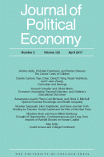
Financial Behavior: Wealth Accumulation
Financial literacy is an important determinant of wealth inequality
Better planning often leads to higher wealth accumulation during retirement
Thus, more financially literate individuals are able to gather more wealth by virtue of planning better
Important finding: 30-40% of U.S. retirement wealth inequality can potentially be attributed to difference in financial knowledge
Financial literacy is a strong determinant of financial behavior
2
15

Slide 17
Section 3
Initiatives and Effectiveness
From Research Results to Education Programs
2
16

Slide 18
How to Improve Financial Decision-Making
Need to improve levels of financial literacy
Research shows levels of knowledge are low and financial literacy is strongly linked to financial behavior
Address lack of knowledge and information
Need for more targeted programs
Start with the individual and his/her needs
One size does not fit all
Particularly addressing vulnerable groups (Millennials, women)
Need for large and scalable programs
Financial education in school
Financial education in the workplace
Financial education in the community (libraries, museums, other places where people go to learn)
Widespread financial illiteracy requires robust interventions
2
17

Slide 19
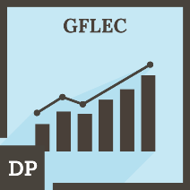
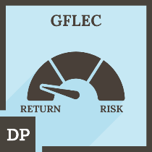
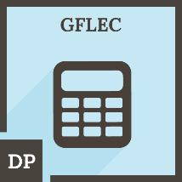
Overview of Our Education Programs and Initiatives
Besides research, GFLEC develops personal finance education material for schools and the workplace, and builds initiatives to advance financial literacy
Financial Literacy Micro-Credentials
College Personal Finance Course
Financial Literacy Curriculum for Girl Rising
International Federation of Finance Museums (IFFM)
Workplace financial wellness programs
2
18

Slide 20
Employee Financial Literacy and Retirement Plan Behavior: A Case Study
Set-up:
Administrative data from the Federal Reserve System
Study of the participation in and contribution to the DC plan (Thrift Saving Plan)
Learning module about retirement planning
Comparing employee plan behavior one year after the intervention
Findings:
Most financially knowledgeable employees
are more likely to participate
contribute 3 percentage points more of their earnings to the DC plan
hold more equity in their pension accounts
Higher levels of financial literacy levels are linked to greater retirement readiness
Employees who completed the learning module were
more likely to start contributing to their DC plan
less likely to have stopped contributing post-survey
More likely to boost contributions and equity allocations after the intervention
Evidence that employer-provided educational programs do have positive effects on employees’ behavior
2
19

Slide 21
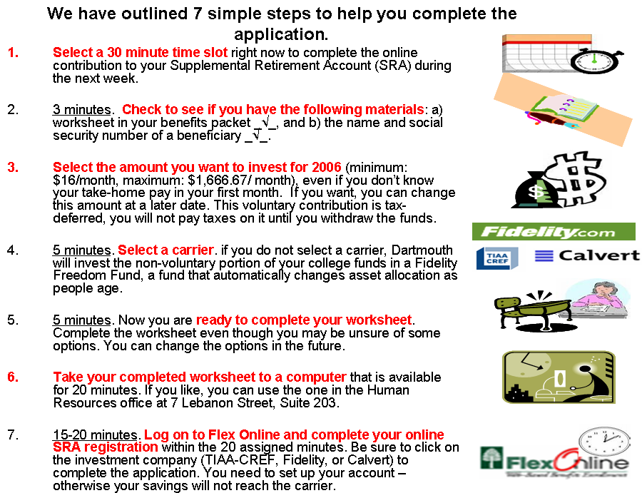
New Ways to Make People Save: The Dartmouth Project
A social marketing program that targeted individuals who wanted to save but were limited by a lack of knowledge
Development of a comprehensive, cost-effective plan to improve participation in and contribution to Supplementary Retirement Accounts (SRAs)
Step-by-step planning aid
The planning aid enhanced enrollment in supplementary pensions: Retirement plan election rates more than tripled in the 30-day period and doubled in the 60-day period
Guiding principles for “best practice”:
simplify financial decisions
provide information when needed by individuals (“teachable moments”)
target specific subgroups
planning aids to complement other saving programs
2
20

Slide 22
Five Steps to Planning Success: Experimental Evidence from US Households
Set-up:
Design of a low-cost, easily-replicable financial education program called «Five Steps»
Covering five basic financial planning concepts that relate to retirement
Delivery models: written narratives and online videos
Field experiment to evaluate the overall impact
Follow-up tests 8 months after the intervention
Program:
Targeted to young workers
Kept the message free of economic/ finance jargon
Covered concepts that people know the least in a simple story
Findings:
Short videos and narratives have sizeable short-run effects on financial knowledge
Format has significant effects (keeping informational content relatively constant)
After being exposed to videos, the performance on financial literacy questions improved
While young were targeted, the videos affected all age groups
25-33% of the knowledge gain is still observable 8 months after the intervention
Simple program has effects both in the short and medium run
2
21

Slide 23
Concluding Remarks
Financial literacy is like reading and writing
It is an essential skill for the 21st century
As it was not possible in the past to participate in society without being able to read and write, so it is not possible to thrive in today’s society without being financially literate
Everyone deals with finance, and finance is sufficiently complex that we cannot leave it to the individual to learn by himself/herself
It is very important to be financially literate as early as possible
What is the future we want to build?
2
22

Slide 24
Thank you!
Questions? Contact us at gflec@gwu.edu

