Slide 2
introduction

Slide 3
Agenda
How to manage your spending and prepare a realistic budget
How to manage credit
How to pay off debt
Ways to save
How to set and reach your own financial goals
How to protect yourself from fraud
Introduction

Slide 4
Benefits of gaining financial skills
Control your financial future
Achieve your life goals
Provide for yourself and your family
Be a smarter consumer
Reduce stress and sleep better
Be confident that you can manage your finances
Introduction

Slide 5
Budgeting
The percentage of Canadian households that use a budget to manage their finances is:
32%
49%
68%
Introduction

Slide 6
Credit and debt management
In 2019, the proportion of Canadians who had outstanding debt or used a payday loan within the
previous 12 months was:
33%
53%
73%
Introduction

Slide 7
Emergency savings
The best way to plan for unexpected expenses is:
Buy a lottery ticket every week
Only have friends who will lend you money
Set money aside in an emergency savings fund
Introduction

Slide 8
budgeting

Slide 9
Did you know?
6% of budgeters do not have a plan for how they are going to
pay for their next major purchase, compared with almost 15%
of those who feel too time-crunched or overwhelmed to budget.
Budgeting

Slide 10
Parts of a budget
Income
Expenses
Difference between the two: surplus or deficit
Budgeting

Slide 11
Know what you spend
Keep every receipt
Record every expense in a notebook or electronic device
Review bank and credit card statements
Make a list of irregular expenses (gifts, donations, car or home repairs, vacations)
Total your expenses at the end of the month
Do this for at least three months
Budgeting

Slide 12
Monthly income
Average monthly income from employment after deductions: $______
OR choose an occupation from the list provided and indicate the current monthly income.
Examples
Food and beverage servers $2,860
Cooks $2,690
Early child educators and assistants $3,530
Administrative assistant $4,155
Retail salespersons and clerks $2,690
Hairstylists and barbers $2,890
Sales and service occupations $2,690
Dental assistants $4,270
Bookkeepers $4,230
Graphic art technicians $5,250
Construction trades workers $3,860
Banking, insurance and other financial clerks $4,030
Other sources of income (gifts, tax credits, investments, student loan or family, etc.)
Source 1: $_____
Source 2: $_____
Source 3: $_____
Total monthly income $_____
Budgeting

Slide 13
Monthly expenses – Fixed expenses
Examples
Housing (rent - own) $1,700 – 1,300
Car payments $400
Insurance (car, home, travel, etc.) $225
Utilities (electric, gas) $325
Telecommunications (cable, Internet, telephone, cell phone, $275
streaming subscription)
Child care $650
Other $____
Total fixed expenses $____
Budgeting

Slide 14
Monthly expenses – Variable and irregular expenses
Examples
Groceries $670
Eating out $180
Household expenses (cleaning, maintenance, furniture) $300
Computer (hardware, software, accessories, supplies) $20
Transportation (transit, gas, car maintenance, etc.) $100-250
Health care (medical services plan, dental, glasses/lenses, medication) $230
Clothing and footwear $190
Personal care (toiletries, hair care, make-up, laundry) $120
Recreation (movies, games, music, clubs, concerts, sports, etc.) $350
Gifts and charitable donations $140
Total variable expenses $____
Total monthly expenses (fixed + variable) $____
Budgeting

Slide 15
Net surplus or deficit
Difference between total monthly income and total monthly expenses:
Net surplus (more income than expenses)
Or
Net deficit (more expenses than income)
Budgeting

Slide 16
Managing your cost of living – Being a smart consumer

Slide 17
Did you know?
40% of Canadians feel they are just getting by financially
Managing your cost of living – Being a smart consumer

Slide 18
Areas for saving
Check your bills
Negotiate better plans (banking fees and services, telephone, cell phone)
Review your food costs (groceries, take out, buying lunch)
Consider whether you need to own a car, a home or the latest high-tech gadget
Managing your cost of living – Being a smart consumer

Slide 19
Check your bills
Spot mistakes and overcharges
Pay less in late fees, interest and penalties
Get errors corrected before it’s too late
Managing your cost of living – Being a smart consumer

Slide 20
Negotiate better plans
Call each service provider and ask:
How can I cut back my monthly bills?
Am I currently on any plans?
Do you have a better plan or deal for me?
If so, what is the timeframe?
Will I be put on contract for any new deals?
Can I bundle services to save money?
Can I avoid interest or late payment penalties?
Managing your cost of living – Being a smart consumer

Slide 21
Reduce banking costs
What am I paying in monthly service charges?
How much am I paying for ATM fees?
Can I save by doing more banking online?
Am I eligible for a low-fee deal if I’m a student?
Can I get a reduced fee if I keep a minimum balance?
Can you suggest a better plan for me?
Am I eligible for a low-cost account or a no-cost account?
Managing your cost of living – Being a smart consumer

Slide 22
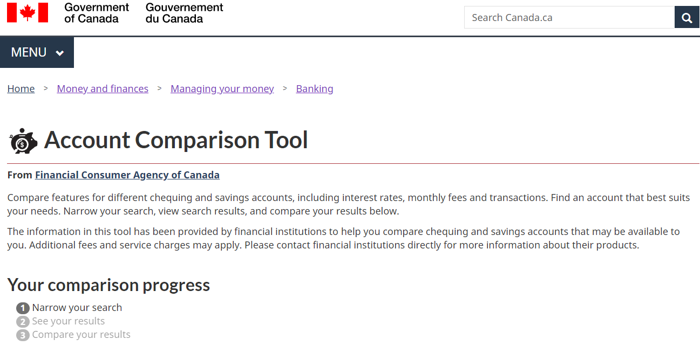
Account Comparison Tool
Managing your cost of living – Being a smart consumer

Slide 23
New digital services
Digital services (mobile wallets and other applications)
May offer convenient, inexpensive alternatives to traditional banking services
May increase risks to reliability, privacy and security
Ask questions regarding:
How your personal information is protected
Who your personal information is shared with
Where the information is stored (Canada or elsewhere)
Managing your cost of living – Being a smart consumer

Slide 24
Do you need a land line AND a cell phone?
Ask yourself:
What am I paying for land line and cell phone?
How much do my long distance calls cost?
Is my land line part of a bundle?
Managing your cost of living – Being a smart consumer

Slide 25
Bundling services pays big time
You pay $25/month for home phone, $30 for cell phone, $35 for Internet and $40 for cable TV = $130
Example of bundling discounts:
Combine 2 services, save 5%
Combine 3 services, save 10%
Combine 4 services, save 15%
Save 15% of $130 — $19.50 per month
Managing your cost of living – Being a smart consumer

Slide 26
How to save on food
Eat breakfast at home
Bring your lunch, drinks, snacks, and coffee
“Veg out” on low-cost meatless meals at least once a week
Cook one big dish on weekends and freeze
Shop with a buddy at discount supermarkets and split quantities
Set a budget and stick to it
Managing your cost of living – Being a smart consumer

Slide 27
Save when you shop for groceries
Plan meals and snacks in advance
Bring a list and buy only what you need
Buy fresh when in season, freeze extras for later
Buy canned and frozen vegetables and fruit
Know which stores near you are the best value
Check for discounts and coupons (a mobile app can help)
Buy non-food items at a discount store
Don’t shop on an empty stomach
Managing your cost of living – Being a smart consumer

Slide 28
Do you really need a car?
Add up the real costs of ownership (gas, insurance, depreciation, interest and maintenance)
Compare the full costs of car ownership and leasing against alternatives
Be wary of long-term financing
Managing your cost of living – Being a smart consumer

Slide 29
Car sharing
Can save money if you drive less than 10,000 km per year
May charge membership, monthly, hourly and mileage costs
Fees and rules vary — Compare different services
If you don’t own a car, consider car sharing for trips too long to cycle or when you have a big load to carry
Managing your cost of living – Being a smart consumer

Slide 30
Can you afford it?
Try it out:
Put the monthly costs of owning a home (mortgage, property taxes, maintenance, etc.) into a savings account.
Can you afford to live on what’s left?
Could you afford higher costs for heating, taxes or insurance?
Canada Mortgage and Housing Corporation (CMHC) Affordability calculator
Managing your cost of living – Being a smart consumer

Slide 31
When owning a home doesn’t make sense
When you move frequently:
It takes at least five years to make it worthwhile
If you have a very low down payment:
You’ll need mortgage default insurance
You may have a higher interest rate
When your income covers only mortgage payments and taxes
Managing your cost of living – Being a smart consumer

Slide 32
Do you need insurance?
Insurance can protect you from risks, such as:
Damage or injury caused in a driving accident
Damage to your home or furnishings
Medical costs that are not covered under a public health plan
Loss of income from illness, injury or death
Insurance can protect you and your loved ones from financial losses and offer peace of mind, but you pay for the security it provides
The policy is a contract that specifies all the details:
Be sure you understand how much your policy costs and what it includes and excludes
Managing your cost of living – Being a smart consumer

Slide 33
How to cut $162/month of spending
Category | Behaviour Change | Daily saving | Weekly saving | Monthly saving | Annual saving
Food | Take lunch 3 x week | $5 ($8 fast food lunch - $3 cost) | $15 | $60 | $720
Transportation | Take transit, not car, once a week | $18 ($22 parking + $3 gas - $7 transit fee | $18 | $72 | $864
Cell phone plan | Pay as you go vs. monthly | N/A | N/A | $30 ($55 to $25 a month) | $360
Managing your cost of living – Being a smart consumer

Slide 34
Your latte factor
“We’ve all got a latte factor, regardless of our income level.”
—David Bach
Designer coffees
Lunches in restaurants
Impulse buys
The latest, greatest [fill in the blank]
Managing your cost of living – Being a smart consumer

Slide 35
Questions to ask yourself
When does a want become a need?
What motivates you to buy—advertising, friends, trendy styles, rough day?
Does the urge to buy die the next day?
Do your purchases make you happier?
What “needs” are now collecting dust?
What can you learn to live without?
Managing your cost of living – Being a smart consumer

Slide 36
Reduce impulse buying
Avoid unnecessary trips to stores and shopping malls and online buying sites
Leave credit cards at home and use your debit card or cash instead
Use cash to pay for your purchases and/or carry only the cash you are willing to spend
Reduce available credit on your credit card and line of credit
Sleep on it and see if you still want it the next day
Managing your cost of living – Being a smart consumer

Slide 37
Credit and debt management

Slide 38
Did you know?
Federal regulations say that credit card companies have to ask your permission to raise your credit limit.
Credit and debt management

Slide 39
Using credit cards wisely
Credit cards offer convenience for small purchases, online items and emergencies
Charges are a loan – with interest unless you pay in full by the due date
Charges add up quickly – pay the monthly balance in full
Choose the card with the features you want with the lowest cost
Limit the number of credit cards you hold
Keep your credit limit low
Read your monthly statement
Avoid cash advances except for emergencies
Credit and debt management

Slide 40
Credit card quiz
Paying your credit card bill just a couple of days after the due date won’t affect your credit report.
True or false?
Credit and debt management

Slide 41
Credit card quiz
Last month, your credit card balance was zero. This month, your statement shows that you made a $500 purchase. If you pay off $400 by the due date, you will be charged interest only on the $100 left to pay.
True or false?
Credit and debt management

Slide 42
Credit card quiz
If you use your credit card to take money out as a “cash advance,” you don’t have to pay interest on the amount you’ve withdrawn as long as you pay your credit card bill in full by the due date on your statement.
True or false?
Credit and debt management

Slide 43
Credit card quiz
Without a good credit history…
Your bank may charge you higher interest rates on a personal loan for a car, house, etc.
Your bank may refuse to give you a loan
You might not be able to get a lease on an apartment
1 and 2 only
All of the above
Credit and debt management

Slide 44
Pick the right credit card
Choose a card that suits your needs and how you will use the card
In addition to the interest rate, consider:
Annual fees or other user fees
Real value of any points or benefits offered
FCAC’s Credit Card Comparison Tool helps you choose
Credit and debt management

Slide 45
How to keep control of your credit card
Pay the balance in full each month
If you can’t pay it in full, pay as much as you can
Don’t make only the minimum payment
If you always carry a balance, get a low rate card
Transfer the balance to a line of credit with a lower rate
Pay a few days before the due date
Credit and debt management

Slide 46
Minimum vs fixed payments
Initial balance: $3,000
Interest rate: 18%
 | Make minimum payments of 2.5%/ month (in this example $75) | Make fixed payments of $100/month | Difference
Time to pay off balance | 263 months | 41 months | 222 months
Total interest paid | $4,115.41 | $1,015.49 | $3,099.92
Credit and debt management

Slide 47
Canada Student Loans Program
Federal program for students in financial need
Interest-free while you are enrolled in post-secondary education
Loan becomes payable six months after you leave your studies
Apply through your provincial or territorial student assistance office
For more information, visit canada.ca/education-funding and click on Education planning and student aid
Credit and debt management

Slide 48
Qualifications for a Canada Student Loan
Canadian citizen or permanent resident
Registered in a degree, diploma or certificate program offered by a designated post-secondary school
Full-time or part-time student
Show financial need
Pass a credit check
Maintain a certain grade average
Reapply every year
Credit and debt management

Slide 49
Repaying a Canada Student Loan
Repayment begins after you graduate or leave school
No payments required for the first six months
Contact the lender to arrange a payment plan
The Loan Repayment Estimator online tool helps you compare options
Credit and debt management

Slide 50
Canada Student Loan Tips
Borrow only what you need
Make lump sum payments while in school
Consider a summer job or co-op placement to reduce borrowing
Set up automatic monthly payments so you don’t miss any
Make extra or larger payments whenever you have money available
If you have trouble with payments:
Contact your loan officer as early as possible
Find out if you can reduce or defer payments
Credit and debt management

Slide 51
Other types of loans
Mortgages
Car loans
Lines of credit
Overdraft protection
Payday loans
Personal loans
Credit and debt management

Slide 52
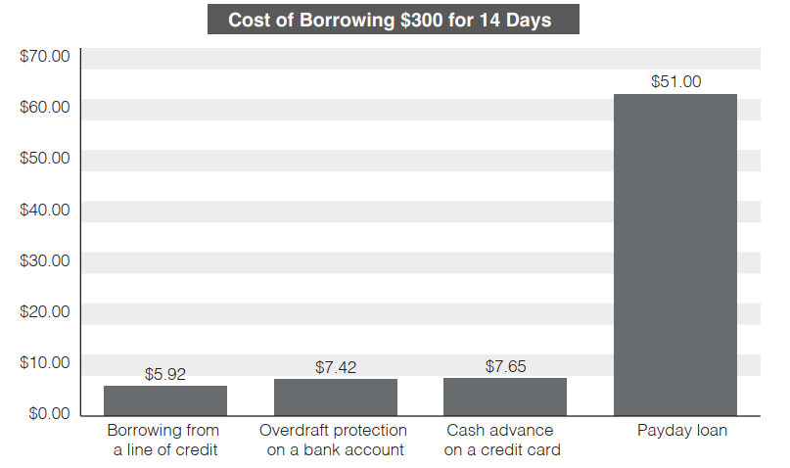
Payday loans
An arrangement to borrow money and pay it back, with added costs, from your next paycheque
Interest rates are high, and other fees are added to the loan amount
Credit and debt management

Slide 53
Tips for managing loans
Shop around
Compare interest rates. Don’t accept your first offer
Keep within your budget
Borrow only what you can afford to pay back in a realistic time
Pay back more and pay more often
Additional payments mean you’ll pay it off sooner and pay less interest
Credit and debt management

Slide 54
Credit report
A summary of your credit history and other financial information
Past lenders and others send information to companies that collect, assess and share data
Canada’s two main credit bureaus:
TransUnion
Equifax
You can get your credit report for free by ordering it online, by mail or in person
You can also access your credit report online for free
Credit and debt management

Slide 55
Credit score
A number rating of your credit worthiness at a specific point in time
Indicates the risk you represent for lenders, compared with other consumers
Scoring system gives a number between 300 and 900
The higher your score, the lower the risk
Lenders use credit scores to decide whether to lend you money and to set the interest rate
You can access your credit score online from Canada’s two main credit bureaus
Your credit score from Equifax is accessible online for free and is updated monthly
If you live in Quebec, you can also access your credit score from TransUnion online for free
Credit and debt management

Slide 56
Credit report and credit score quiz
Getting a copy of your credit report is:
A good way to check for identity theft
The only way to know if your report is accurate
Free of charge, if you request the report be sent to you by mail
All of the above
Credit and debt management

Slide 57
Credit report and credit score quiz
If you have applied for several credit cards or other forms of credit within a short period of time, this could have a negative impact on your credit score.
True or false?
Credit and debt management

Slide 58
Credit report and credit score quiz
Which of the following does not affect your credit score?
Your payment history—whether you have ever missed a debt payment
Any collection of bankruptcy that has been recorded against you
Your history of repaying informal loans from family or friends
Any outstanding debts you have
Your account history—how long you have had credit, and the type of credit you have
Credit and debt management

Slide 59
Checking your credit report
Get a free copy of your credit report by mail every year
Review for errors or accounts that are not yours
Mistakes could be a sign of identity theft
Contact the credit bureau to report any errors
Request a correction or place a note on the file
Credit and debt management

Slide 60
Checking your credit report
Always make your payments on time
Use credit wisely
Don’t go over your credit limit
Only use part of the credit you have available
Build a longer credit history
Keep older accounts open if there is no fee
Use them from time to time
Don’t make a lot of credit applications or credit checks
Credit and debt management

Slide 61
Recognize the danger signals
Do you:
Use your credit as a necessity instead of a convenience?
Use credit or cash advances for your daily living expenses?
Miss payments or due dates?
Stay near the credit limit on most of your cards?
Borrow from one card to pay another?
Transfer balances every few months just before the introductory offer expires?
Credit and debt management

Slide 62
Take control of your debt
Use savings to pay off balances
Pay down your highest interest rate debts first
Switch to less expensive credit cards
Call creditors to negotiate lower interest rates
Start automatic/online bill payment to stay on schedule
Leave your credit card at home
Avoid “buy now, pay later” offers
Credit and debt management

Slide 63
Debt management options
Credit counseling
Counsellors create a personal debt management program
Often based on a consolidation loan
Consumer proposal
A voluntary offer to lenders through a Licensed Insolvency Trustee
Bankruptcy
A trustee takes over your assets to cancel debts
Credit and debt management

Slide 64
Saving and investing

Slide 65
Did you know?
In 2022, Over 4% of Canadians used an online lender or payday loan company to manage their daily expenses. Among these online or payday loan borrowers, almost half used a short-term pay day loan or cash advance.
Saving and investing

Slide 66
Why save for the future?
Feel more secure and in control
Be prepared for emergencies
Reduce stress and conflict
Spend with less guilt or fear
Afford major purchases
Pay off debt and avoid new debt
Retire comfortably
Saving and investing

Slide 67
Reasons not to save
I don’t make enough money to save.
I don’t know what’s going to happen in the future, so I’m going to enjoy myself now.
I don’t know what to do with the money I might save. It’s too complicated.
Tying up my money in savings reduces my options.
I save so little that it doesn’t make any difference.
I’ll be earning more in the future, so I’ll start saving then.
I don’t need to save because I’m expecting an inheritance.
I can always sell my things if I need more money.
Saving and investing

Slide 68
Four steps to savings
Set up an emergency fund
Pay yourself first
Make savings automatic
Grow your savings
Saving and investing

Slide 69
Make your savings automatic
Set up direct transfers from your bank account or paycheque
Save 5% to 10% of your take-home pay
If you earn $2,000 a month after tax:
Saving 5 per cent — $100 a month — $1,200 a year
Saving 10 per cent — $200 a month — $2,400 a year
Extra money (from gifts, tax refunds, etc.) or a raise or bonus? Save it!
Saving and investing

Slide 70
Compounding makes your money grow
Saving and investing

Slide 71
Case study: Amy and Amanda
Case study: Amy and Amanda
Actions | Amy | Amanda
Starts saving at age: | 20 | 30
Puts $1,000 a year into her RRSP to age: | 34 | 64
Total she saves: | $15,000 | $35,000
Total earned at age 65: | $141,700 | $116,100
Saving and investing

Slide 72
Case study: Amy and Amanda
Case study: Amy and Amanda
Actions | Amy | Amanda
Total earned at age 65: | $141,700 | $116,100
Conclusion:
Compound interest makes a big difference over time
Start saving as soon as you can (the sooner the better)
Save as long as you can (for a long period of time)
Saving and investing

Slide 73
Risk and return
Expected Return
Risk
Saving and investing

Slide 74
Registered tax plans
Tax-Free Savings Accounts (TFSAs)
Earn income from investments without paying taxes on the income
Registered Retirement Savings Plans (RRSPs)
Defer paying income tax until retirement
Registered Education Savings Plans (RESPs)
Save for education and receive government grants
Registered Disability Savings Plans (RDSPs)
Save for someone with a disability and receive government grants
Saving and investing

Slide 75
Tax-Free Savings Accounts
Invest in cash, mutual funds, stocks, GICs, bonds
Generally pay no taxes on investment income
The TFSA contribution room is the total amount of all of the following:
the TFSA dollar limit of the current year
any unused TFSA contribution room from previous years
any withdrawals made from the TFSA in the previous year
You must be 18 or older and have a social insurance number
Saving and investing

Slide 76
Registered Retirement Savings Plan (RRSP)
Invest in cash, mutual funds, stocks, GICs, bonds
Contributions and earnings are generally free from income tax until withdrawn
You may pay a lower tax rate when you withdraw funds
Yearly contribution limit is calculated by the Government of Canada up to a maximum amount
Saving and investing

Slide 77
Registered Education Savings Plan (RESP)
You put money into an RESP
Government of Canada adds a maximum amount per year into the plan (if eligible)
Quebec, Saskatchewan and B.C. also offer incentives to save for education
The plan pays the contributions, government grants and earned income to a student
The student pays taxes due (if any) on grants and income earned in the plan
Saving and investing

Slide 78
Registered Disability Savings Plan (RDSP)
You put money into a RDSP for an eligible person with a disability
Government of Canada pays matching amounts into the plan (if eligible)
The plan pays the contributions, government grants and earned income to a person with a long-term disability
The recipient pays taxes due (if any) on grants and income earned in the plan
Saving and investing

Slide 79
Getting financial advice
Savings accounts and GICs
Compare rates and talk to your financial institution
Long-term or complex investments
Talk to a licensed financial advisor
Saving and investing

Slide 80
Questions to ask a prospective financial advisor
What is your background, experience and track record?
Is your firm registered with a securities commission or other formal body?
What can you do for me? Provide advice only, sell products, help me build a financial plan?
What products do you sell?
How do you get paid?
How do you work with your clients?
Can you provide references?
Saving and investing

Slide 81
The three knows
Know yourself:
Your investment goals
Your timeline
Your risk tolerance
Know your investment: is it right for you?
Know your advisor
Saving and investing

Slide 82
Setting financial goals

Slide 83
Did you know?
About 25% of Canadians have monthly spending that exceeds their income.
Setting financial goals

Slide 84
Financial goals
Prioritize – You can’t do everything
Decide what’s important to you
Choose one or more goals for your focus
Write it down
Check your progress
Check in regularly to stay on track
Adjust what you are doing if you have to
Setting financial goals

Slide 85
S.M.A.R.T. goals
Specific
Well-defined and focused
Measurable
What can I track to measure achievement?
Achievable
Big or small, but within your abilities
Realistic
Considering current and expected conditions
Timely
Set a time for achievement
Setting financial goals

Slide 86
SMARTer goals
Even SMARTer, break goals down into small steps:
Cut lunches down to one per week, save $20 per week ($1,040 per year)
Cut restaurant meals to two per month, save $100 per month ($1,200 per year)
Switch to basic cable, save $50 per month ($600 per year)
Work extra shifts a few days a month, earn $300 per month ($3,600 per year)
Total $6,440 in 12 months!
Setting financial goals

Slide 87
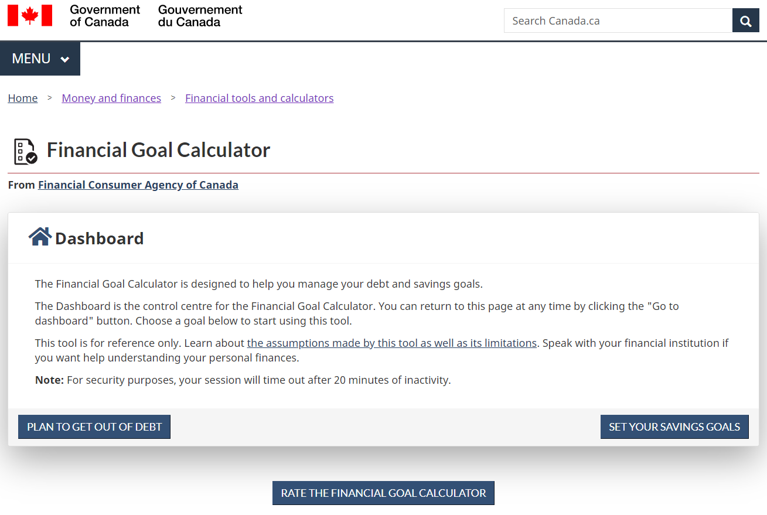
FCAC Financial Goal Calculator
Setting financial goals

Slide 88
Protect yourself

Slide 89
Did you know?
In 2022, the Canadian Anti-Fraud Centre received fraud and cybercrime reports totalling a staggering $530 million in victim losses.
Protect yourself

Slide 90
Fraud statistics
Total credit card fraud in Canada:
2010: $366 million
2016: $940 million
Protect yourself

Slide 91
Sample CRA Scam
INTERAC e-Transfer Reminder: You received money from CRA interac@payments.interac.ca
Mon 2022-07-11 9:44 AM
To John.Smith@email.com
Dear Client
You received $458.00 (CAD) from Canada Revenue Agency.
Click Accept to deposit your money
Respond immediately. This message expires in 24 hours,
FAQs | This is a secure Transaction
Protect yourself

Slide 92
Signs of bogus job ads
Offer considerable pay with few to no duties
Promise payment of wages in cash
Contain no physical address or contact person
Require you to open a new bank account or accept company cheques to “test” a wire transfer service
Protect yourself

Slide 93
Social media scams
Fake polls, fake links, fake apps
May download malware or spam your friends
Fake messages and phishing
Ask you to log into a fake site and steal your ID
Fake friend request
Gather data to send spam or scams
Fake money transfer or crowdfunding request
May ask you to help a friend by sending money
Protect yourself

Slide 94
Protecting yourself
Don’t share personal information freely
Shred documents with personal information before discarding them
Keep your wallet or purse safe
Don’t carry ID you don’t need (such as your SIN card)
Lock your household mailbox if possible
Protect yourself

Slide 95
Protecting yourself, continued
Limit the number of credit cards you hold
Check your credit report once a year
Make sure websites are secure before transmitting personal information
Delete emails that ask for personal information
Keep computer firewalls and spyware up to date
Protect yourself

Slide 96
Protecting yourself, continued
Keep your computer passwords safe
Don’t give telemarketers personal information
Save paper bank records for at least a year
Be skeptical—if an offer sounds too good to be true, it is!
Protect yourself

Slide 97
What to do if you are a victim
Contact your financial institution immediately
Notify Canada’s two main credit bureaus
Equifax Canada www.equifax.ca
TransUnion Canada www.transunion.ca
Contact the Canadian Anti-Fraud Centre www.antifraudcentre.ca
Notify your local police as soon as you are aware of fraud or theft
Protect yourself

Slide 98
Summary and Wrap-up

Slide 99
What have we learned
Keep track of your income and your expenses in a budget
Save money by reviewing your bills and reducing your “latte factor”
Shop around for the best bank accounts, credit cards and service plans
Pay yourself first with automatic savings
Build an emergency fund equal to three months’ income
Pay all debts on time and in full, if possible
Set clear savings goals
Use registered savings plans to let your savings grow tax-free
Find a licensed financial advisor for long-term investment guidance
Secure your identity and avoid identity theft
Summary and wrap-up

