Slide 1

Income, expenses and budget

Slide 2
Agenda
Start time: _____
Break time: _____ (10 minutes)
End time: _____
Please set phones and devices to silent ring and answer outside of the room.

Slide 3
Income, Expenses and Budget
This module covers:
How to decide what’s really important when you spend money
How to calculate income after deductions are taken off your paycheque
How to track your expenses and reduce them if you need to
How to prepare a realistic budget
How to plan your finances to achieve your goals

Slide 4


Section 1: Needs and wants
I need winter tires, a video game and money to go out.
I need textbooks and a new dress to go out with my friends this Friday.

Slide 5
Needs and wants
This section covers:
How to tell the difference between needs and wants
How to set spending priorities
What your usual spending habits are

Slide 6
Needs, wants and priorities
Need: a necessity, something required, something essential for life
Want: a desire, something wished for, something non-essential
Priority: something that you have to do first because it is more important than other things
1 = items that are essential for healthy living
2 = items that are not essential but are important
3 = items that are not essential and not important

Slide 7
Summary of Key Messages
Needs are essential for life; wants are other things
Balance your needs and wants
Priorities focus on things you really need and want
Awareness of personal factors like emotions, habits and behaviours can help control your spending
Such as stress-shopping or stress-eating during first year or exam time

Slide 8
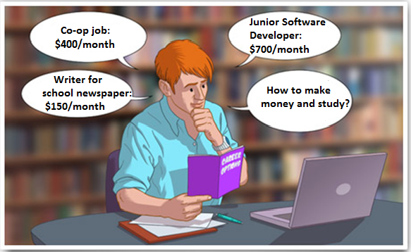
Section 2: Income

Slide 9
Funding my Education
This section covers:
How to understand your paycheque
How to calculate your total income from all your sources, including resources to fund your studies
What to do if your income drops unexpectedly

Slide 10
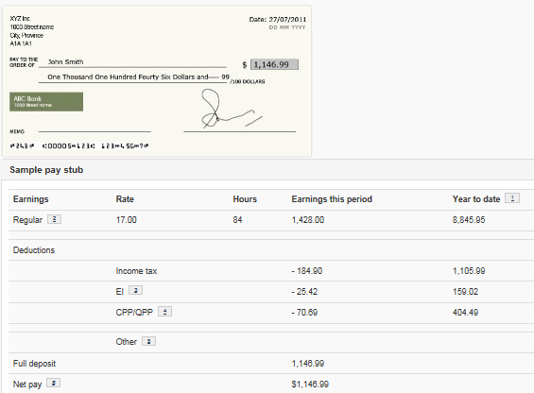
Understanding Your Paycheque

Slide 11
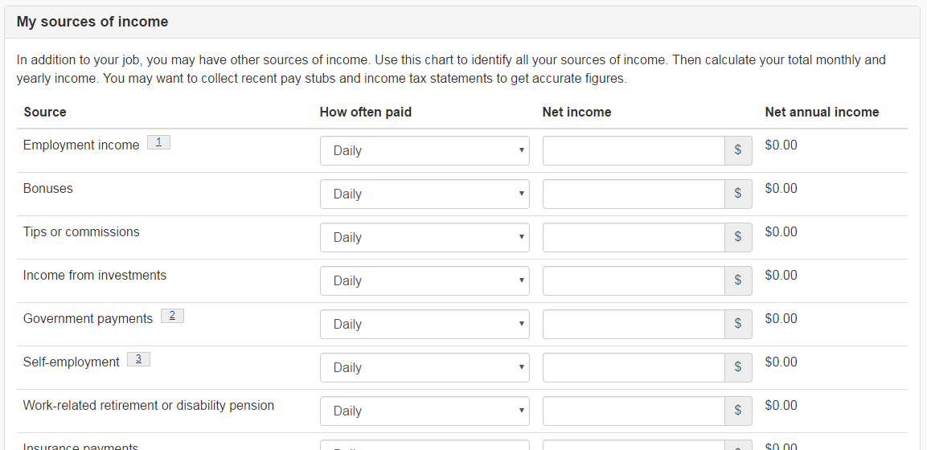
Funding my Education - My Sources of Income

Slide 12
Funding my Education
Institutional need- and merit-based awards
External awards:
Universities Canada: http://www.univcan.ca/universities/
Yconic/Student Awards: https://yconic.com/
Scholarships Canada: http://www.scholarshipscanada.com
Loran Scholars Foundation: http://loranscholar.ca/
Indspire: https://indspire.ca/
Indigenous Bursaries Search Tool: https://www.sac-isc.gc.ca/eng/1351687337141/1531406419657
Disabilityawards.ca Scholarship Database: https://www.disabilityawards.ca/
Bursaries are need-based
Scholarships are merit-based
Grants are based on listed criteria

Slide 13
Government Aid
Financial assistance in the form of loans and grants to post-secondary students who demonstrate financial need
Based on the province and residency and not the institution location
Application: generally online through the province of residence portal

Slide 14
Replacing lost income
Tap into your savings / emergency fund
Ask family / friends / partners / providers in your life for loans or contributions
Ask educational institution for loans / need-based awards / scholarships
Apply for external funding from associations or institutions or private foundations
Look into bank loans (student line of credit)
Search for a part time job during the academic year if course load allows and/or full time job during the Winter and Summer breaks
Students with disability may contact their institution or government for potential grants/loans
Depending on the province, students may look into employment insurance

Slide 15
Summary of Key Messages
A job is the main source of income, but there are others
As a student, it’s important to explore other available resources to fund your studies
Deductions are taken off paycheques for taxes, social programs, etc.
Net income is what you take home after deductions
Set aside money for an emergency fund

Slide 16
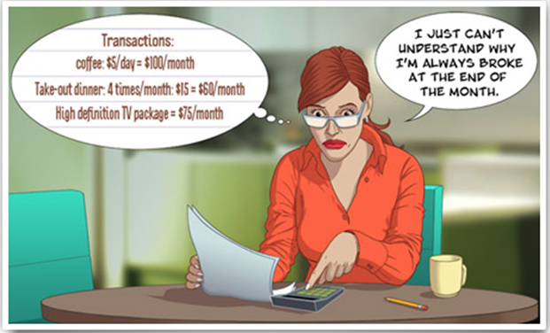
Section 3: Expenses

Slide 17
Expenses
This section covers:
How to get a true picture of what you actually spend
How to reduce your expenses and put aside money for savings and other goals

Slide 18
Know What You Spend
Keep every receipt in a folder or in an electronic format (as a picture)
Record every expense every day (cash, debit, credit)
List irregular expenses (gifts, donations, taxes, repairs, etc.)
Total your expenses at the end of the month
Do this for at least three months

Slide 19
Reduce unnecessary spending
Save your money for essentials
Focus spending cuts on non-essentials (discretionary spending)
Easier to cut back on non-essentials
Even small daily savings add up
Example: Save $5 a day = $1,825 a year
What do the savings mean in the long run for your RESP’s (assuming 4%)?
$20/month for the next 35 years starting now in a savings account: $17,676
$30/month for the next 35 years starting now in a savings account: $26,514
(This does not even take into consideration the tax deductions)
More details can be found in Your Financial Toolkit Program’s Investing Module.

Slide 20
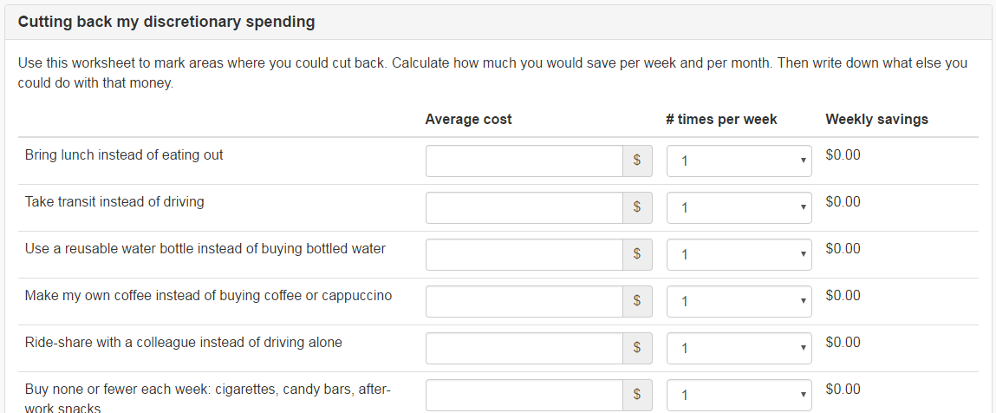
Cutting Back My Discretionary Spending

Slide 21
Tips to Reduce Expenses
Do it yourself Eat at home Shop smarter: buy on sale, in bulk or package discounts Cut out anything you don’t use (subscriptions, memberships, etc.) Use less energy (turn off, turn down switches) Walk, cycle, take transit Find cheap recreation (entertain at home, go to free events, etc.) | Do not buy groceries when hungry (eat a snack before you go shopping) Make your own coffee/tea Budget the week to avoid overspending Have a list before entering the store Avoid debt regret. Do your research and shop around before re-financing existing debt or adding more debt Wait and save rather than purchase on credit

Slide 22
Calculating Your Expenses
Track your spending to gain control
Fixed expenses: are those that come up every month and are roughly the same each month, like rent, utilities, loan repayments and cell phone bills. Other examples are: tuition
Variable expenses: are those that may vary from month to month, like food, entertainment, travel, books and supplies, and car repairs
Irregular expenses: come up through the year
Unplanned expenses: surprises you can’t plan for
VIDEO: How to reduce your spending

Slide 23
Summary of Key Messages
Expenses may be fixed or variable
Track your daily expenses
Include irregular and unexpected expenses
To reduce unnecessary spending:
Avoid impulse buying
Make easy lifestyle changes
Make smart shopping choices
Put money for unexpected expenses in a special account

Slide 24
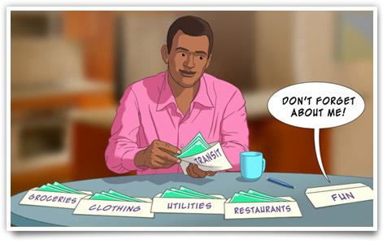
Section 4: Budgeting

Slide 25
Budgeting
This section covers:
How to compare income with expenses in a budget
How to adjust your budget to balance it or even achieve a surplus
How to keep your budget up-to-date and realistic

Slide 26
Budgets
A comparison of income and expenses
An organized way to manage your money
Income minus expenses equals surplus or deficit

Slide 27
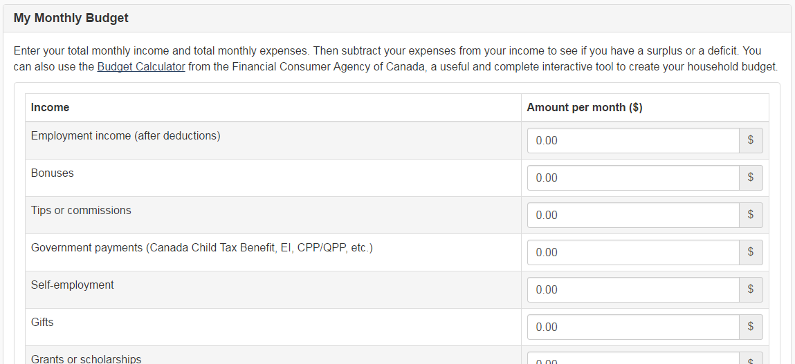
My Monthly Budget

Slide 28
Keep your budget up to date and realistic
Budgeting is an ongoing activity
Check that income and expenses are correct
Keep up your savings and debt repayment
If you are moving toward a deficit (or surplus), see where you can make changes

Slide 29
Summary of Key Messages
A budget compares income and expenses
If you have a surplus, repay debt and increase your savings
If you have a deficit, reduce your spending or increase your income
Find and use a method/tool to track and manage your spending that works best for you
Check your budget regularly to keep it up to date and realistic
Remember: Your income and expenses are not static from month to month, so neither is your budget. Adjust your monthly budget as changes arise to keep your financial plan and goals on track.

Slide 30
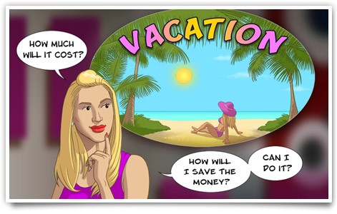
Section 5 : Budgeting to Reach Your Goals

Slide 31
Budgeting to Reach Your Goals
This section covers:
How to identify short-, medium- and long-term financial goals
How to define your goals so they are achievable
How to use your budget to help you reach your goals
VIDEO: Budgeting to reach your goals

Slide 32
Summary of Key Messages
Set short-, medium- and long-term financial goals
Set goals that are SMART:
Specific
Measurable
Achievable
Realistic
Time-framed
Break your goals into monthly savings
Adjust your finances to meet your monthly savings goals

Slide 33
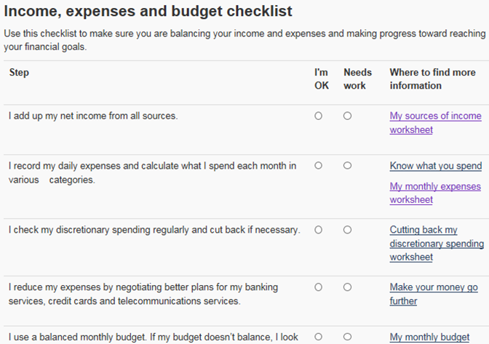
Action Plan

Slide 34
QUESTIONS / COMMENTS

