Slide 1

Mortgages

Slide 2
Agenda
Start time: _____
Break time: _____ (10 minutes)
End time: _____
Please set phones to silent ring and answer outside of the room.

Slide 3
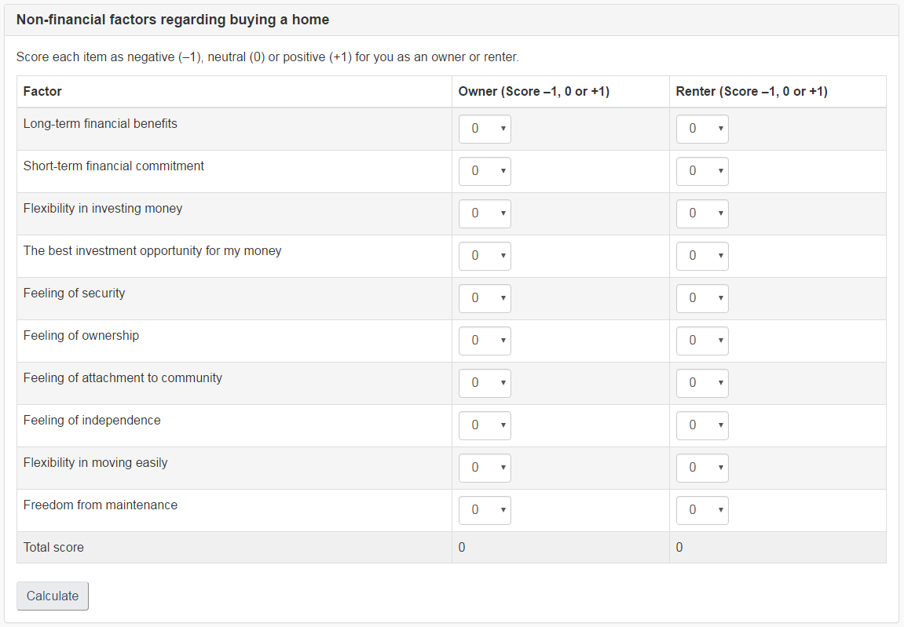
Non-financial factors regarding buying a home

Slide 4
Mortgages
This module covers:
Why you should carefully think through the choice between renting and owning
The basic types and terms of a mortgage agreement
The costs of taking on a mortgage and of buying a home
How to negotiate for the best mortgage deal and avoid problems

Slide 5

Owning your home

Slide 6
Owning your home
This section covers:
The relative costs of renting or buying your home
The emotional and other non-financial factors that go into choosing whether to rent or buy

Slide 7
Financial costs and benefits of owning
Benefits
Payments build equity
No income taxes on sale of primary residence
Interest charges can be locked until mortgage is renewed
Costs
Requires down payment
Interest costs on mortgage
Sales and transfer charges, fees and commissions
Property taxes
Maintenance costs
Possible loss of equity and other opportunities

Slide 8
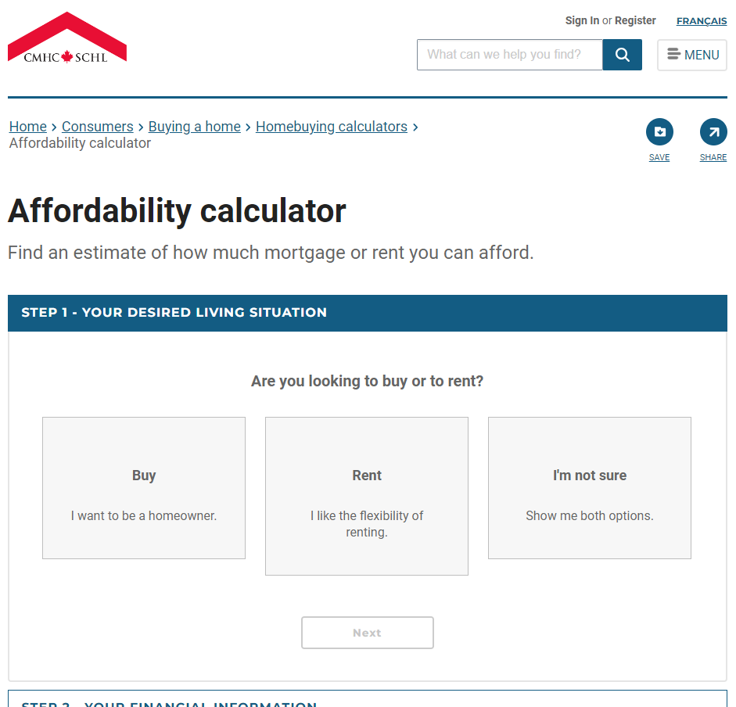
Affordability calculator
Canada Mortgage and Housing Corporation (CMHC)

Slide 9
Why own? Why rent?
Owning gives:
A feeling of security, pride of ownership and attachment
The right to decorate and renovate
Independence from landlord’s choices
Renting gives:
The ability to move easily
Freedom from many of the responsibilities of ownership
Flexibility in how you invest

Slide 10
Summary of key messages
The financial benefits of renting and owning depend on costs and alternatives
Many non-financial factors are important, including:
Feelings about ownership
Feelings about responsibilities
Flexibility
Your choice depends on how important each factor is to you

Slide 11
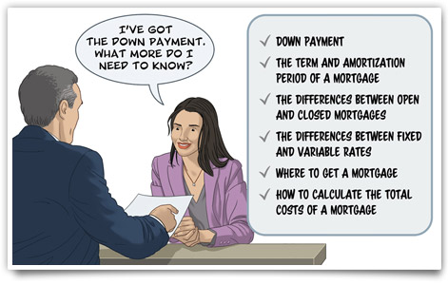
Mortgage basics

Slide 12
Mortgage basics
This section covers:
Down payments
The term and amortization period of a mortgage
The differences between open and closed mortgages
The differences between fixed and variable rates
Where to get a mortgage
How to calculate the costs of a mortgage

Slide 13
What is a mortgage?
A type of loan often used to buy property
Allows the lender to take possession if you don’t repay the loan
The borrower is the mortgagor
The lender is the mortgagee
The amount borrowed is the principal
Payments cover interest plus part of the principal
The equity is the part you own:
The difference between the property value and the principal owing

Slide 14
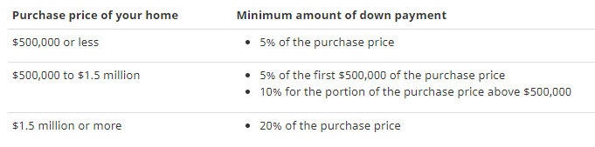
Down payment
Money you pay up front toward the price of your home
The minimum down payment is based on the purchase price of your home
Higher down payment means less money to borrow
Less interest to pay
Less time needed to repay
May be able to avoid mortgage default insurance
May be able to use RRSP for down payment

Slide 15
Pre-approval
Mortgage lender agrees before you take out a mortgage:
Maximum amount of loan
Interest rate
Other terms
Saves time when you make an offer
Locks in an interest rate for a time
Lets you know what you can borrow
Mortgage lender gives final approval based on actual purchase

Slide 16
Mortgage term
The length of time that the mortgage agreement is in effect
Mortgage may be renewed when term expires
Can give stability if terms are pre-set
Limits ability to look for lower rates
May be high costs to end term early

Slide 17
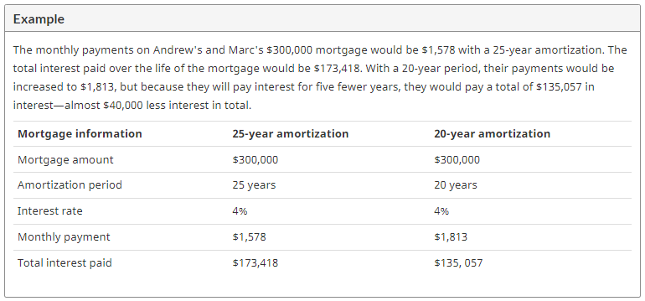
Amortization period
The length of time it will take to fully pay off the mortgage loan
Longer amortization increases amount of interest paid, but reduces monthly payments
E.g.:

Slide 18
Types of mortgages
Open mortgage:
Can pay off or make prepayments any time
Usually only for a year or less
Closed mortgage:
Limited or no rights to make prepayments
Usually charges apply to pay mortgage early

Slide 19
Interest rates
Fixed interest rate:
Interest rate is set for entire term
Payments are fixed
Secure and predictable
Variable interest rate:
Rate can change during the term
Adjusted to follow market interest rate

Slide 20
Variable interest payments
With variable interest rate, payments may be:
Fixed Payments:
Interest rate may change
Payments stay the same
Amount paid on principal varies
Variable Payments:
Interest rate may change
Payments change if interest changes
Amount paid on principal is fixed
Convertible from variable to fixed
Combination

Slide 21
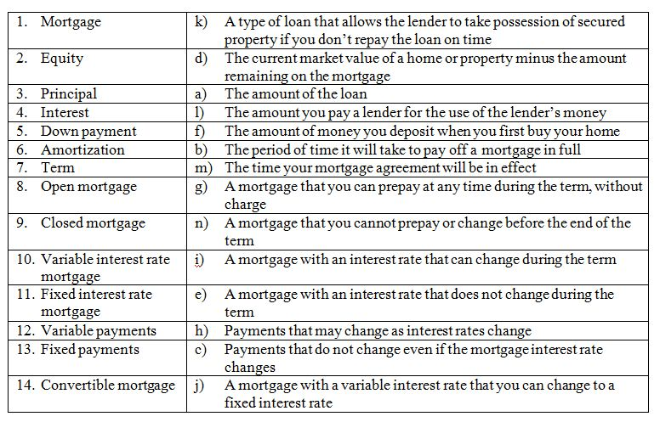
What’s the word? Answers

Slide 22
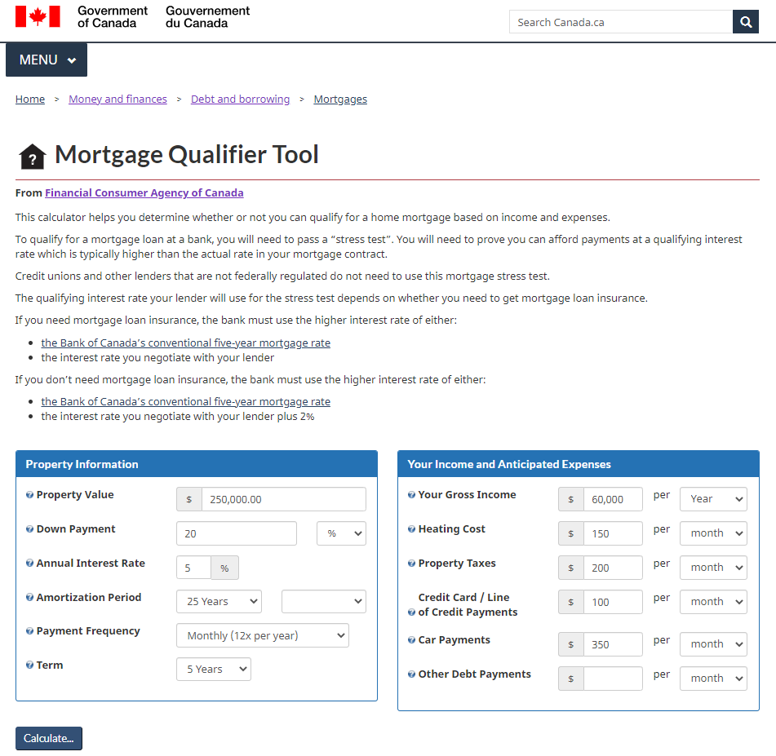
Mortgage Qualifier Tool

Slide 23
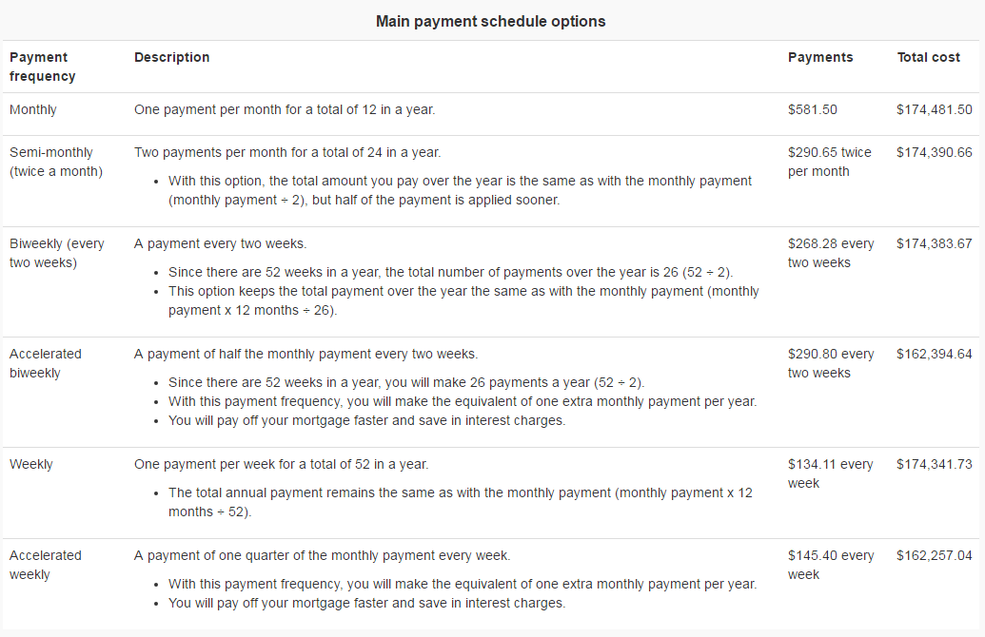
Payment options
The table below shows the main payment schedule options. The example shows payments and the total cost for a mortgage of $100,000 at an interest rate of five percent with an amortization period of 25 years.

Slide 24
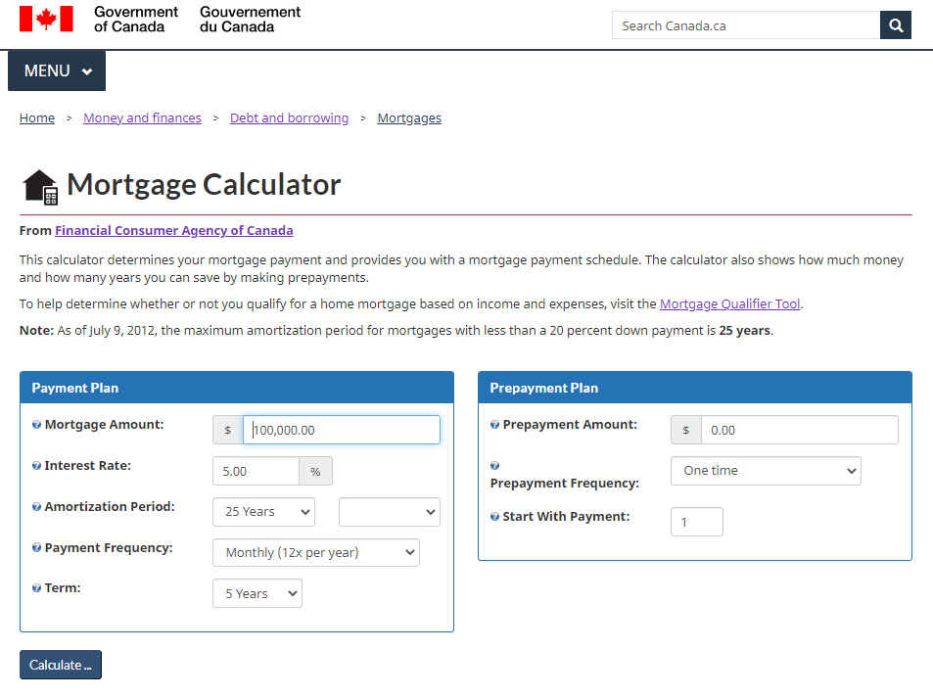
Mortgage Calculator Tool

Slide 25
Summary of key messages
In a mortgage, you can choose:
The amount of the down payment you can pay
The amortization period that will best fit your monthly budget
An open or closed term mortgage
A fixed or variable interest rate
Fixed or variable payments
A monthly, weekly, biweekly or accelerated payment schedule
The key factor in choosing a mortgage is what you can afford in your monthly budget
A mortgage calculator will help you compare the costs of different mortgage options

Slide 26
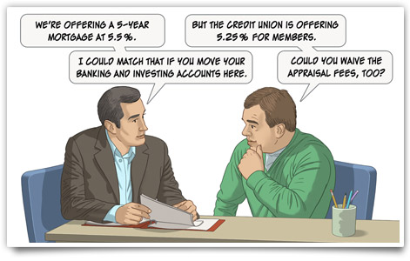
Negotiating your mortgage

Slide 27
Negotiating your mortgage
This section covers:
How can you get the best deal when you negotiate your loan
Your rights and responsibilities when you have a mortgage
What happens when your mortgage term is up and you want to renew
Alternative ways to use your home equity
How to be alert for mortgage frauds

Slide 28
Where to get a mortgage
Financial institutions
Banks
Trust companies
Caisses populaires
Credit unions
Certain life insurance companies
Finance companies
Mortgage brokers
The seller of the home
Mortgage, down payment or guarantee from family and friends

Slide 29
Mortgage brokers
Have knowledge and skills to negotiate mortgages
Represent a variety of lenders
May represent only a few lenders
Paid a fee by the lender
Regulated by province or territory
Interview and check references before selecting a broker

Slide 30
Mortgage rights and responsibilities
Your rights:
Lender must give clear information about terms such as interest and penalties
Borrower can go to a new lender when term ends
Lender can not force borrower to buy other products
But may offer better terms for a package deal
Lender must have a process for complaints
Your responsibilities:
Understand terms of the mortgage
Make payments in full and on time
Make full repayment
You are responsible even if property value drops

Slide 31
Mortgage renewal
If you owe money when the term ends, you can:
Pay the balance owing or renew
Choose terms that fit your needs
Compare terms from different lenders
Research costs of a new mortgage
Negotiate for the best terms

Slide 32
Renegotiating a mortgage
If you want to change the agreement before the term ends:
May be prohibited
May be prepayment fees to end early or pay extra
Compare the fees with the benefits of renegotiating:
Ask lender to provide details
Search for online renegotiation calculator

Slide 33
Borrowing on home equity
If you have equity in your home:
You can use the equity as security for a loan
Interest may be higher (or lower) than mortgage interest
May be extra fees and costs
Carefully consider costs and alternatives, including:
Refinance mortgage for a larger amount
Second mortgage
Home equity line of credit (HELOC)
Reverse mortgage
Borrow back any prepayments

Slide 34
Mortgage fraud
Usually based on identity theft or misrepresentation
Protect personal documents
Get professional advice when signing property documents
Check your credit report regularly
Equifax (www.equifax.ca)
TransUnion (www.transunion.ca)
Consider benefits and costs of title insurance
If you suspect fraud, contact your lender and the police.

Slide 35
Summary of key messages
Many sources of mortgage financing
Negotiate for the best deal
Consider using a mortgage broker
Be aware of your rights and responsibilities
Consider the costs and benefits of home equity financing
Be alert to the possibility of fraud

Slide 36
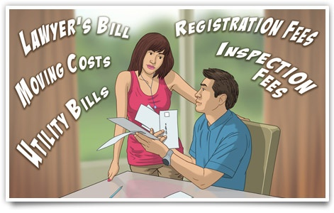
Total costs of a mortgage

Slide 37
Total costs of a mortgage
This section covers:
The costs of buying and maintaining a home
Mortgage insurance
Questions to ask about mortgages

Slide 38
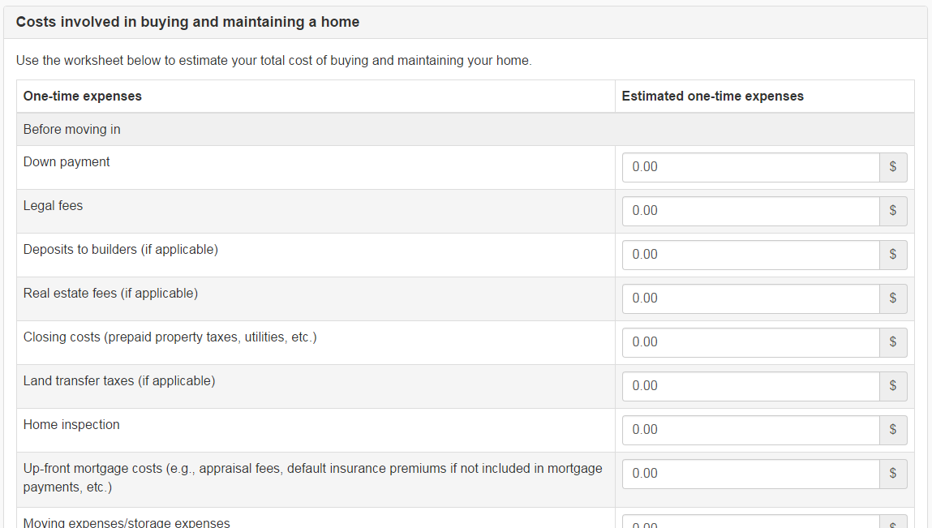
The cost of a home

Slide 39
Mortgage default insurance
Pays the lender if you default on mortgage
Required if down payment is less than 20%
May be a lump sum or included in mortgage
Adds from 0.6% to 4.5% to cost of loan

Slide 40
Other mortgage insurance
Mortgage life insurance
Pays lender if you die
Mortgage disability insurance
Pays lender if you become disabled
Term life insurance
Pays your beneficiary if you die
You set the term and who receives payment
Payout is not tied to mortgage

Slide 41
Summary of key messages
Plan for all the costs of a new home or mortgage
Consider what insurance, if any, you will need
Ask questions so you can compare different lenders

Slide 42
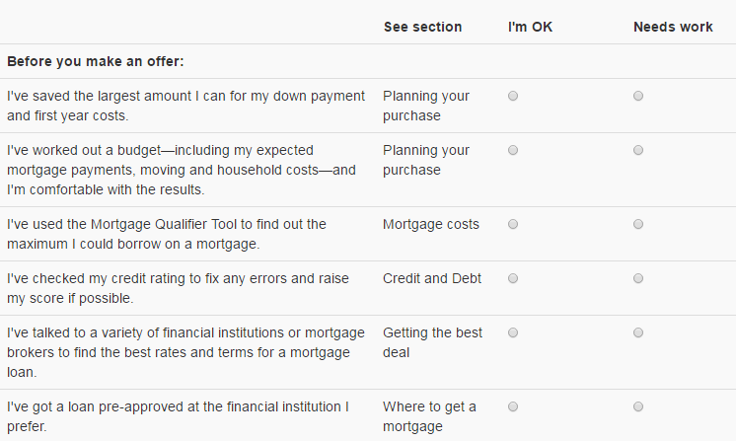
Action plan: Before you make an offer

Slide 43
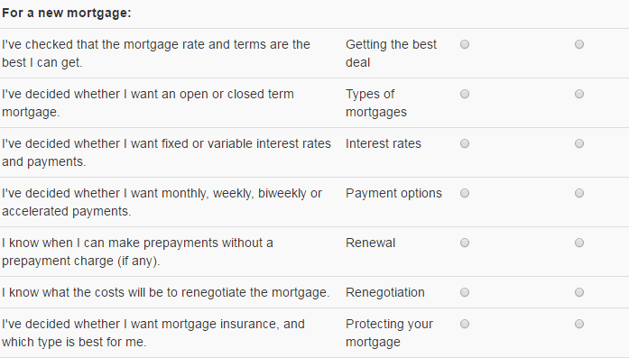
Action plan: For a new mortgage

Slide 44
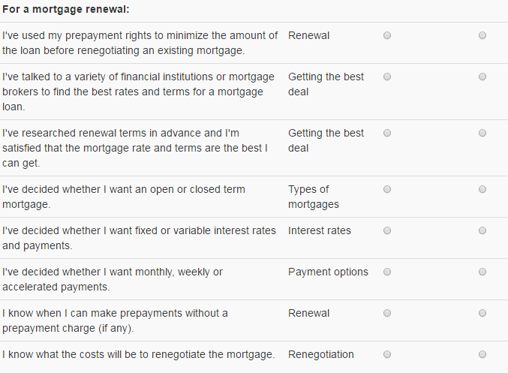
Action plan: For a mortgage renewal

