Slide 1
Men in trades, substance use & the opioid overdose crisis
Addiction can be a heavy load to carry. Ease the Burden

Slide 2
The opioid overdose crisis
26,690
Since 2016, there have been over
26,690 opioid-related deaths in Canada
20
On average, 20 people die per day in Canada
17
17 are hospitalized per day in Canada
86%
In 2021, (January to September), 86% of opioid-related deaths involved fentanyl, a very strong opioid that is now being found in other illegal drugs

Slide 3
The chain of events
1. Over-reliance on opioid prescriptions
2. Increase in
diverted or illegally produced opioids
3. Unprecedented
rise in synthetic opioids (e.g., Fentanyl)
4. Fentanyl dominates illegal market & is mixed with other drugs causing toxic illegal drug supply
The opioid overdose crisis started by high opioid prescribing, causing some to become dependant
Then opioids where being illegally made and sold
Because of demand, strong synthetic opioids (like illegally produced fentanyl)
started infiltrating the illegal market
Now, most opioid overdose deaths are caused by people looking for strong opioids like fentanyl,
by mixing drugs or by taking other illegal drugs that contain fentanyl (sometimes without knowing)
Notes:
The opioid overdose crisis started by high opioid prescribing, causing some to become dependant
Then opioids where being illegally made and sold
Because of demand, strong synthetic opioids (like illegally produced fentanyl)
started infiltrating the illegal market
Now, most opioid overdose deaths are caused by people looking for strong opioids like fentanyl,
by mixing drugs or by taking other illegal drugs that contain fentanyl (sometimes without knowing)

Slide 4
Men in trades are disproportionally impacted
Since 2016 around ¾ of opioid-related deaths were men
Men in trades are overly represented:
  of people who were employed at the
  time of death, 30–50% were employed
  in trades
Notes:
The opioid overdose crisis in Canada is taking a toll on men in particular and specifically men who work in the trades and construction industries.
Men account for around ¾ of opioid-related deaths in Canada
In fact, 30-50% of people who were working at the time of their death were employed in physically demanding jobs.
Work-related injuries, stress and pain are common for people who work in construction or trades. Some people may not have or know where to find the resources they need to take care of these issues, which can lead to using pain medications and other substances more often to cope.

Slide 5
Work hard, play hard
Many trades workplaces have a “work hard, play hard”
culture, especially
outside of work
Men are more likely to use substances to cope with stress or mental health issues
Men are less likely to reach out for help because there is a pressure to be “strong”
Notes:
Some trades and construction workplaces have a “work hard, play hard” culture. This can reinforce heavy alcohol and other substance use after work, which can expose people who may be susceptible to addiction to situations that might be harmful to them.
Pain is common among workers in physically demanding occupations, with 60-75% reporting on-going musculoskeletal pain, and men are less likely to acknowledge and seek care for pain, more likely to receive high doses of prescription opioids, and more likely to use alcohol and other substances as coping strategies.
The stigma associated with substance use is severe, and masculinity-related expectations to be independent, self-sufficient, and invulnerable means less help seeking and makes it more challenging to reach them with services. Add to this lack of paid sick leave and fear of job loss.
Trades workers may not talk about substance use problems at work for fear of losing their jobs.
But conversations can happen elsewhere with those that they can trust, such as family and friends.

Slide 6
Hard, physical labour takes a toll
Hard, physical labour takes a toll on the body
It increases the risk of injury and can result in pain
When taken properly, pain medication,
like prescription opioids, can help people
manage pain
But some take higher doses of opioids or seek illegal opioids to keep working through pain which creates a higher risk for addiction & harms
Notes:
Work-related injuries and associated pain are relatively common among people working in construction and other physically demanding occupations, the majority of whom are men.
Given the lack of alternative treatments, pain medications such as opioids are often the only available option to help manage pain.
Men are less likely to acknowledge and seek care for pain. They may come back to work before they are ready and take higher doses of opioids or seek opioids from the illegal market to help manage their pain.
This increases the risk of addiction and opioid harms and death.
Preventing the problem before it happens can be thought of as looking ‘upstream’ to prevent health problems that may occur further ‘downstream’ - that’s why it’s important to have adequate training and safety protocols at job sites to prevent injuries.
In the long term, injuries and pain can lead to loss of work for the individual and for companies the loss of a valuable workforce.

Slide 7
What can you do to help?
We need to talk about the impact addiction and substance use is having on our friends and coworkers
Reducing the stigma of seeking help and sharing resources can help save lives
Learning more about how to use prescription opioids safely, combining pain treatments, and ways to help others who may be struggling with addiction will also save lives
Notes:
A healthy workforce benefits everyone, especially when there is a shortage of skilled workers.
The culture of our workforce needs to change to be more receptive.
We can also help those using substances to reduce the harms and be safer.

Slide 8
Addiction is a treatable medical condition.
Not a choice.
Notes:
Addiction is not a choice or a moral failing, it’s a treatable medical condition.
It changes the brain and body causing a person to have intense cravings for the drug or alcohol that are beyond their control, making it hard to stop even if someone wants to.

Slide 9
Many people choose to use substances but no one chooses to become addicted.
Notes:
People use substances for many reasons, like for pleasure or to manage pain, but no one chooses to become addicted.

Slide 10
This misconception is preventing people from asking for help.
Notes:
The misconception that people with addictions can just “stop using if they want to” is causing stigma. It makes people feel that it’s their fault, it stops people from understanding that addiction is a treatable medical condition that deserves the same compassion as any other medical condition (like cancer)
This is preventing people from asking for help for fear of judgment

Slide 11
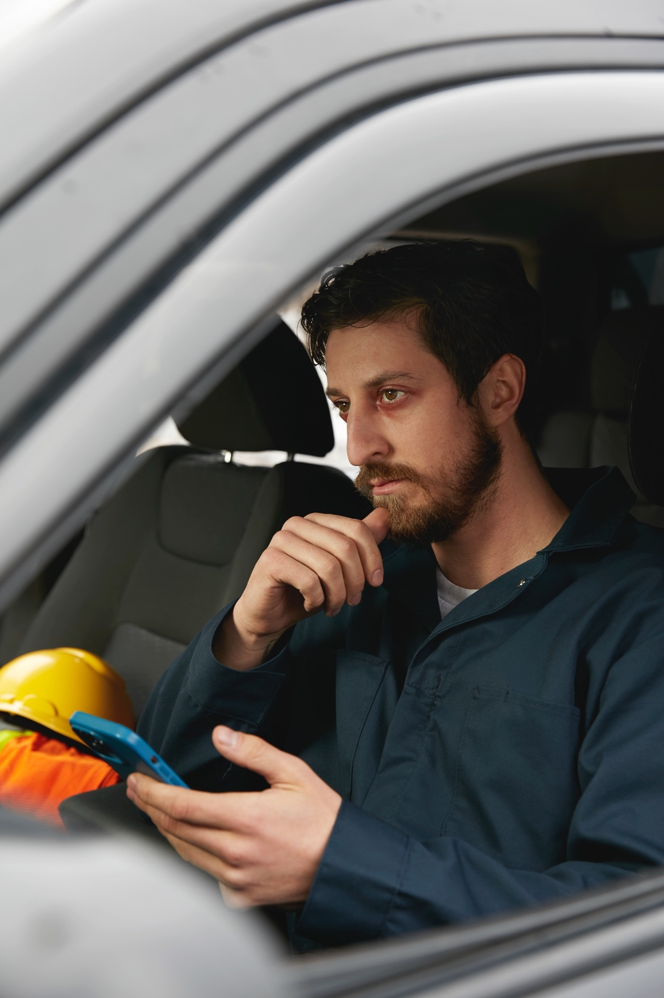
Addiction changes the brain’s “reward” system
  When someone is affected by an addiction:
  They experience powerful cravings for the drug (or alcohol) that are extremely hard to ignore
  They continue using even though it may cause harm to themselves or others
  The need to obtain the drug/alcohol often overtakes their normal social behaviours
  and their ability to get help
  They may be unable to stop,
  even if they want to
Notes:
Addiction changes the brain’s “reward” system
When someone is affected by an addiction:
They experience powerful cravings for the drug (or alcohol) that are extremely hard to ignore
They continue using even though it may cause harm to themselves or others
The need to obtain the drug/alcohol often overtakes their normal social behaviours and their ability to get help
They may be unable to stop, even if they want to

Slide 12
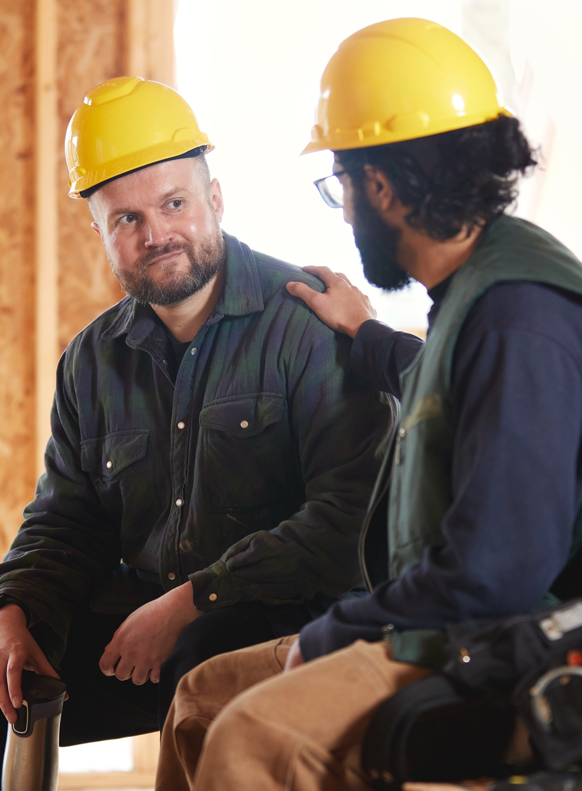
Recovery is possible
Counselling
peer support
abstinence
Medical treatment (e.g. opioid agonist therapy)
Notes:
Recovery is possible and looks different for everyone.
Recovery from addiction is possible but the pathway looks different for everyone. Some people may benefit from non-use/abstinence, whereas others may need different support, which could include medications, counselling, and withdrawal management.
Resources are available to help if you or a friend is struggling with substance use.
With the right supports, it is possible for you to improve your or their health.

Slide 13
Stigma surrounding addiction can
Create barriers
Prevent people from asking
for help
Lead people
to use
drugs alone
Notes:
Stigma, in the form of negative words, attitudes, and behaviours, can create barriers to accessing appropriate and compassionate health and social services. Stigma can make people who use drugs worry that others will not be kind and respectful towards them, which can prevent them from even reaching out for help. Sadly, this can lead people to use drugs alone.
We know that many accidental overdose deaths occur when people are alone, so it is very important to do what you can to speak and act compassionately about people who have an addiction.
It’s important to share messages of hope: addiction has one of the highest rates of recovery among all mental conditions.

Slide 14
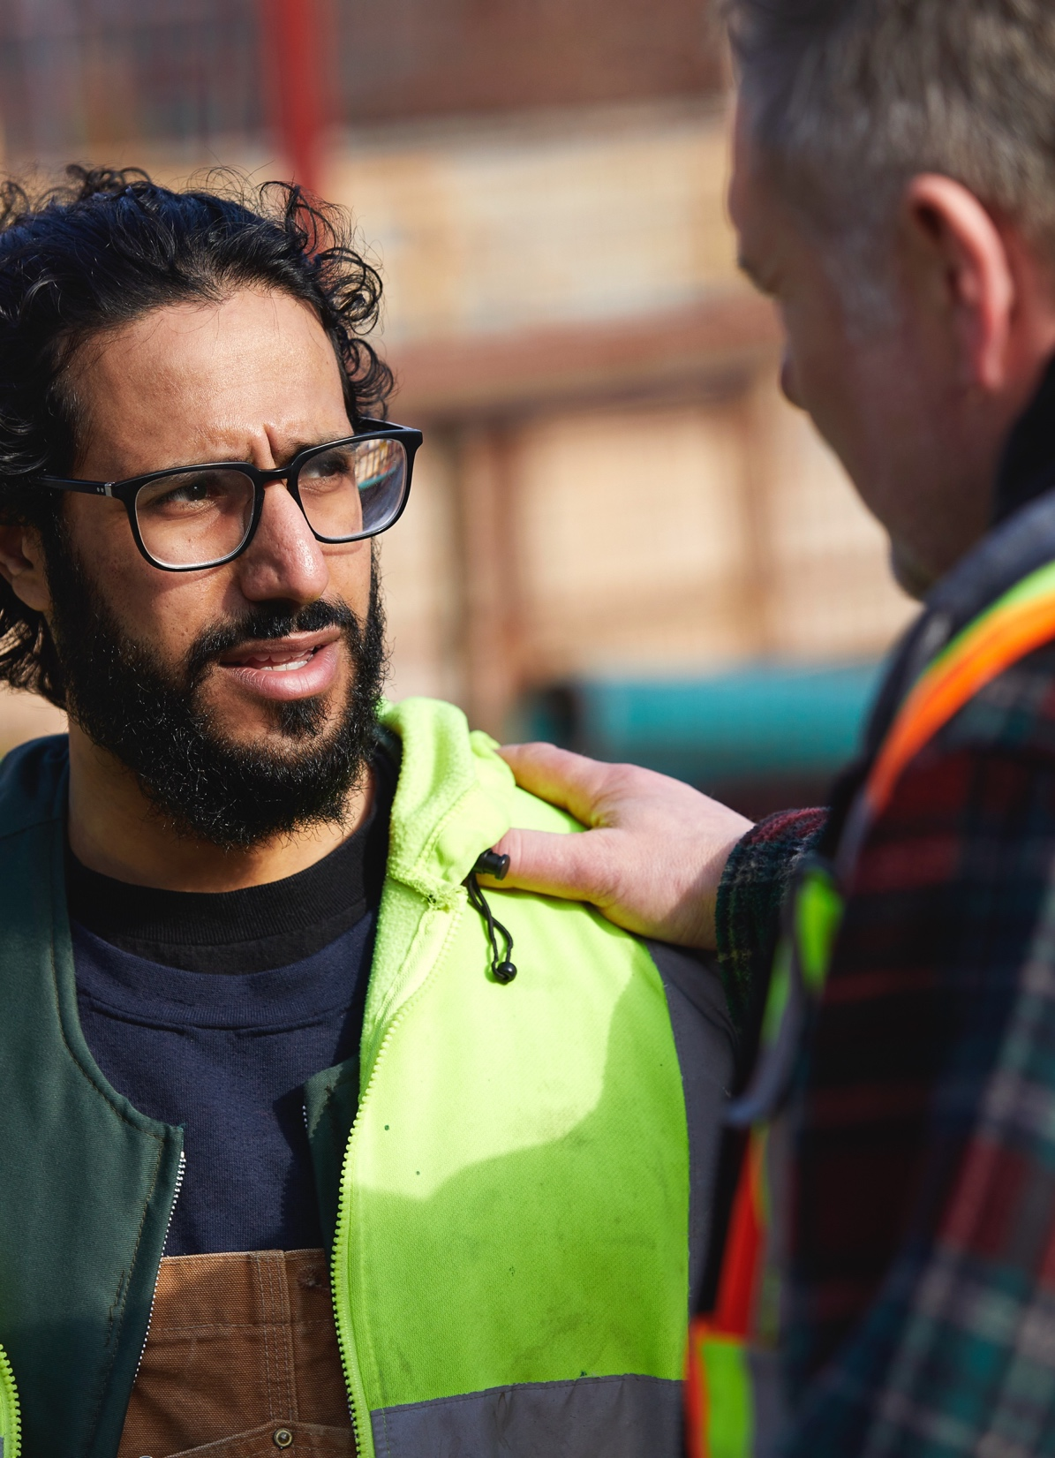
How can you help?
Help reduce stigma
  Be a buddy and support your crew
  Remember that addiction is a treatable medical condition, not a choice
  Don’t judge, just listen
  Don’t use slang such as
  “addict” and “junkie”
  Let them know that support is available
Visit Canada.ca/EaseTheBurden
for more resources available to you.
Notes:
Stigma can cause people to hide their drug use and use drugs alone, which can result in overdosing and dying alone.
By reducing stigma we can help to break down these barriers to getting help.

Slide 15
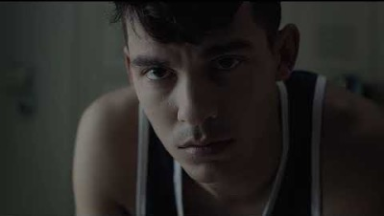
See the real impact of stigma
Notes:
-- play video---

Slide 16
It takes strength to reach out for help.
A lot of focus is put on being strong in physically demanding jobs
People may not ask for help for fear they may be seen as weak, be judged, or get in trouble
But addiction is not a choice, it’s a heavy burden to carry alone
We can make it easier for those who may be struggling if we share and normalize that it takes real strength to ask for help

Slide 17
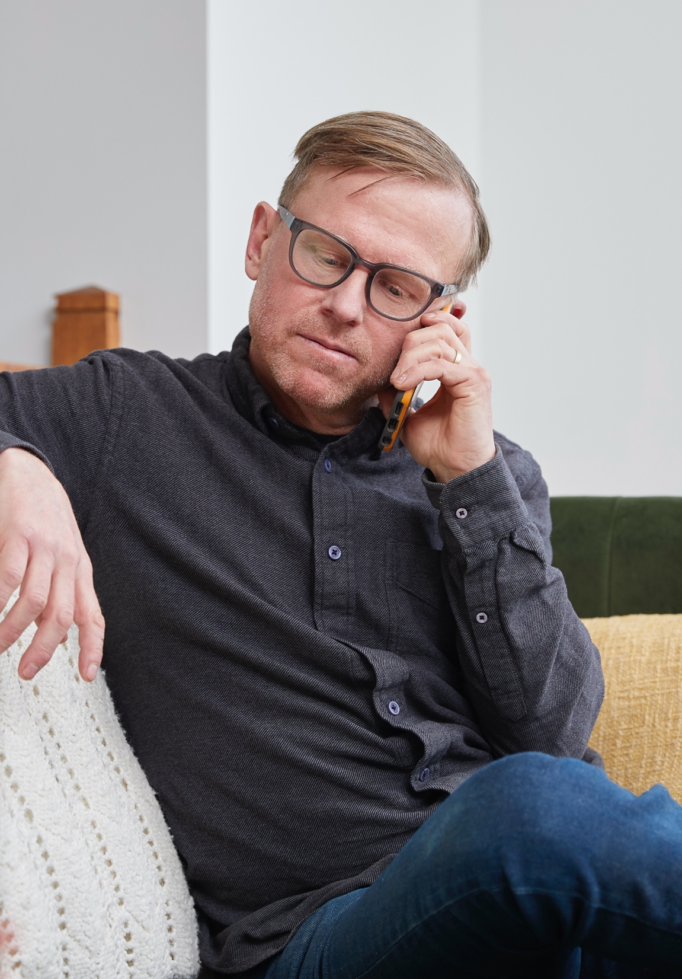
Talking to healthcare provider about opioids
Using only medications
may not take away your pain
Treatment options (e.g., medication, exercise, movement, physical activity, physiotherapy, massage therapy or speaking to a psychologist) are most effective when used in combination
Opioids, like all medications, come with risks and potential serious side effects
Notes:
Talking to your healthcare provider about opioids
Opioids are medications that are prescribed to treat pain. When taken properly, prescription opioids can help people manage pain. As with all medications, opioids have risks and potentially serious side effects.
If you are prescribed an opioid, it is important to have a conversation with your healthcare provider—such as your physician, surgeon, or nurse practitioner, to find out if this medication is right for you, and how to use it safely.
Using only medications will not take away your pain. Talk to you healthcare provider about other parts of your treatment plan like exercise, movement, and physical activity, or about getting help from other treatment like physiotherapy or massage or speaking to a psychologist.

Slide 18
Know the potential risks
of using opioids
Side effects:
Impotence
in men
Nausea
and vomiting
Difficulty
breathing
Headaches,
dizziness and
confusion
Notes:
Know the potential short term risks of using opioids
For example, short term effects can include:
Impotence in men
Nausea and vomiting
Difficulty breathing
Headaches, dizziness and confusion

Slide 19
Know the potential risks
of using opioids
Long-term use:
Physical dependence
Liver damage
Worsening pain
Addiction
Notes:
Examples of long-term effects may include:
Physical dependence
Liver damage
Worsening pain
Addiction

Slide 20
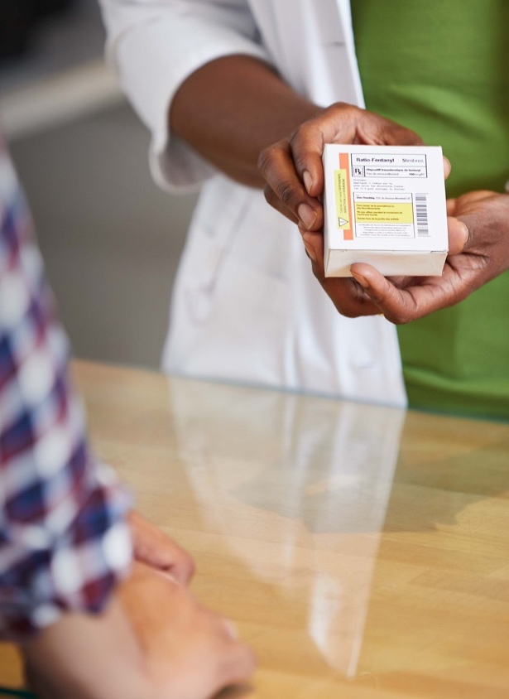
Prescribed
an opioid?
  Always follow the instructions
  Use the lowest dose possible
  Take for the shortest amount
  of time possible
  Ask your healthcare provider
  about alternatives to treating pain
Notes:
If you are prescribed an opioid, make sure you:
always follow the instructions given to you by your healthcare provider
use the lowest dose of opioids possible to control your pain
take the medication for the shortest amount of time possible
have regular check-ins with your healthcare provider to discuss how the medication is addressing your pain
get Naloxone – more on this later in the presentation.
Other treatment options
It is important to discuss how best to manage your pain with your healthcare provider, particularly if your pain is expected to last more than 1 to 2 weeks. Opioids may not always be the best treatment option for your pain. Other medications or treatment options that do not use opioids may be available to help you manage your pain.

Slide 21
You can’t see, taste
or smell fentanyl
Fentanyl is being added to many illegal drugs
Notes:
However, Canada’s illegal drug supply is increasingly being contaminated with illegal fentanyl.
It can be mixed with other drugs such as heroin and cocaine, and is also being found in counterfeit pills that are made to look like prescription opioids
86% of accidental opioid-related deaths in Canada involve fentanyl
There is no way to know how much fentanyl has been mixed into illegal drugs because you can’t see, smell or taste it
Many overdoses have occurred in individuals who were not aware they were consuming fentanyl
Consuming as little as a few grains of salt worth of fentanyl can kill an average-sized person

Slide 22
Signs of an opioid overdose?
Blue lips
or nails
Dizziness and confusion
Can’t be
woken up
Choking, gurgling or snoring sounds
Slow, weak or no breathing
Drowsiness
or difficulty staying awake
Notes:
How can opioids cause an overdose?
Opioids affect how your brain controls your breathing. If you take more opioids than your body can handle, you will start to show signs and symptoms of an overdose
If you use illegal opioids or other street drugs:
don’t mix them with alcohol or other drugs
don’t use alone – stick with a friend
know the signs of an opioid overdose
carry a naloxone kit
get your drugs checked at a supervised consumption site
Overdoses can happen if you take an opioid:
that was not prescribed for you
above your prescribed dosage
with alcohol or other drugs
that has been tampered with
that has been illegally produced or obtained
after a period of non-use

Slide 23
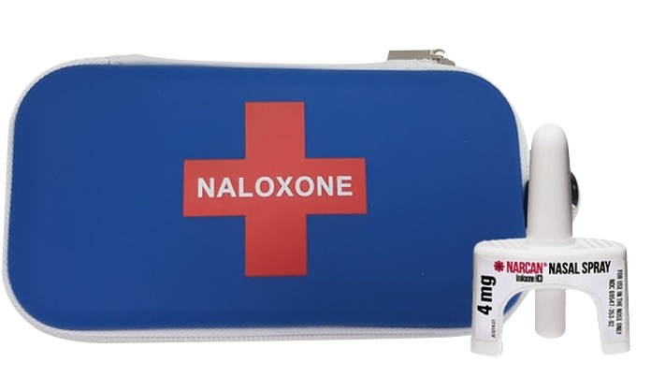
Naloxone
  can temporarily reverse the effects of an opioid overdose within 2 to 5 minutes.
  An overdose is always an emergency. Even if naloxone has been administered,
  always call for help.
Notes:
What is naloxone?
Naloxone (pronounced na-LOX-own) is a fast-acting drug used to temporarily reverse the effects of an opioid overdose
Naloxone can restore breathing within 2 to 5 minutes
Naloxone is safe for everyone of all ages
It works only if you have opioids in your system
It is safe to keep on-hand because it cannot be improperly used and does not create dependence
Why does naloxone work only temporarily?
Naloxone is active in the body for only 20 to 90 minutes, but the effects of most opioids can last longer
This means that the effects of naloxone are likely to wear off before the opioids
are gone from the body, which could cause breathing to stop again
Naloxone may need to be used again, depending on the amount, type or method of consumption of the opioids (e.g., oral, injection)
An overdose is always an emergency. Even if naloxone has been administered, always call 9-1-1, or your local emergency number
In Canada, two types of take-home naloxone kits are available:
Naloxone Nasal Spray is sprayed directly into the nose where it is absorbed. It starts to take effect in 2 to 3 minutes
Injectable Naloxone is injected into a muscle in your body: the upper arm, thigh or buttocks are best. It starts to take effect in 3 to 5 minutes

Slide 24
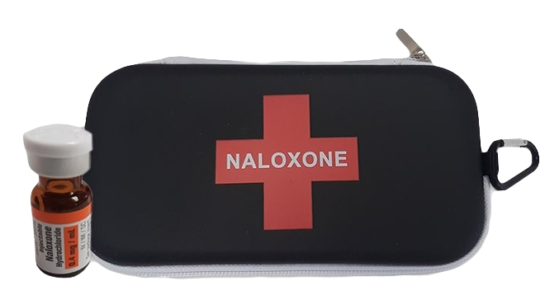
Get a kit for free
Take-home naloxone kits are
available at most pharmacies
or local health authorities
No prescription is needed
Go to Canada.ca/opioids
and search for “naloxone”
Notes:
Take-home kits are available at most pharmacies or local health authorities; no prescription is needed.
Whether you are prescribed opioids or you use them illegally, you should carry a naloxone kit.
Some provinces and territories also offer free kits. You can consult your provincial, territorial or local health authority to see where these kits are available.

Slide 25
The Good Samaritan law
Even if you’ve taken drugs or have some on you,
the Good Samaritan law protects you from:
  simple drug possession charges
  violation of conditions regarding simple possession in:
  pre-trial release, conditional sentence, probation orders, parole
In other words, you will not get in trouble if you are high or have some drugs on you if you are calling to save someone’s life.
Notes:
If an overdose occurs, the number one priority is saving that life by calling 9-1-1 or your local emergency number

Slide 26
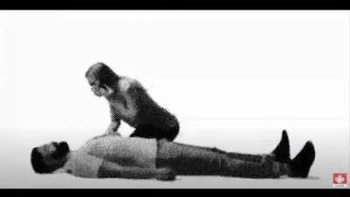
Call, stay and help
Notes:
<<<< PLAY THE EMBEDDED GSL VIDEO HERE >>>>
If you witness an overdose, stay and help:
Overdoses are a medical emergency
Call 9-1-1 (or your local emergency help line) and stay at the scene
Staying at the scene to help can save someone’s life
Give naloxone, if you have it
If you've taken drugs, or have some on you, you are protected from simple drug possession charges by the Good Samaritan Drug Overdose law
This law applies to the person who seeks help and anyone else at the scene when help arrives

Slide 27
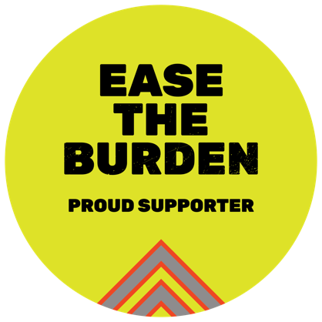

If you think that you, or a friend or family member, might need help with substance use support is available.
Men in trades
Canada.ca/DrugsInTheTrades
Wellness Together Canada
wellnesstogether.ca
Notes:
Whether you are looking for help for yourself, a friend or a family member, support is available.
Visit Canada.ca/easetheburden for more information
Wellness Together Canada provides mental health and substance use support for Canadians - https://wellnesstogether.ca/en-CA

